Slide 1
The Scaling Habits of ASP.NET Applications
Richard Campbell

Slide 2



Richard Campbell
Background
  After thirty years, done every job in the computer industry you’ve ever heard of
Currently
  Co-Founder and Product Evangelist for Strangeloop Networks
  Co-Host of .NET Rocks!
  Host of RunAs Radio

Slide 3

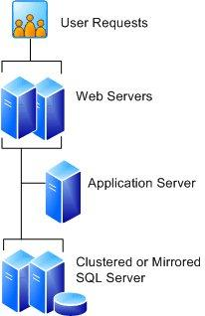

50 000 foot view
Business Success
Business
Traction
Make it Work
Right
Page Views
Make it Work
Version 1
Version 2
Version 3
Version N
Time

Slide 4
What are we measuring?
Capacity
  Total number of known users
  Number of active users (aka active sessions)
  Number of concurrent users (aka concurrent requests)
Throughput
  Page Views per Month
  Requests per Second
  Transactions per Second
Performance
  Load time in milliseconds
  Time to first byte (TTFB), Time to last byte (TTLB)

Slide 5
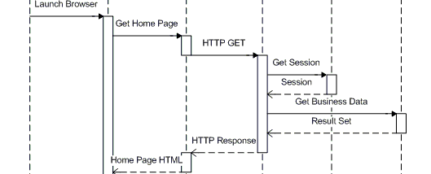
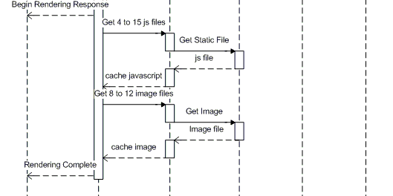
The Anatomy of a Web Request

Slide 6

Performance Equation
Legend:
R: Response time
RTT: Round Trip Time
App Turns: Http Requests
Concurrent Requests: # server sockets open by browser
Cs: Server Side Compute time
Cc: Client Compute time
Source: Field Guide to Application Delivery Systems, by Peter Sevcik and Rebecca Wetzel, NetForecast
Notes:
We need to look at the whole picture. We need to look what are the maximum possible gains. We need to make sure our performance approach makes sense. We need to back that up with data from our test environment.

Slide 7
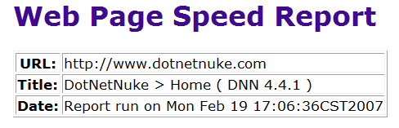

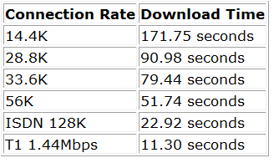

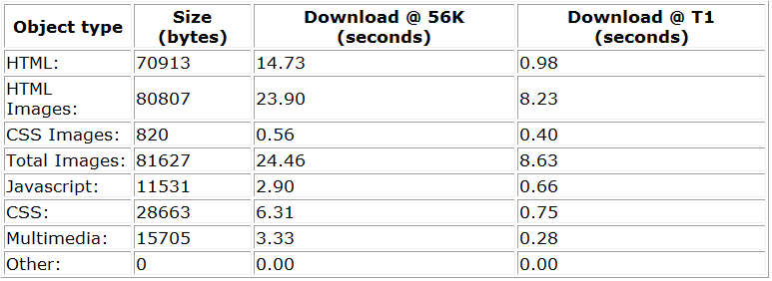
Where do the numbers come from?
Server Code Timing: 0.8 secs
4.5 sec
Client Code Timing: 1.2 secs
http://www.speedtest.net/
Ping statistics for 209.162.190.188:
Packets: Sent = 4, Received = 4, Lost = 0 (0% loss),
Approximate round trip times in milli-seconds:
Minimum = 80ms, Maximum = 92ms, Average = 85ms
http://www.websiteoptimization.com/services/analyze/

Slide 8
Performance Spreadsheet

Slide 9
Version 1: Make it work
Get Version 1 out the door
Define the initial hardware platform
Meet the launch date
The only one who likes your app is you

Slide 10
Scaling Habits
10 to 50 requests/second
5 to 15 users
15 active sessions at peak
Problems with performance on areas of the site
  Multi-User Issues
  Complex input screens
  Reports

Slide 11
Solutions for Version 1
Fix logical scaling problems
  Multi-user data access
Get user feedback
  Humiliating but useful
  Fix the actual user pains
  Watch your app in use

Slide 12
Version 2: Make it work right
Focus on features
  What is missing
Bug Fixing
Rethink the App or UI
  Some new directions
Larger and more diverse users base
Now your boss likes your app too

Slide 13
Scaling Habits
50 to 100 requests/second
15 to 50 users (5-10 are remote!)
30 active sessions at peak
Problems
  Fights with IT over remote access
  Reach the single server limit
    What does this look like?

Slide 14


Slide 15
What does it really look like?
Memory consumption above 80%
Processor consumption at 100% all the time
Request queues start to grow out of hand
Page timeouts (server not available)
Sessions get lost
People can’t finish their work!

Slide 16
Solutions for Version 2
More Hardware
  Dedicated web server
  Separate database server (probably shared)
Find the low hanging fruit
  Fix querying
  Get your page size under control

Slide 17
Version 3: Business Traction
Weighing business priorities
  Formal IT transition point
  There is budget
Scaling versus Reliability
  Which one is more important
99% verses 100% up time
  Cost of Reliability
People you don’t know like your app

Slide 18
Scaling Habits
300 to 1000 requests/second
100 to 500 users
300 active sessions at peak
Problems
  Performance is now front and center
  Consequences of downtime are now significant

Slide 19
Network vs. Development IQ
Network IQ Test
  Explain each of the Web.config file
  Explain the load-balancing scheme required by the app
  Explain the bottlenecks of the production system
Development IQ Test
  Explain the network diagram of your application
  Explain how to access the production log files
  Explain the redundancy model of the production system

Slide 20
Solutions for Version 3
Move to multiple web servers: You need a load balancer
More bandwidth: Move to a hosting facility
Get methodical, use profiling
  Red Gate Ants, SQL Profiler, Web Site Optimizer
Get the facts on the problem areas
  Work methodically and for the business on addressing slowest lines of code
  Focus on understanding what the right architecture is rather than ad-hoc architecting
Let the caching begin!

Slide 21
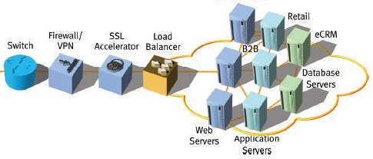
Version N: Business Success
IT costs now out weigh the software development
Getting new features to production takes months
  Or Cowboy it! (which always happens)
IT and Dev process is a focus – Tech Politics
It’s no longer your app

Slide 22
Scaling Habits
500+ requests/second
5000+ users
3000 active sessions at peak
Problems
  Running out of memory with inproc sessions
  Worker process recycling
  Cache Coherency
  Session Management

Slide 23
A Word About Load-balancing
Load Balancer
Virtual IP
Web Server 1
Web Server 2
Web Server 3
Web Server 4
Sticky vs. Round Robin vs. WMI
Persistent Data
Session?

Slide 24
Performance and Scale
Now the problem is that scale and performance are intertwined
  A new class of ‘timing’ problem shows up under load (and are almost impossible to reproduce outside of production)
  Caches are flushed more than expected
    And performance plummets

Slide 25
Solutions for Version N
Your architecture is now hardware and software
  Use third party accelerators
  Create a performance team and focus on best practices
  Use content routing
    Separate and pre-generate all static resources
Cache, cache, and more cache
  Output Cache – All static pages are cached
  Response.Cache – Look for database gets with few updates

Slide 26
Summary
Focus on actual user performance problems
  What is reality?
Start with low hanging fruit
Use methodical, empirical performance improvement
At large scale, the network is the computer

