Slide 1
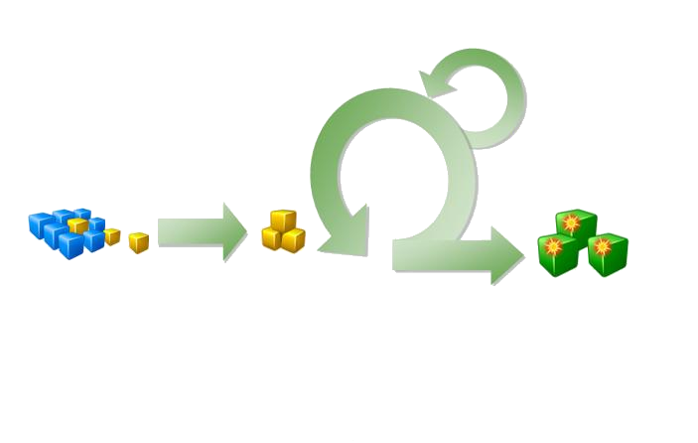
Team Development with Microsoft Scrum 1.0
Doncho Angelov
Developer Evangelist
Microsoft Bulgaria

Slide 2
Agenda
SCRUM – quick overview
SCRUM and TFS
  Backlog items
  Sprint management
  Reporting
  Sprint Retrospective
Q&A

Slide 3
How to setup the demo environment?
(Optional) VS 2010 RTM Virtual Machine: http://bit.ly/VS2010RTMVHD
Scrum V1.0 Process Template: http://visualstudiogallery.msdn.microsoft.com/en-us/59ac03e3-df99-4776-be39-1917cbfc5d8e

Slide 4
Scrum Overview & Terms
Chicken and Pig Roles
Meetings
Sprint
  2-5 week milestone
Product Backlog
  Collection of features or scenarios required to release
Sprint Backlog
  Collection of work items required to deliver Sprint goals
Teamlet
  Collection of team members on Scrum team working towards a Sprint deliverable
Burndown Chart
  Tool for Scrum team to track progress. Shows how the work remaining is reducing over time toward zero.
Retrospective
  Team provides data: What went well? What didn’t go well? What could be changed for next time?

Slide 5

The Scrum Framework
Roles
Which contributes to these
Product owner
Scrum Master
Team
Ceremonies
TFS facilitates
these
Release planning
Sprint planning
Daily scrum meeting
Sprint review
Sprint retrospective
And helps
them
Artifacts
Product backlog
Sprint backlog
Burndown charts
Notes:
Scrum is a simple framework, describe each box.
Agile methodologies value Individuals and interactions over processes and tools, but
TFS facilitates these interactions and artifacts, which contributes…

Slide 6
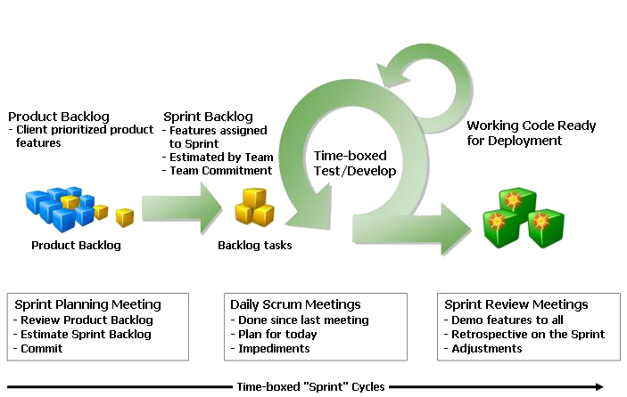
The Scrum Framework

Slide 7
Product Backlog
Requirements / Defects
A list of all desired work on the project
(Product Backlog Item = Story)
Ideally expressed such that each item has value to the users or customers of the product
Prioritized by the product owner in collaboration with team.
Reprioritized on an ad-hoc basis (typically done prior to Sprint Planning and does not affect current Sprint)
Product Backlog
Notes:
Switch over and create a product backlog item:

Slide 8
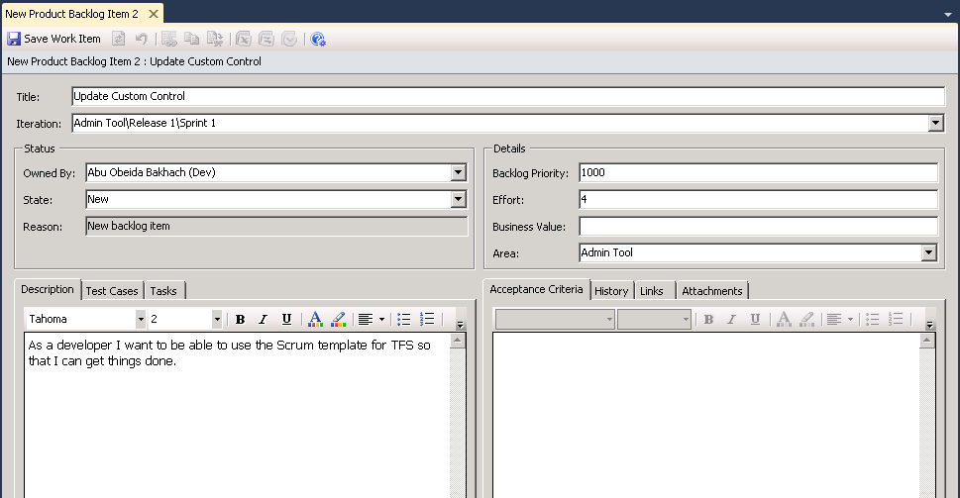
Product Backlog Item
Represents a user story or defect that has a business value

Slide 9
Sprint Backlog
Individuals sign up for work of their own choosing
Work is never assigned by any individual
Estimated work remaining is updated daily
Sprint Backlog
Notes:
Talk about this slide and then flip over &
Talk about how a sprint is work item and also an iteration.
Create several sprint backlog items (tasks) for the story we created.

Slide 10
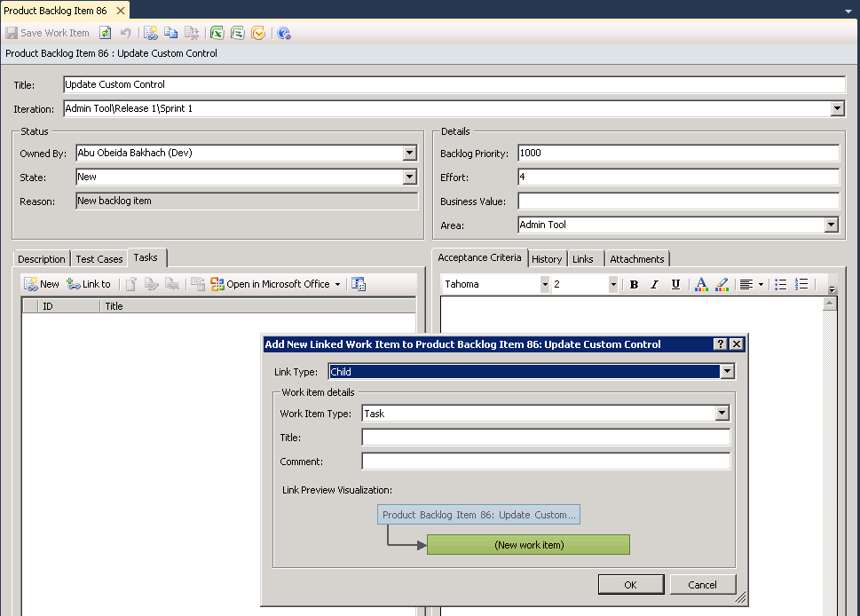
Sprint Backlog Item
Represents a task that a team member will perform to assist the team in completing a story (Product Backlog Item)

Slide 11
SCRUM vs Agile template comparison
(Work item Types)
From bharry’s blog: http://bit.ly/bvqGJn
Work item types
TFS Scrum v1.0 WITs | MSF Agile v5.0 WITs
Product Backlog Item | User Story
Bug | Bug
Task | Task
Impediment | Issue
Test Case | Test Case
Shared Steps | Shared Steps
Sprint

Slide 12


SCRUM vs Agile template comparison
(Item States)
Product Backlog Item and Bug Work Items
Task Work Item
Impediment Work Item

Slide 13
SCRUM vs Agile template comparison
(New Reports)
Release Burndown – Indicates how quickly the team is completing work and delivering Product Backlog Items
Velocity – Indicates the amount of effort the team is completing in each sprint
Sprint Burndown – Indicates the team's progress towards completing its work for a sprint

Slide 14
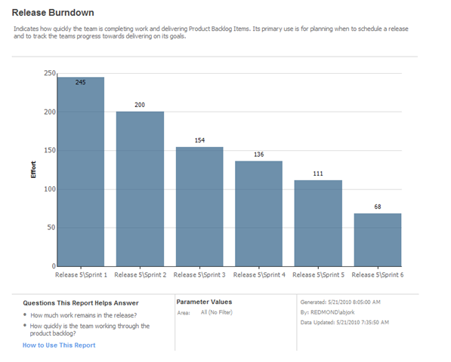
Release Burndown Chart

Slide 15
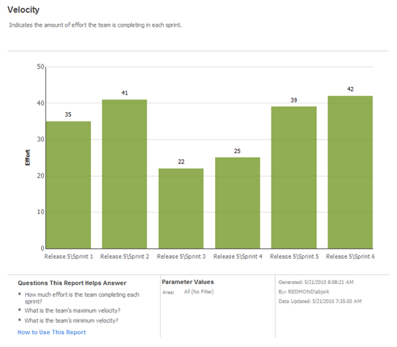
Velocity

Slide 16
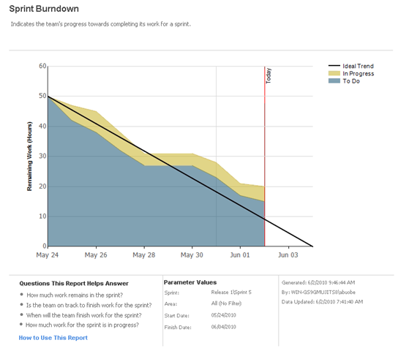
Sprint Burndown Chart
Can be used in the daily stand up
Notes:
In the daily standup we review the amount of work left to do…
In the Beta there are only 3 reports: Release Burndown, Sprint Burndown & Velocity. A few more are envisioned for release:
Build Success Over Time, Build Summary, Test Case Readiness & Test Plan Progress

Slide 17
Tips & Tricks
For experimenting with TFS Reporting

Slide 18
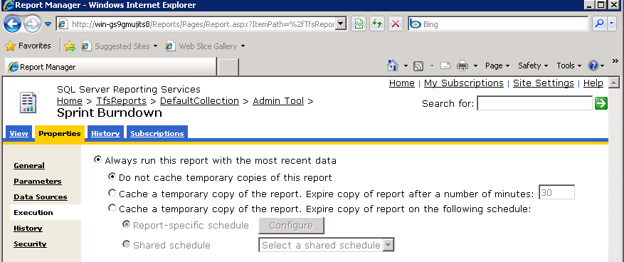
Turn off Report Cache for testing

Slide 19
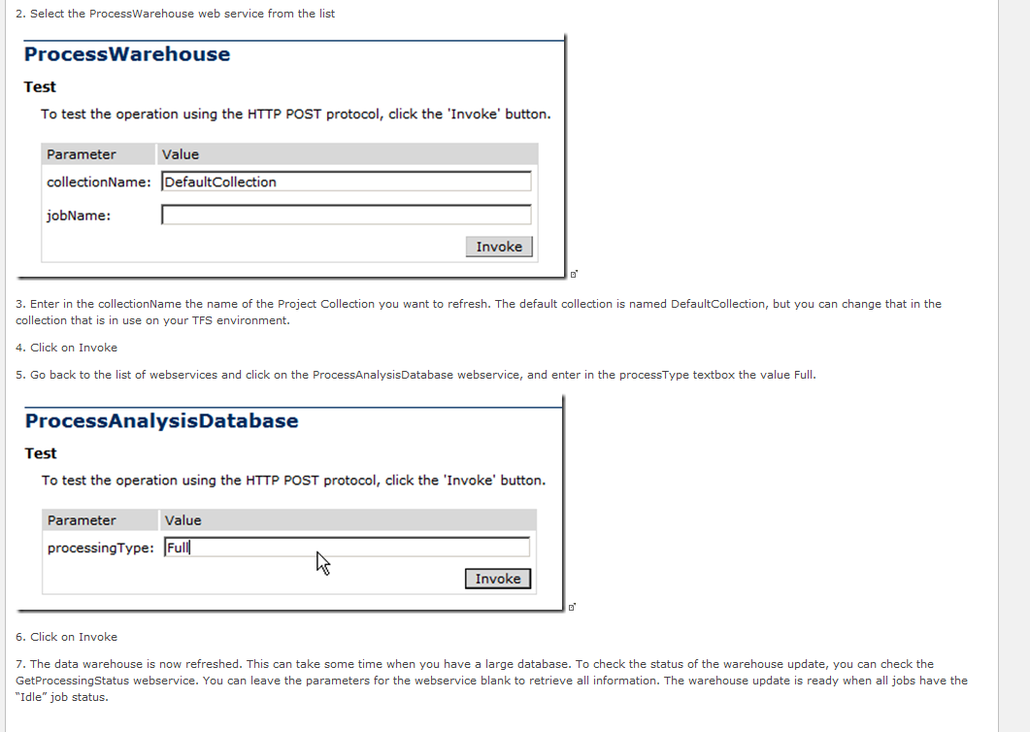
Force Warehouse Update
Source: http://www.ewaldhofman.nl/post/2009/11/25/Refresh-the-TFS-Warehouse-manually.aspx

Slide 20
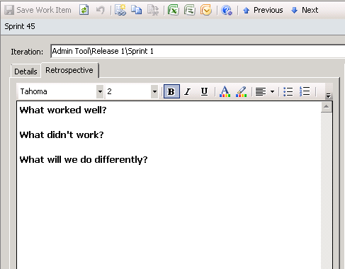
Sprint Retrospective
Captured in the customized Sprint work item
Notes:
Scrum is about continuous feedback and improvement. A meeting is held at the end of every Sprint to reflect on what worked well, what didn’t and what you can do differently in the next sprint. You can capture these details right on the Sprint work item.

Slide 21
Resources
(Optional) VS 2010 RTM Virtual Machine: http://bit.ly/VS2010RTMVHD
Scrum V1.0 Process Template: http://visualstudiogallery.msdn.microsoft.com/en-us/59ac03e3-df99-4776-be39-1917cbfc5d8e

Slide 22

Q&A
Doncho Angelov
doncho.angelov@microsoft.com
http://blog.doncho.net (BG & EN)
@doncho

Slide 23
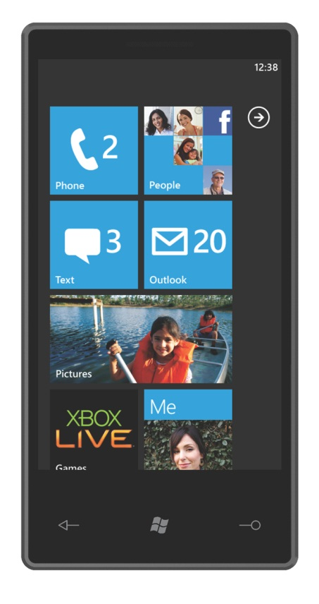


Please fill the questionnaire !
You have a chance to win:
Sponsored by:

