Slide 1
Let’s talk Scrum
Stephen Forte
@worksonmypc
stephenforte@hotmail.com
Chief Strategy Officer Telerik www.telerik.com
www.stephenforte.net

Slide 2
Session.About.ToString();
Would like to implement Agile at your organization or have done so and would like to get more out of it
Assume you know something about Agile, but a complete novice is ok
“Agile Presenting” ☺
The goal is to be interactive
  Success of the seminar depends on your questions!
    Ask a question at any time!

Slide 3


The Agile Manifesto–a statement of values
Individuals and interactions
Process and tools
over
Working software
Comprehensive documentation
over
Customer collaboration
Contract negotiation
over
Responding to change
Following a plan
over
Source: www.agilemanifesto.org

Slide 4
We’re losing the relay race
“The… ‘relay race’ approach to product development…may conflict with the goals of maximum speed and flexibility. Instead a holistic or ‘rugby’ approach—where a team tries to go the distance as a unit, passing the ball back and forth—may better serve today’s competitive requirements
Hirotaka Takeuchi and Ikujiro Nonaka, “The New Product Development Game”, Harvard Business Review, January 1986.
Notes:
would be nice to include a quote from Wicked Problems here

Slide 5
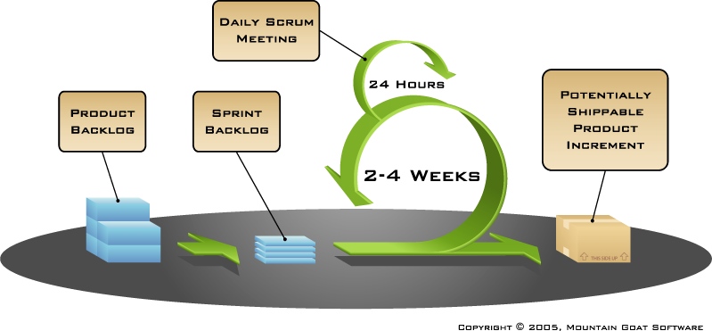
Scrum

Slide 6

Product owner
Define the features of the product
Decide on release date and content
Be responsible for the profitability of the product (ROI)
Prioritize features according to market value
Adjust features and priority every iteration, as needed
Accept or reject work results

Slide 7

The ScrumMaster
Represents management to the project
Responsible for enacting Scrum values and practices
Removes impediments
Ensure that the team is fully functional and productive
Enable close cooperation across all roles and functions
Shield the team from external interferences

Slide 8





The team
Typically 4-9 people
Cross-functional:
  Programmers, testers, user experience designers, etc.
Members should be full-time
  May be exceptions (e.g., database administrator)
Teams are self-organizing
  Ideally, no titles but rarely a possibility
Membership should change only between sprints

Slide 9
A sample product backlog
Backlog item | Estimate
Allow a guest to make a reservation | 3
As a guest, I want to cancel a reservation. | 5
As a guest, I want to change the dates of a reservation. | 3
As a hotel employee, I can run RevPAR reports (revenue-per-available-room) | 8
Improve exception handling | 8
... | 30
... | 50

Slide 10
Sprints
Scrum projects make progress in a series of “sprints”
  Analogous to Extreme Programming iterations
Typical duration is 2–4 weeks or a calendar month at most
A constant duration leads to a better rhythm
Product is designed, coded, and tested during the sprint

Slide 11
Sprint planning
Team selects items from the product backlog they can commit to completing
Sprint backlog is created
  Tasks are identified and each is estimated (1-16 hours)
  Collaboratively, not done alone by the ScrumMaster
High-level design is considered

Slide 12
A sprint backlog
Tasks
Mon
Tues
Wed
Thur
Fri
Code the UI
8
4
8
Code the middle tier
16
12
10
4
Test the middle tier
8
16
16
11
8
Write online help
12
Write the foo class
8
8
8
8
8
Add error logging
8
4

Slide 13
The Daily Scrum
Parameters
  Daily
  10-15 minutes
  Stand-up
Not for problem solving
Helps avoid other unnecessary meetings
Great way to manage remote teams
  Prevents teams from wasting time

Slide 14

Everyone answers 3 Qs
1
What did you do yesterday?
2
What will you do today?
3
Is anything in your way?
These are not status for the ScrumMaster
  They are commitments in front of peers

Slide 15
The sprint review
Team presents what it accomplished during the sprint
Typically takes the form of a demo of new features or underlying architecture
Informal
  2-hour prep time rule
  No slides
Whole team participates
Invite everyone

Slide 16
Sprint retrospective
Periodically take a look at what is and is not working
Typically 15–30 minutes
Done after every sprint
Whole team participates
  ScrumMaster
  Product owner
  Team
  Possibly customers and others

Slide 17
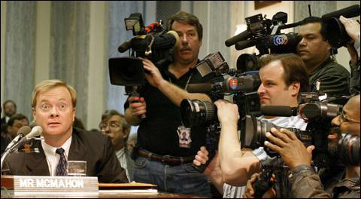
Questions?

