Slide 1
Chapter 11
I/O Management and Disk Scheduling
Operating Systems:
Internals and Design Principles
Seventh Edition
By William Stallings
Notes:
“Operating Systems: Internal and Design Principles”, 7/e, by William Stallings, Chapter 11 “I/O Management and Disk Scheduling”.

Slide 2
Categories of I/O Devices
External devices that engage in I/O with computer systems can be grouped into three categories:
Human readable
Machine readable
Communication
suitable for communicating with the computer user
printers, terminals, video display, keyboard, mouse
suitable for communicating with electronic equipment
disk drives, USB keys, sensors, controllers
suitable for communicating with remote devices
modems, digital line drivers
Notes:
As was mentioned in Chapter 1 , external devices that engage in I/O with computer
systems can be roughly grouped into three categories:
• Human readable: Suitable for communicating with the computer user.
Examples include printers and terminals, the latter consisting of video display,
keyboard, and perhaps other devices such as a mouse.
Machine readable: Suitable for communicating with electronic equipment.
Examples are disk drives, USB keys, sensors, controllers, and actuators.
• Communication: Suitable for communicating with remote devices. Examples
are digital line drivers and modems.

Slide 3
Differences in I/O Devices
Devices differ in a number of areas:
Data Rate
there may be differences of magnitude between the data transfer rates
Application
the use to which a device is put has an influence on the software
Complexity of Control
the effect on the operating system is filtered by the complexity of the I/O module that controls the device
Unit of Transfer
data may be transferred as a stream of bytes or characters or in larger blocks
Data Representation
different data encoding schemes are used by different devices
Error Conditions
the nature of errors, the way in which they are reported, their consequences, and the available range of responses differs from one device to another
Notes:
There are great differences across classes and even substantial differences
within each class. Among the key differences are the following:
• Data rate: There may be differences of several orders of magnitude between
the data transfer rates. Figure 11.1 gives some examples.
• Application: The use to which a device is put has an influence on the software
and policies in the operating system and supporting utilities. For example, a
disk used for files requires the support of file management software. A disk
used as a backing store for pages in a virtual memory scheme depends on the
use of virtual memory hardware and software. Furthermore, these applications
have an impact on disk scheduling algorithms (discussed later in this
chapter). As another example, a terminal may be used by an ordinary user or a
system administrator. These uses imply different privilege levels and perhaps
different priorities in the operating system.
• Complexity of control: A printer requires a relatively simple control interface.
A disk is much more complex. The effect of these differences on the operating
system is filtered to some extent by the complexity of the I/O module that
controls the device, as discussed in the next section.
Unit of transfer: Data may be transferred as a stream of bytes or characters
(e.g., terminal I/O) or in larger blocks (e.g., disk I/O).
• Data representation: Different data encoding schemes are used by different
devices, including differences in character code and parity conventions.
• Error conditions: The nature of errors, the way in which they are reported,
their consequences, and the available range of responses differ widely from
one device to another.
This diversity makes a uniform and consistent approach to I/O, both from the
point of view of the operating system and from the point of view of user processes,
difficult to achieve.

Slide 4

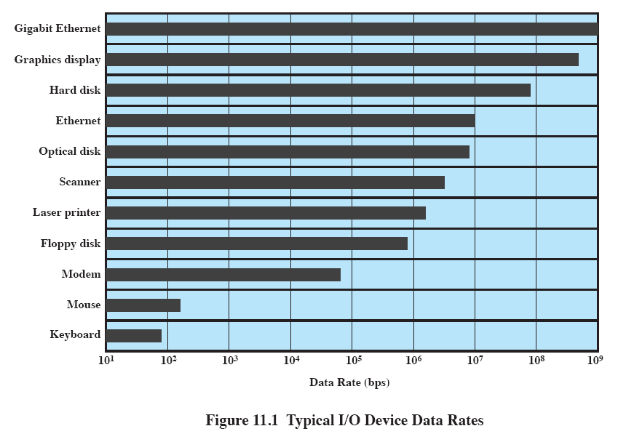
Data Rates
Notes:
There may be differences of several orders of magnitude between the data transfer rates.
Figure 11.1 gives some examples.

Slide 5
Organization of the I/O Function
Three techniques for performing I/O are:
Programmed I/O
  the processor issues an I/O command on behalf of a process to an I/O module; that process then busy waits for the operation to be completed before proceeding
Interrupt-driven I/O
  the processor issues an I/O command on behalf of a process
    if non-blocking – processor continues to execute instructions from the process that issued the I/O command
    if blocking – the next instruction the processor executes is from the OS, which will put the current process in a blocked state and schedule another process
Direct Memory Access (DMA)
    a DMA module controls the exchange of data between main memory and an I/O module
Notes:
Appendix C summarizes three techniques for performing I/O:
• Programmed I/O : The processor issues an I/O command, on behalf of a process,
to an I/O module; that process then busy waits for the operation to be completed
before proceeding.
• Interrupt-driven I/O : The processor issues an I/O command on behalf of
a process. There are then two possibilities. If the I/O instruction from the
process is nonblocking, then the processor continues to execute instructions
from the process that issued the I/O command. If the I/O instruction
is blocking, then the next instruction that the processor executes is from
the OS, which will put the current process in a blocked state and schedule
another process.
• Direct memory access (DMA) : A DMA module controls the exchange of data
between main memory and an I/O module. The processor sends a request for
the transfer of a block of data to the DMA module and is interrupted only
after the entire block has been transferred.

Slide 6
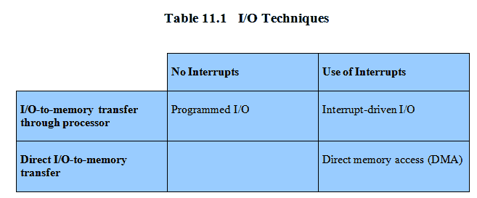
Techniques for Performing I/O
Notes:
Table 11.1 indicates the relationship among these three techniques. In most
computer systems, DMA is the dominant form of transfer that must be supported
by the operating system.

Slide 7
Evolution of the I/O Function
1
Processor directly controls a peripheral device
2
A controller or I/O module is added
3
Same configuration as step 2, but now interrupts are employed
4
5
6
The I/O module is given direct control of memory via DMA
The I/O module is enhanced to become a separate processor, with a specialized instruction set tailored for I/O
The I/O module has a local memory of its own and is, in fact, a computer in its own right
Notes:
As computer systems have evolved, there has been a pattern of increasing
complexity and sophistication of individual components. Nowhere is this more
evident than in the I/O function. The evolutionary steps can be summarized as
Follows:
1. The processor directly controls a peripheral device. This is seen in simple
microprocessor-controlled devices.
2. A controller or I/O module is added. The processor uses programmed I/O
without interrupts. With this step, the processor becomes somewhat divorced
from the specific details of external device interfaces.
3. The same configuration as step 2 is used, but now interrupts are employed. The
processor need not spend time waiting for an I/O operation to be performed,
thus increasing efficiency.
4. The I/O module is given direct control of memory via DMA. It can now move
a block of data to or from memory without involving the processor, except at
the beginning and end of the transfer.
5. The I/O module is enhanced to become a separate processor, with a
specialized instruction set tailored for I/O. The central processing unit
(CPU) directs the I/O processor to execute an I/O program in main
memory. The I/O processor fetches and executes these instructions without
processor intervention. This allows the processor to specify a sequence of
I/O activities and to be interrupted only when the entire sequence has been
performed.
6. The I/O module has a local memory of its own and is, in fact, a computer
in its own right. With this architecture, a large set of I/O devices can be
controlled, with minimal processor involvement. A common use for such an
architecture has been to control communications with interactive terminals.
The I/O processor takes care of most of the tasks involved in controlling the
terminals.
As one proceeds along this evolutionary path, more and more of the I/O
function is performed without processor involvement. The central processor is
increasingly relieved of I/O-related tasks, improving performance. With the last
two steps (5 and 6), a major change occurs with the introduction of the concept of
an I/O module capable of executing a program.
A note about terminology: For all of the modules described in steps 4
through 6, the term direct memory access is appropriate, because all of these
types involve direct control of main memory by the I/O module. Also, the I/O
module in step 5 is often referred to as an I/O channel , and that in step 6 as an
I/O processor ; however, each term is, on occasion, applied to both situations. In
the latter part of this section, we will use the term I/O channel to refer to both
types of I/O modules.

Slide 8
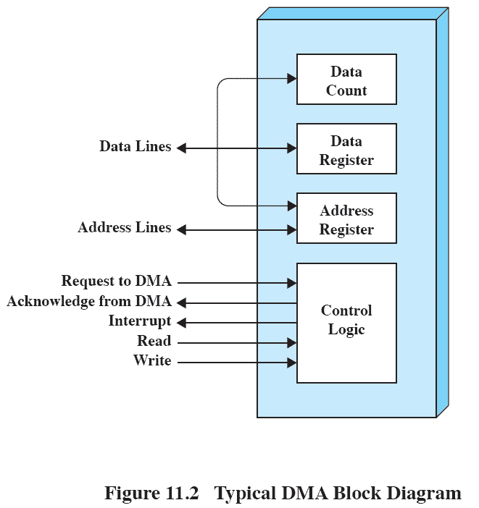
Direct Memory Access
Notes:
Figure 11.2 indicates, in general terms, the DMA logic. The DMA unit is capable of
mimicking the processor and, indeed, of taking over control of the system bus just
like a processor. It needs to do this to transfer data to and from memory over the
system bus.
The DMA technique works as follows. When the processor wishes to read or
write a block of data, it issues a command to the DMA module by sending to the
DMA module the following information:
• Whether a read or write is requested, using the read or write control line
between the processor and the DMA module
• The address of the I/O device involved, communicated on the data lines
• The starting location in memory to read from or write to, communicated on
the data lines and stored by the DMA module in its address register
• The number of words to be read or written, again communicated via the data
lines and stored in the data count register
The processor then continues with other work. It has delegated this I/O operation
to the DMA module. The DMA module transfers the entire block of data, one word
at a time, directly to or from memory, without going through the processor. When the
transfer is complete, the DMA module sends an interrupt signal to the processor. Thus,
the processor is involved only at the beginning and end of the transfer (Figure C.4c).

Slide 9
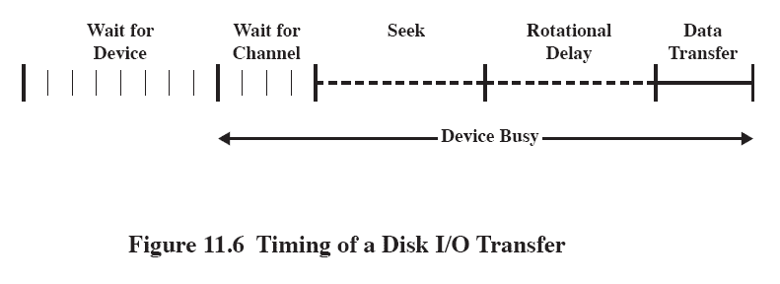
Disk Performance Parameters
The actual details of disk I/O operation depend on the:
    computer system
    operating system
    nature of the I/O channel and disk controller hardware
Notes:
The actual details of disk I/O operation depend on the computer system, the operating
system, and the nature of the I/O channel and disk controller hardware. A
general timing diagram of disk I/O transfer is shown in Figure 11.6 .

Slide 10
Positioning the
Read/Write Heads
When the disk drive is operating, the disk is rotating at constant speed
To read or write the head must be positioned at the desired track and at the beginning of the desired sector on that track
Track selection involves moving the head in a movable-head system or electronically selecting one head on a fixed-head system
On a movable-head system the time it takes to position the head at the track is known as seek time
The time it takes for the beginning of the sector to reach the head is known as rotational delay
The sum of the seek time and the rotational delay equals the access time
Notes:
When the disk drive is operating, the disk is rotating at constant speed. To
read or write, the head must be positioned at the desired track and at the beginning
of the desired sector on that track. 1 Track selection involves moving the head in a
movable-head system or electronically selecting one head on a fixed-head system.
On a movable-head system, the time it takes to position the head at the track is
known as seek time . In either case, once the track is selected, the disk controller
waits until the appropriate sector rotates to line up with the head. The time it takes
for the beginning of the sector to reach the head is known as rotational delay , or
rotational latency. The sum of the seek time, if any, and the rotational delay equals
the access time , which is the time it takes to get into position to read or write. Once
the head is in position, the read or write operation is then performed as the sector
moves under the head; this is the data transfer portion of the operation; the time
required for the transfer is the transfer time .
In addition to the access time and transfer time, there are several queuing
delays normally associated with a disk I/O operation. When a process issues an
I/O request, it must first wait in a queue for the device to be available. At that
time, the device is assigned to the process. If the device shares a single I/O channel
or a set of I/O channels with other disk drives, then there may be an additional
wait for the channel to be available. At that point, the seek is performed to begin
disk access.
In some high-end systems for servers, a technique known as rotational
positional sensing (RPS) is used. This works as follows: When the seek command
has been issued, the channel is released to handle other I/O operations. When
the seek is completed, the device determines when the data will rotate under
the head. As that sector approaches the head, the device tries to reestablish the
communication path back to the host. If either the control unit or the channel is
busy with another I/O, then the reconnection attempt fails and the device must
rotate one whole revolution before it can attempt to reconnect, which is called
an RPS miss. This is an extra delay element that must be added to the time line
of Figure 11.6 .

Slide 11
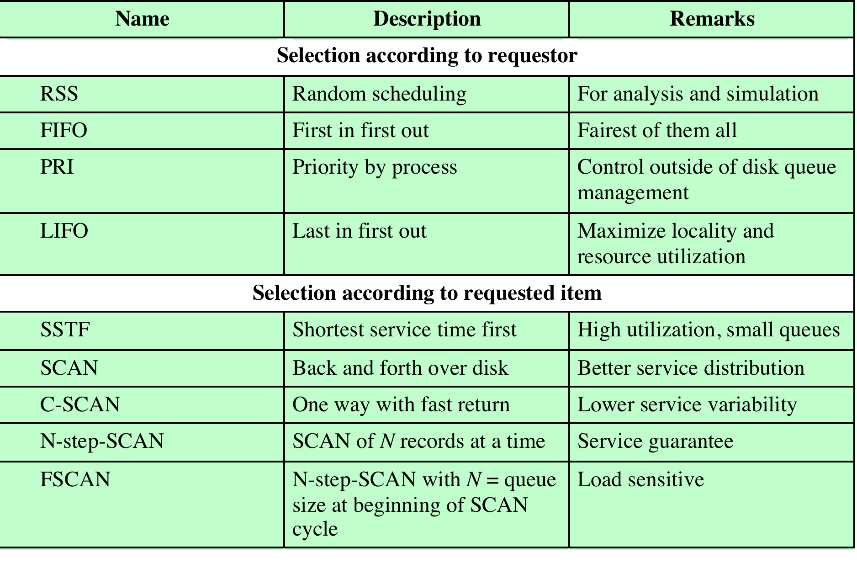
Table 11.3 Disk Scheduling Algorithms
Notes:
Table 11.3 Disk Scheduling Algorithms

Slide 12
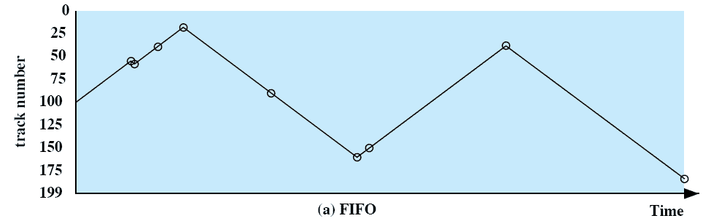
First-In, First-Out (FIFO)
Processes in sequential order
Fair to all processes
Approximates random scheduling in performance if there are many processes competing for the disk
Notes:
The simplest form of scheduling is first-in-first-out (FIFO)
scheduling, which processes items from the queue in sequential order. This strategy
has the advantage of being fair, because every request is honored and the requests are
honored in the order received. Figure 11.7a illustrates the disk arm movement with
FIFO. This graph is generated directly from the data in Table 11.2a . As can be seen,
the disk accesses are in the same order as the requests were originally received.
With FIFO, if there are only a few processes that require access and if many
of the requests are to clustered file sectors, then we can hope for good performance.
However, this technique will often approximate random scheduling in performance,
if there are many processes competing for the disk. Thus, it may be profitable to
consider a more sophisticated scheduling policy. A number of these are listed in
Table 11.3 and will now be considered.

Slide 13
Priority (PRI)
Control of the scheduling is outside the control of disk management software
Goal is not to optimize disk utilization but to meet other objectives
Short batch jobs and interactive jobs are given higher priority
Provides good interactive response time
Longer jobs may have to wait an excessively long time
A poor policy for database systems
Notes:
With a system based on priority (PRI), the control of the scheduling is
outside the control of disk management software. Such an approach is not intended
to optimize disk utilization but to meet other objectives within the operating system.
Often short batch jobs and interactive jobs are given higher priority than longer jobs
that require longer computation. This allows a lot of short jobs to be flushed through
the system quickly and may provide good interactive response time. However, longer
jobs may have to wait excessively long times. Furthermore, such a policy could lead
to countermeasures on the part of users, who split their jobs into smaller pieces to
beat the system. This type of policy tends to be poor for database systems.

Slide 14
Scheduling Criteria
Disk scheduling strategies are generally designed to treat all requests as if they have equal priority. The objective of the strategy is to optimize one or more of the following quantities:
Throughput: number of requests processed per unit of time
Average response time: waiting for a request to be processed
Variance of response times: no starvation (indefinite postponement). Each request should be processed within a reasonable time period.
  Measures fairness and predictability.

Slide 15
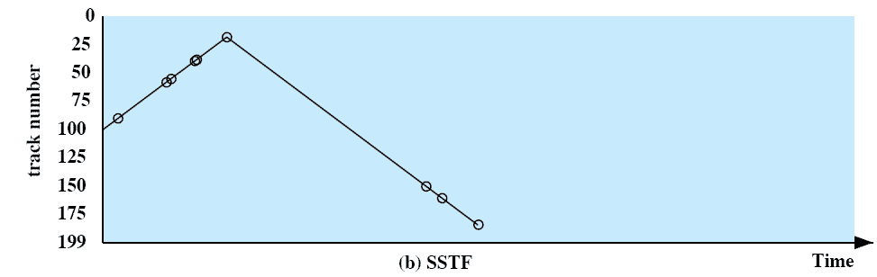
Shortest Service
Time First (SSTF)
Select the request that requires the least movement of the disk arm from its current position
Always choose the minimum seek time
Possible starvation: suppose requests constantly arrive for tracks between tracks 100 & 1
Notes:
The shortest-service-time-first (SSTF) policy
is to select the disk I/O request that requires the least movement of the disk arm
from its current position. Thus, we always choose to incur the minimum seek time.
Of course, always choosing the minimum seek time does not guarantee that the
average seek time over a number of arm movements will be minimum. However,
this should provide better performance than FIFO. Because the arm can move in
two directions, a random tie-breaking algorithm may be used to resolve cases of
equal distances.
Figure 11.7b and Table 11.2b show the performance of SSTF on the same
example as was used for FIFO. The first track accessed is 90, because this is the
closest requested track to the starting position. The next track accessed is 58 because
this is the closest of the remaining requested tracks to the current position of 90.
Subsequent tracks are selected accordingly.

Slide 16
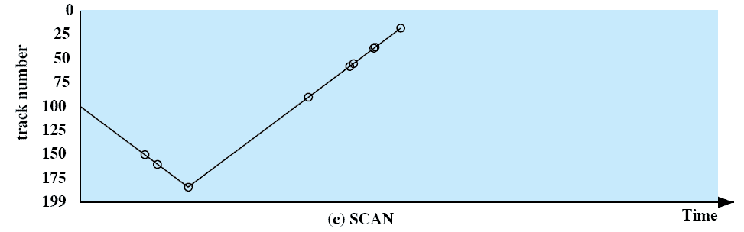
SCAN
Also known as the elevator algorithm
Arm moves in one direction only
    satisfies all outstanding requests until it reaches the last track in that direction then the direction is reversed
  Favors jobs whose requests are for tracks nearest to both innermost and outermost tracks but does not cause starvation.
Notes:
With the exception of FIFO, all of the policies described so far can leave
some request unfulfilled until the entire queue is emptied. That is, there may always
be new requests arriving that will be chosen before an existing request. A simple
alternative that prevents this sort of starvation is the SCAN algorithm, also known
as the elevator algorithm because it operates much the way an elevator does.
With SCAN, the arm is required to move in one direction only, satisfying all
outstanding requests en route, until it reaches the last track in that direction or until
there are no more requests in that direction. This latter refinement is sometimes
referred to as the LOOK policy. The service direction is then reversed and the scan
proceeds in the opposite direction, again picking up all requests in order.
Figure 11.7c and Table 11.2c illustrate the SCAN policy. Assuming that the
initial direction is of increasing track number, then the first track selected is 150,
since this is the closest track to the starting track of 100 in the increasing direction.
As can be seen, the SCAN policy behaves almost identically with the SSTF
policy. Indeed, if we had assumed that the arm was moving in the direction of lower
track numbers at the beginning of the example, then the scheduling pattern would
have been identical for SSTF and SCAN. However, this is a static example in which
no new items are added to the queue. Even when the queue is dynamically changing,
SCAN will be similar to SSTF unless the request pattern is unusual.
Note that the SCAN policy is biased against the area most recently traversed.
Thus it does not exploit locality as well as SSTF.
It is not difficult to see that the SCAN policy favors jobs whose requests are
for tracks nearest to both innermost and outermost tracks and favors the latest arriving
jobs. The first problem can be avoided via the C-SCAN policy, while the
second problem is addressed by the N-step-SCAN policy.

Slide 17
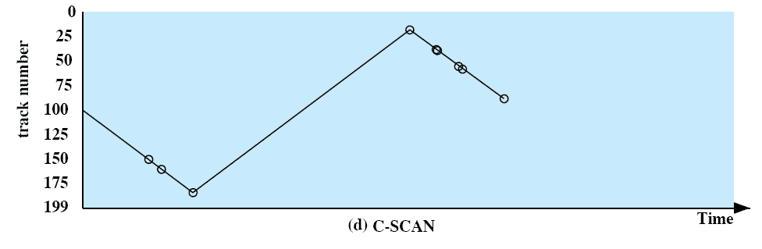
C-SCAN
(Circular SCAN)
Restricts scanning to one direction only
When the last track has been visited in one direction, the arm is returned to the opposite end of the disk and the scan begins again
Reduces maximum delay for new requests.
Notes:
The C-SCAN (circular SCAN) policy restricts scanning to one direction
only. Thus, when the last track has been visited in one direction, the arm is returned
to the opposite end of the disk and the scan begins again. This reduces the maximum
delay experienced by new requests. With SCAN, if the expected time for a scan
from inner track to outer track is t , then the expected service interval for sectors at
the periphery is 2 t. With C-SCAN, the interval is on the order of t + s max , where
s max is the maximum seek time.
Figure 11.7d and Table 11.2d illustrate C-SCAN behavior. In this case the first
three requested tracks encountered are 150, 160, and 184. Then the scan begins
starting at the lowest track number, and the next requested track encountered is 18.

Slide 18
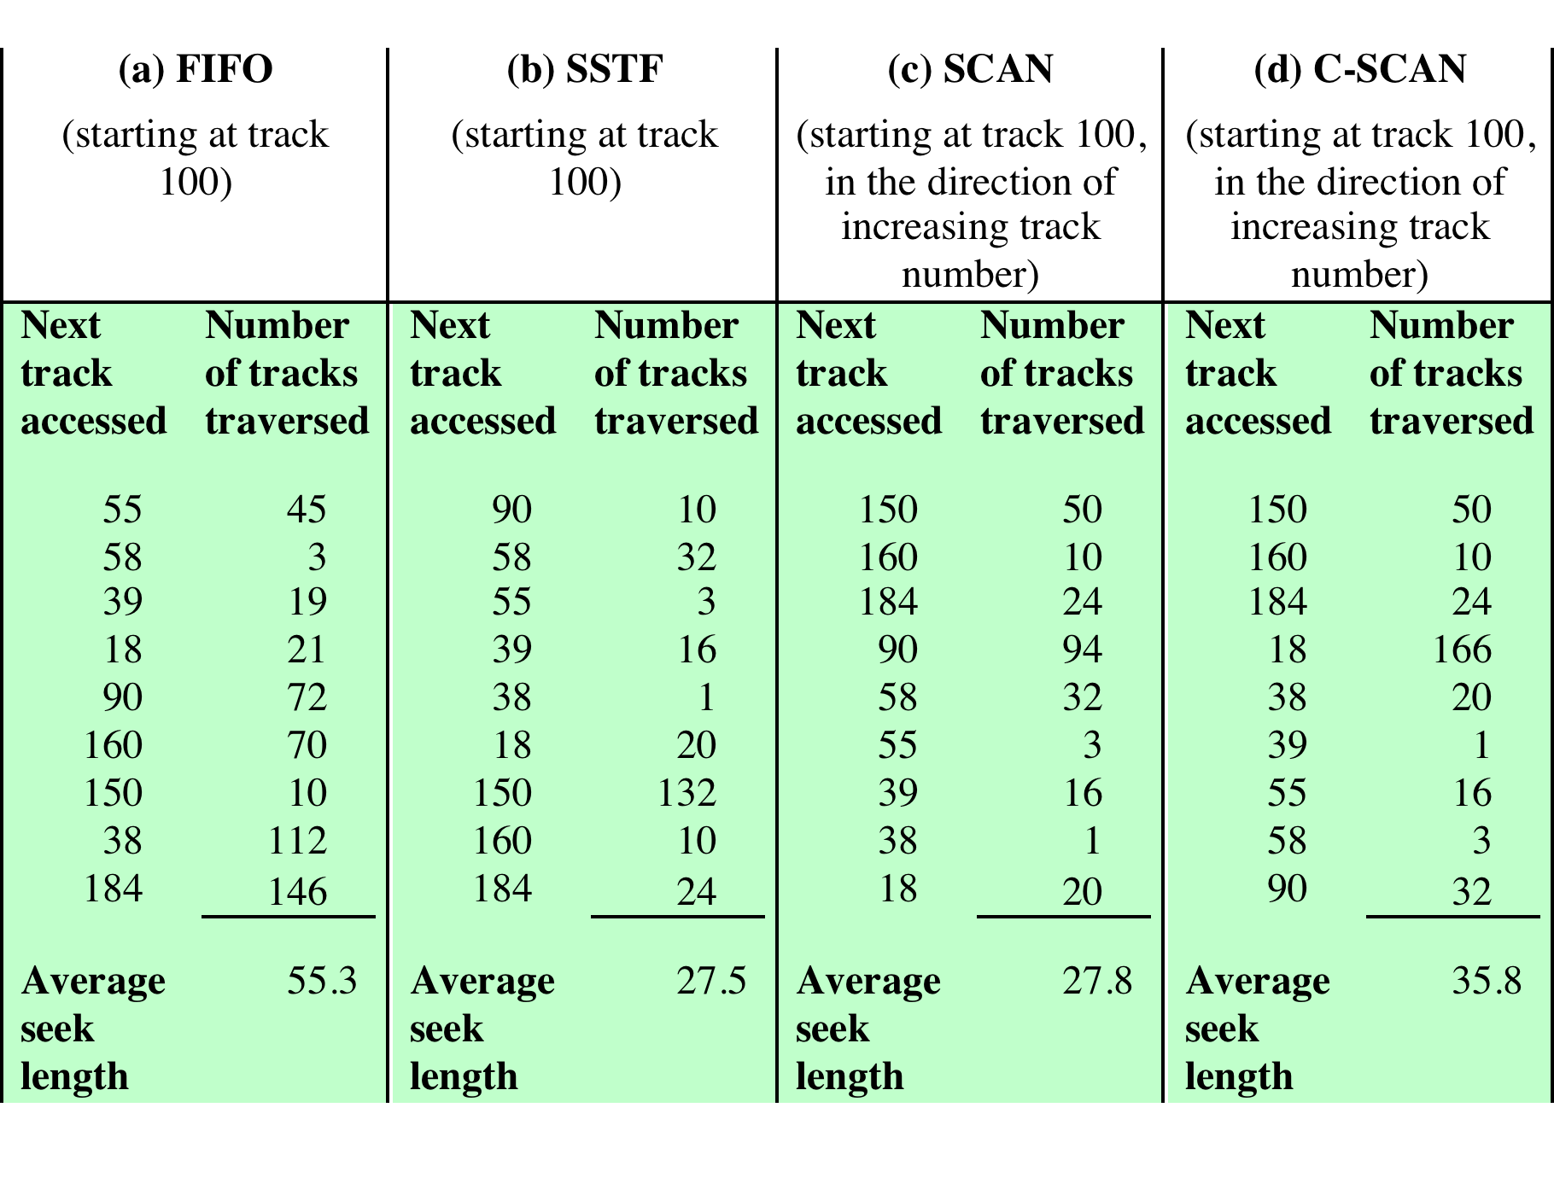
Table 11.2 Comparison of Disk Scheduling Algorithms
Notes:
Table 11.2 Comparison of Disk Scheduling Algorithms

Slide 19
RAID
Design architectures share three characteristics:
RAID is a set of physical disk drives viewed by the operating system as a single logical drive
data are distributed across the physical drives of an array in a scheme known as striping
redundant disk capacity is used to store parity information, which guarantees data recoverability in case of a disk failure
Redundant Array of Independent Disks
Objective: improve performance & reliability of disk I/O
Consists of seven levels, zero through six
  Levels 0 & 1 don’t include
  parity checks
  Details for striping and
  parity differ from level
  to level
Notes:
With the use of multiple disks, there is a wide variety of ways in which the data
can be organized and in which redundancy can be added to improve reliability. This
could make it difficult to develop database schemes that are usable on a number of
platforms and operating systems. Fortunately, industry has agreed on a standardized
scheme for multiple-disk database design, known as RAID (redundant array of
independent disks). The RAID scheme consists of seven levels, 2 zero through six.
These levels do not imply a hierarchical relationship but designate different design
architectures that share three common characteristics:
1. RAID is a set of physical disk drives viewed by the operating system as a single
logical drive.
2. Data are distributed across the physical drives of an array in a scheme known
as striping, described subsequently.
3. Redundant disk capacity is used to store parity information, which guarantees
data recoverability in case of a disk failure.

Slide 20
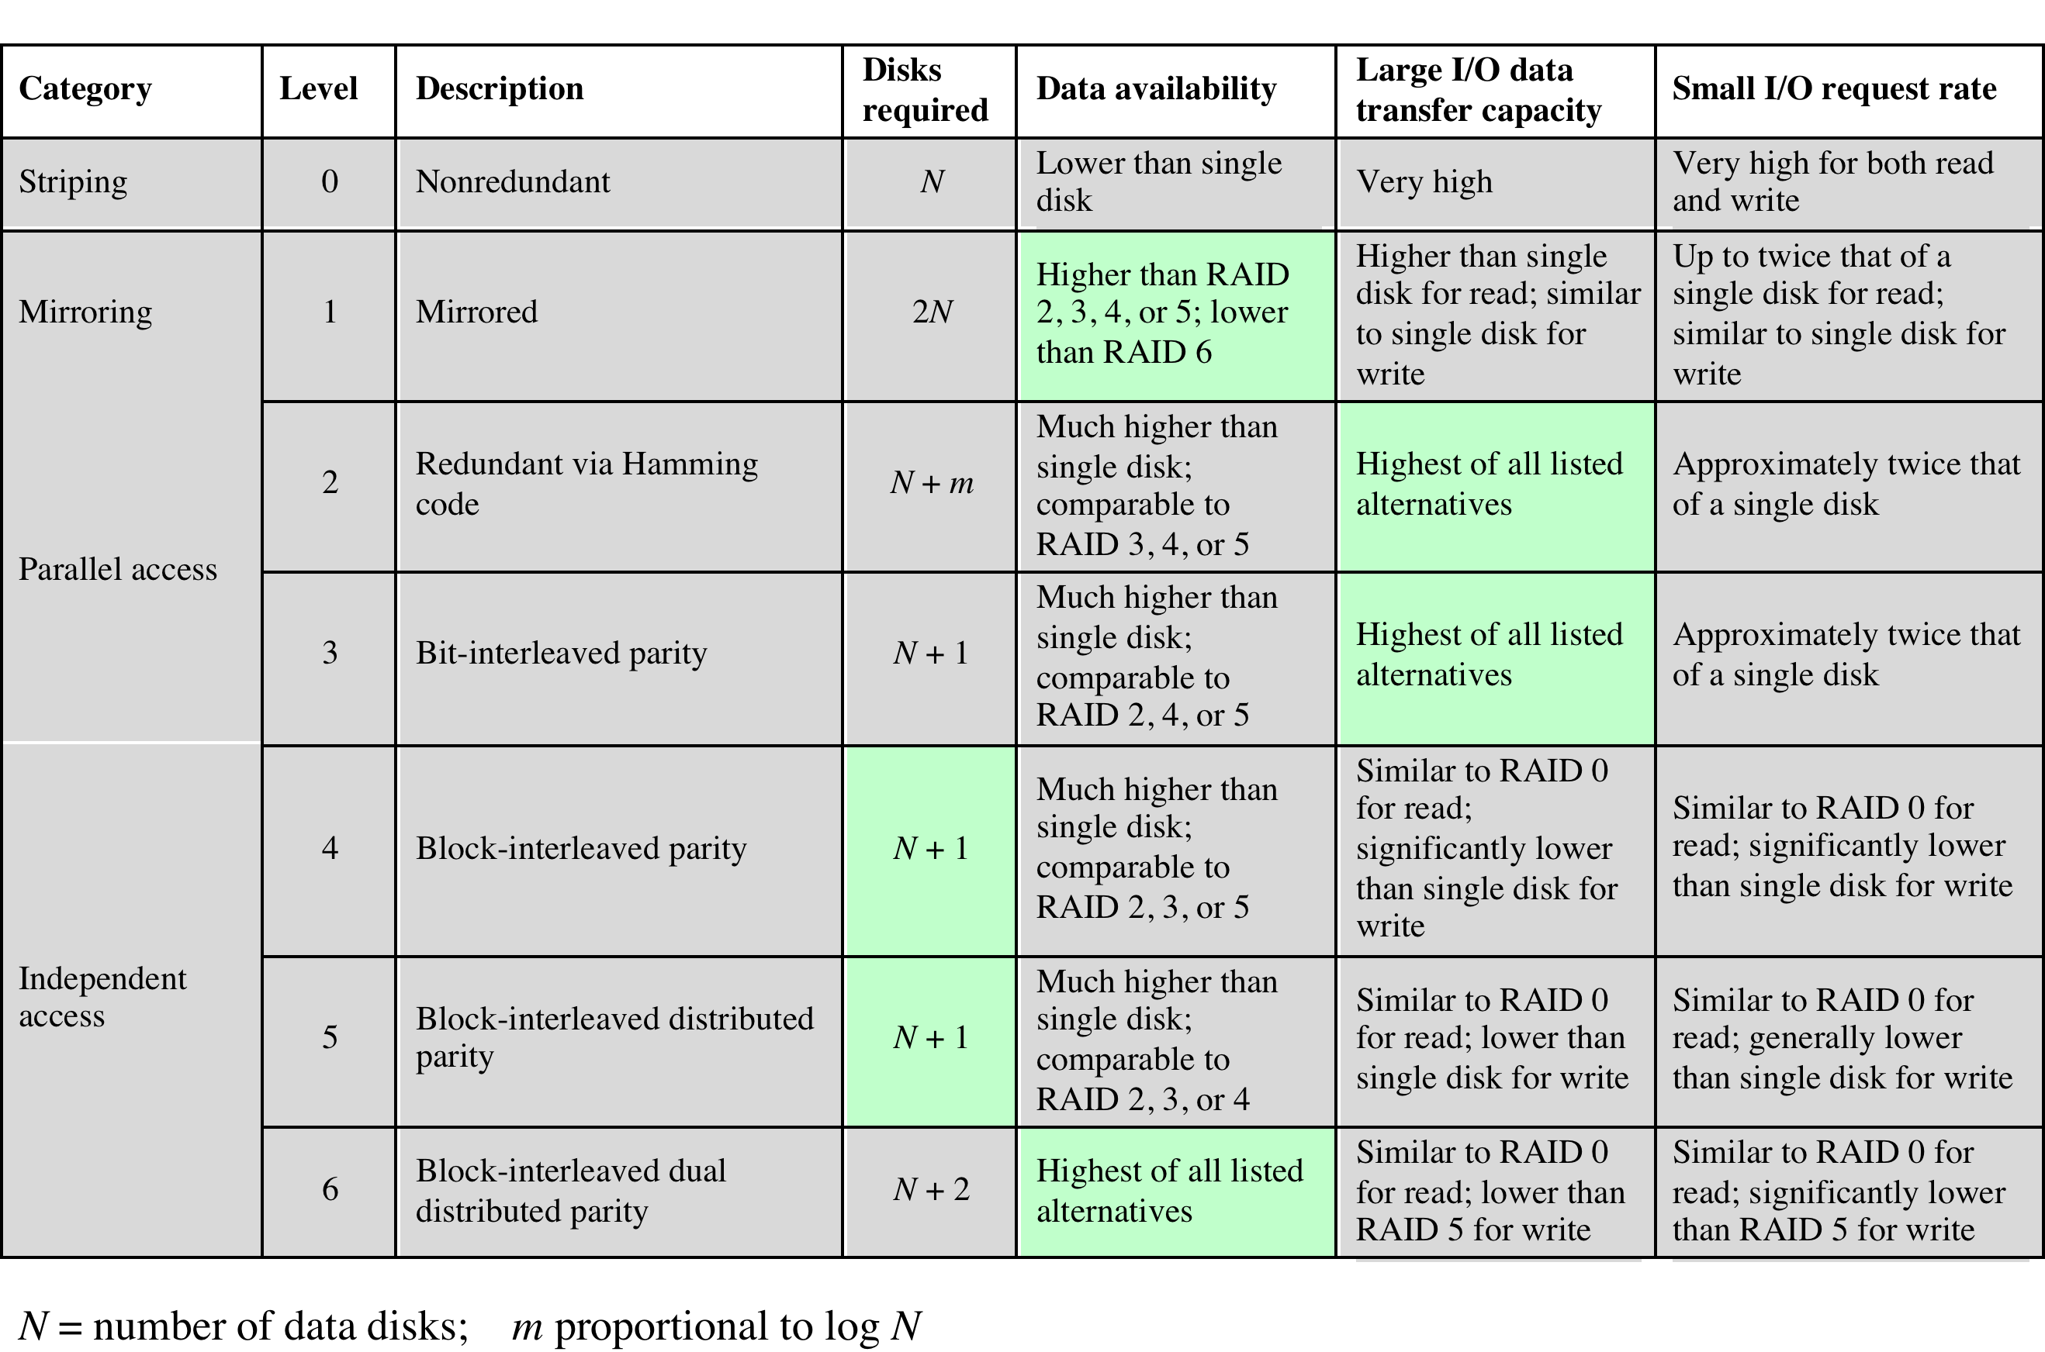
Table 11.4 RAID Levels
Notes:
We now examine each of the RAID levels. Table 11.4 provides a rough
guide to the seven levels. In the table, I/O performance is shown both in terms of
data transfer capacity, or ability to move data, and I/O request rate, or ability to
satisfy I/O requests, since these RAID levels inherently perform differently relative
to these two metrics. Each RAID level’s strong point is highlighted in color.
Of the seven RAID levels described, only four are commonly used: RAID
levels 0, 1, 5, and 6.

Slide 21
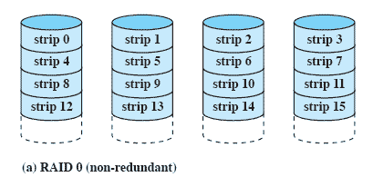
RAID Level 0
Not a true RAID: no redundancy
Data are distributed across all of the disks
Two unrelated I/O requests can be done in parallel if they are on different disks, or
Here, strips 0-3, 4-7, etc. represent a stripe: consecutive bytes in a file and all can be read in parallel in a single related operation.
Notes:
RAID level 0 is not a true member of the RAID family, because it does not include
redundancy to improve performance or provide data protection. However, there
are a few applications, such as some on supercomputers in which performance
and capacity are primary concerns and low cost is more important than improved
reliability.
For RAID 0, the user and system data are distributed across all of the disks
in the array. This has a notable advantage over the use of a single large disk: If two
different I/O requests are pending for two different blocks of data, then there is a
good chance that the requested blocks are on different disks. Thus, the two requests
can be issued in parallel, reducing the I/O queuing time.
But RAID 0, as with all of the RAID levels, goes further than simply distributing
the data across a disk array: The data are striped across the available disks.
This is best understood by considering Figure 11.8 . All user and system data are
viewed as being stored on a logical disk. The logical disk is divided into strips; these
strips may be physical blocks, sectors, or some other unit. The strips are mapped
round robin to consecutive physical disks in the RAID array. A set of logically
consecutive strips that maps exactly one strip to each array member is referred
to as a stripe . In an n -disk array, the first n logical strips are physically stored as
the first strip on each of the n disks, forming the first stripe; the second n strips
are distributed as the second strips on each disk; and so on. The advantage of this
layout is that if a single I/O request consists of multiple logically contiguous strips,
then up to n strips for that request can be handled in parallel, greatly reducing the
I/O transfer time.

Slide 22
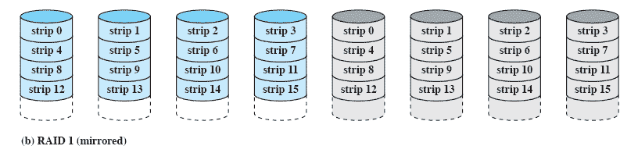
RAID Level 1
Redundancy is achieved by the simple expedient of duplicating all the data
There is no “write penalty” (time required to compute and update parity bits).
When a drive fails the data may still be accessed from the second drive
Principal disadvantage is the cost
Notes:
RAID 1 differs from RAID levels 2 through 6 in the way in which redundancy is
achieved. In these other RAID schemes, some form of parity calculation is used
to introduce redundancy, whereas in RAID 1, redundancy is achieved by the simple
expedient of duplicating all the data. Figure 11.8b shows data striping being
used, as in RAID 0. But in this case, each logical strip is mapped to two separate
physical disks so that every disk in the array has a mirror disk that contains the
same data. RAID 1 can also be implemented without data striping, though this is
less common.
There are a number of positive aspects to the RAID 1 organization:
1. A read request can be serviced by either of the two disks that contains the
requested data, whichever one involves the minimum seek time plus rotational
latency.
2. A write request requires that both corresponding strips be updated, but this
can be done in parallel. Thus, the write performance is dictated by the slower
of the two writes (i.e., the one that involves the larger seek time plus rotational
latency). However, there is no “write penalty” with RAID 1. RAID levels
2 through 6 involve the use of parity bits. Therefore, when a single strip is
updated, the array management software must first compute and update the
parity bits as well as updating the actual strip in question.
3. Recovery from a failure is simple. When a drive fails, the data may still be
accessed from the second drive.
The principal disadvantage of RAID 1 is the cost; it requires twice the disk
space of the logical disk that it supports. Because of that, a RAID 1 configuration
is likely to be limited to drives that store system software and data and other highly
critical files. In these cases, RAID 1 provides real-time backup of all data so that in
the event of a disk failure, all of the critical data is still immediately available.
In a transaction-oriented environment, RAID 1 can achieve high I/O request
rates if the bulk of the requests are reads. In this situation, the performance of RAID
1 can approach double of that of RAID 0. However, if a substantial fraction of the I/O
requests are write requests, then there may be no significant performance gain over
RAID 0. RAID 1 may also provide improved performance over RAID 0 for data
transfer intensive applications with a high percentage of reads. Improvement occurs
if the application can split each read request so that both disk members participate.

Slide 23
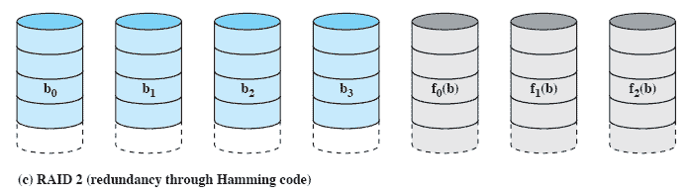
RAID Level 2
Uses a parallel access technique: all disks involved in each operation
Data striping is used, usually small strips
Typically a Hamming code is used; can detect/correct single bit errors, detect double bit errors.
Effective choice in an environment in which many disk errors occur but otherwise overkill: too many extra disks are required.
Notes:
RAID levels 2 and 3 make use of a parallel access technique. In a parallel access
array, all member disks participate in the execution of every I/O request. Typically,
the spindles of the individual drives are synchronized so that each disk head is in the
same position on each disk at any given time.
As in the other RAID schemes, data striping is used. In the case of RAID 2
and 3, the strips are very small, often as small as a single byte or word. With RAID 2,
an error-correcting code is calculated across corresponding bits on each data disk,
and the bits of the code are stored in the corresponding bit positions on multiple
parity disks. Typically, a Hamming code is used, which is able to correct single-bit
errors and detect double-bit errors.
Although RAID 2 requires fewer disks than RAID 1, it is still rather costly.
The number of redundant disks is proportional to the log of the number of data
disks. On a single read, all disks are simultaneously accessed. The requested data
and the associated error-correcting code are delivered to the array controller. If
there is a single-bit error, the controller can recognize and correct the error instantly,
so that the read access time is not slowed. On a single write, all data disks and parity
disks must be accessed for the write operation.
RAID 2 would only be an effective choice in an environment in which many
disk errors occur. Given the high reliability of individual disks and disk drives,
RAID 2 is overkill and is not implemented.

Slide 24
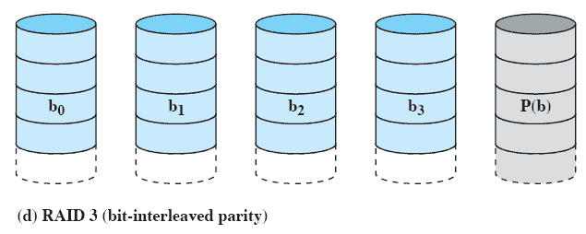
RAID Level 3
Requires only a single redundant disk, which serves as a parity disk. If a single disk fails its contents can be reconstructed from the parity disk.
Employs parallel access, with data distributed in small strips
Can achieve very high data transfer rates due to small strip size.
Notes:
RAID 3 is organized in a similar fashion to RAID 2. The difference is that RAID 3
requires only a single redundant disk, no matter how large the disk array. RAID 3
employs parallel access, with data distributed in small strips. Instead of an error correcting
code, a simple parity bit is computed for the set of individual bits in the
same position on all of the data disks.
REDUNDANCY In the event of a drive failure, the parity drive is accessed and data
is reconstructed from the remaining devices. Once the failed drive is replaced, the
missing data can be restored on the new drive and operation resumed.
Data reconstruction is simple. Consider an array of five drives in which X0
through X3 contain data and X4 is the parity disk. The parity for the i th bit is
calculated as follows:
X4(i) = X3(i) X2(i) X1(i) X0(i)
where is exclusive-OR function.
Suppose that drive X1 has failed. If we add X4(i) X1(i) to both sides of the
preceding equation, we get
X1(i) = X4(i) X3(i) X2(i) X0(i)
Thus, the contents of each strip of data on X1 can be regenerated from the contents
of the corresponding strips on the remaining disks in the array. This principle is true
for RAID levels 3 through 6.
In the event of a disk failure, all of the data are still available in what is referred
to as reduced mode. In this mode, for reads, the missing data are regenerated on the
fly using the exclusive-OR calculation. When data are written to a reduced RAID 3
array, consistency of the parity must be maintained for later regeneration. Return to
full operation requires that the failed disk be replaced and the entire contents of the
failed disk be regenerated on the new disk.
PERFORMANCE Because data are striped in very small strips, RAID 3 can achieve
very high data transfer rates. Any I/O request will involve the parallel transfer of
data from all of the data disks. For large transfers, the performance improvement is
especially noticeable. On the other hand, only one I/O request can be executed at a
time. Thus, in a transaction-oriented environment, performance suffers.

Slide 25
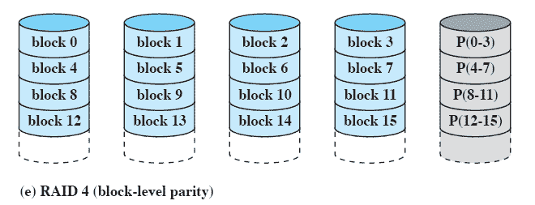
RAID Level 4
Makes use of an independent access technique
A bit-by-bit parity strip is calculated across corresponding strips on each data disk, and the parity bits are stored in the corresponding strip on the parity disk
Involves a write penalty when an I/O write request of small size is performed
Notes:
RAID levels 4 through 6 make use of an independent access technique. In an independent
access array, each member disk operates independently, so that separate
I/O requests can be satisfied in parallel. Because of this, independent access arrays
are more suitable for applications that require high I/O request rates and are relatively
less suited for applications that require high data transfer rates.
As in the other RAID schemes, data striping is used. In the case of RAID
4 through 6, the strips are relatively large. With RAID 4, a bit-by-bit parity strip
is calculated across corresponding strips on each data disk, and the parity bits are
stored in the corresponding strip on the parity disk.
RAID 4 involves a write penalty when an I/O write request of small size is performed.
Each time that a write occurs, the array management software must update
not only the user data but also the corresponding parity bits. Consider an array of
five drives in which X0 through X3 contain data and X4 is the parity disk. Suppose
that a write is performed that only involves a strip on disk X1. Initially, for each bit
i , we have the following relationship:
X4(i) = X3(i) X2(i) X1(i) X0(i) (11.1)
After the update, with potentially altered bits indicated by a prime symbol:
X4=(i) = X3(i) X2(i) X1=(i) X0(i)
= X3(i) X2(i) X1=(i) X0(i) X1(i) X1(i)
= X3(i) X2(i) X1 (i) X0(i) X1(i) X1=(i)
= X4(i) X1(i) X1=(i)
The preceding set of equations is derived as follows. The first line shows that
a change in X1 will also affect the parity disk X4. In the second line, we add the
terms [ X1(i) X1(i)] . Because the exclusive-OR of any quantity with itself
is 0, this does not affect the equation. However, it is a convenience that is used to
create the third line, by reordering. Finally, Equation ( 11.1 ) is used to replace the
first four terms by X4( i ).
To calculate the new parity, the array management software must read the old
user strip and the old parity strip. Then it can update these two strips with the new
data and the newly calculated parity. Thus, each strip write involves two reads and
two writes.
In the case of a larger size I/O write that involves strips on all disk drives, parity
is easily computed by calculation using only the new data bits. Thus, the parity drive
can be updated in parallel with the data drives and there are no extra reads or writes.
In any case, every write operation must involve the parity disk, which therefore
can become a bottleneck.

Slide 26
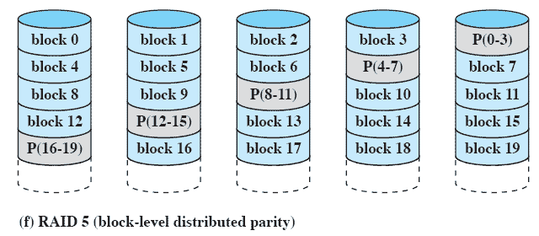
RAID Level 5
Similar to RAID-4 but distributes the parity bits across all disks
Typical allocation is a round-robin scheme
Has the characteristic that the loss of any one disk does not result in data loss
Notes:
RAID 5 is organized in a similar fashion to RAID 4. The difference is that RAID
5 distributes the parity strips across all disks. A typical allocation is a round-robin
scheme, as illustrated in Figure 11.8f . For an n -disk array, the parity strip is on a
different disk for the first n stripes, and the pattern then repeats.
The distribution of parity strips across all drives avoids the potential I/O
bottleneck of the single parity disk found in RAID 4. Further, RAID 5 has the
characteristic that the loss of any one disk does not result in data loss.

Slide 27
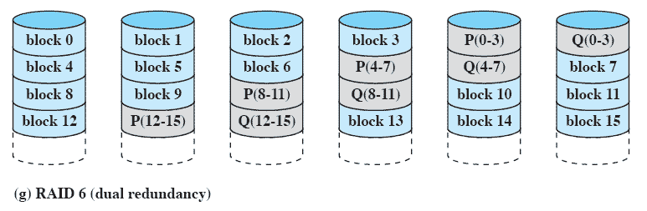
RAID Level 6
Two different parity calculations are carried out and stored in separate blocks on different disks
Provides extremely high data availability
Incurs a substantial write penalty because each write affects two parity blocks
Notes:
RAID 6 was introduced in a subsequent paper by the Berkeley researchers
[KATZ89]. In the RAID 6 scheme, two different parity calculations are carried out
and stored in separate blocks on different disks. Thus, a RAID 6 array whose user
data require N disks consists of N + 2 disks.
Figure 11.8g illustrates the scheme. P and Q are two different data check algorithms.
One of the two is the exclusive-OR calculation used in RAID 4 and 5. But
the other is an independent data check algorithm. This makes it possible to regenerate
data even if two disks containing user data fail.
The advantage of RAID 6 is that it provides extremely high data availability.
Three disks would have to fail within the MTTR (mean time to repair) interval to
cause data to be lost. On the other hand, RAID 6 incurs a substantial write penalty,
because each write affects two parity blocks. Performance benchmarks [EISC07]
show a RAID 6 controller can suffer more than a 30% drop in overall write performance
compared with a RAID 5 implementation. RAID 5 and RAID 6 read
performance is comparable.

Slide 28
Disk Cache
Cache memory is used to apply to a memory that is smaller and faster than main memory and that is interposed between main memory and the processor
Reduces average memory access time by exploiting the principle of locality
Disk cache is a buffer in main memory for disk sectors
Contains a copy of some of the sectors on the disk
when an I/O request is made for a particular sector, a check is made to determine if the sector is in the disk cache
if YES
the request is satisfied via the cache
if NO
the requested sector is read into the disk cache from the disk
Notes:
In Section 1.6 and Appendix 1A, we summarized the principles of cache memory.
The term cache memory is usually used to apply to a memory that is smaller and
faster than main memory and that is interposed between main memory and the
processor. Such a cache memory reduces average memory access time by exploiting
the principle of locality.
The same principle can be applied to disk memory. Specifically, a disk cache
is a buffer in main memory for disk sectors. The cache contains a copy of some of
the sectors on the disk. When an I/O request is made for a particular sector, a check
is made to determine if the sector is in the disk cache. If so, the request is satisfied
via the cache. If not, the requested sector is read into the disk cache from the disk.
Because of the phenomenon of locality of reference, when a block of data is fetched
into the cache to satisfy a single I/O request, it is likely that there will be future
references to that same block.

Slide 29
Least Recently Used
(LRU)
Most commonly used algorithm that deals with the design issue of replacement strategy
The block that has been in the cache the longest with no reference to it is replaced
A stack of pointers reference the cache
  most recently referenced block is on the top of the stack
  when a block is referenced or brought into the cache, it is placed on the top of the stack
Notes:
The most commonly used algorithm is least recently used (LRU)
Replace that block that has been in the cache longest with no reference to it.
The cache consists of a stack of blocks, with the most recently referenced block on the top of the stack.
When a block in the cache is referenced, it is moved from its existing position on the stack to the top of the stack.
When a block is brought in from secondary memory, remove the block that is on the bottom of the stack and push the incoming block onto the top of the stack.
It is not necessary actually to move these blocks around in main memory; a stack of pointers can be associated with the cache.

Slide 30
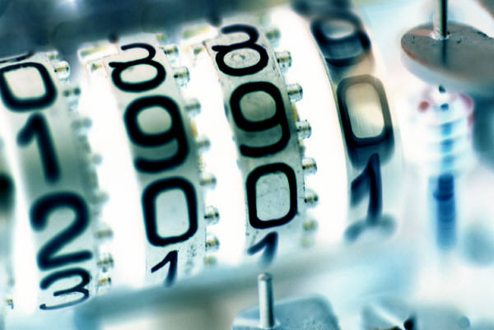
Least Frequently Used (LFU)
The block that has experienced the fewest references is replaced
A counter is associated with each block
Counter is incremented each time block is accessed
When replacement is required, the block with the smallest count is selected
Notes:
Another possibility is least frequently used (LFU) : Replace that block in the
set that has experienced the fewest references. LFU could be implemented by associating
a counter with each block. When a block is brought in, it is assigned a count
of 1; with each reference to the block, its count is incremented by 1. When replacement
is required, the block with the smallest count is selected. Intuitively, it might
seem that LFU is more appropriate than LRU because LFU makes use of more
pertinent information about each block in the selection process.
A simple LFU algorithm has the following problem. It may be that certain
blocks are referenced relatively infrequently overall, but when they are referenced,
there are short intervals of repeated references due to locality, thus building up
high reference counts. After such an interval is over, the reference count may be
misleading and not reflect the probability that the block will soon be referenced
again. Thus, the effect of locality may actually cause the LFU algorithm to make
poor replacement choices.

Slide 31
Summary
I/O architecture is the computer system’s interface to the outside world
  Disk I/O has the greatest impact on overall system performance
  Two of the most widely used approaches are disk scheduling and the disk cache
  A disk cache is a buffer, usually kept in main memory, that functions as a cache of disk block between disk memory and the rest of main memory
Notes:
The computer system’s interface to the outside world is its I/O architecture. This
architecture is designed to provide a systematic means of controlling interaction
with the outside world and to provide the operating system with the information it
needs to manage I/O activity effectively.
The I/O function is generally broken up into a number of layers, with lower
layers dealing with details that are closer to the physical functions to be performed
and higher layers dealing with I/O in a logical and generic fashion. The result is that
changes in hardware parameters need not affect most of the I/O software.
A key aspect of I/O is the use of buffers that are controlled by I/O utilities
rather than by application processes. Buffering smoothes out the differences
between the internal speeds of the computer system and the speeds of I/O devices.
The use of buffers also decouples the actual I/O transfer from the address space
of the application process. This allows the operating system more flexibility in
performing its memory-management function.
The aspect of I/O that has the greatest impact on overall system performance
is disk I/O. Accordingly, there has been greater research and design effort in this
area than in any other kind of I/O. Two of the most widely used approaches to
improve disk I/O performance are disk scheduling and the disk cache.
At any time, there may be a queue of requests for I/O on the same disk. It is
the object of disk scheduling to satisfy these requests in a way that minimizes the
mechanical seek time of the disk and hence improves performance. The physical
layout of pending requests plus considerations of locality come into play.
A disk cache is a buffer, usually kept in main memory, that functions as a
cache of disk blocks between disk memory and the rest of main memory. Because
of the principle of locality, the use of a disk cache should substantially reduce the
number of block I/O transfers between main memory and disk.

