Slide 1
Chapter 4 Threads
Operating Systems: Internals and Design Principles
Seventh Edition
By William Stallings
Notes:
“Operating Systems: Internal and Design Principles”, 7/e, by William Stallings, Chapter 4 “Threads”.

Slide 2
Processes and Threads
Traditional processes have two characteristics:
Resource Ownership
Scheduling/Execution
Process includes a virtual address space to hold the process image
the OS provides protection to prevent unwanted interference between processes with respect to resources
Follows an execution path that may be interleaved with other processes
a process has an execution state (Running, Ready, etc.) and a dispatching priority and is scheduled and dispatched by the OS
Traditional processes are sequential; i.e. only one execution path

Slide 3
Processes and Threads
Multithreading - The ability of an OS to support multiple, concurrent paths of execution within a single process
The unit of resource ownership is referred to as a process or task
The unit of dispatching is referred to as a thread or lightweight process
Notes:
To distinguish the two characteristics, the unit of dispatching is usually referred to as a thread or lightweight process , while the unit of resource ownership is usually referred to as a process or task .
Multithreading refers to the ability of an OS to support multiple, concurrent paths of execution within a single process.

Slide 4
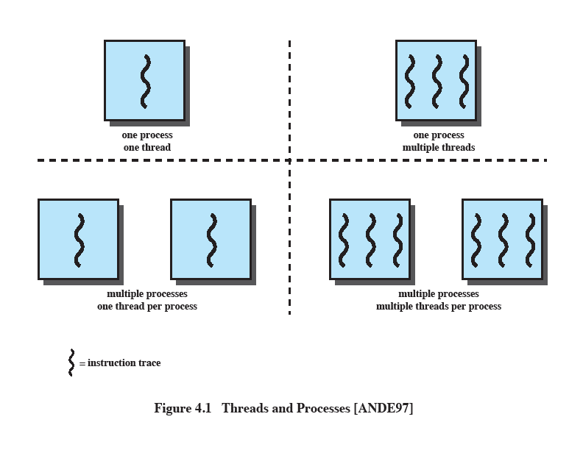
Single Threaded Approaches
A single execution path per process, in which the concept of a thread is not recognized, is referred to as a single-threaded approach
MS-DOS, some versions of UNIX supported only this type of process.
Notes:
The traditional approach of a single thread of execution per process, in which the concept of a thread is not recognized, is referred to as a single-threaded approach. The two arrangements shown in the left half of Figure 4.1 are single-threaded approaches. MS-DOS is an example of an OS that supports a single user process and a single thread.

Slide 5
Multithreaded Approaches
The right half of Figure 4.1 depicts multithreaded approaches
A Java run-time environment is a system of one process with multiple threads; Windows, some UNIXes, support multiple multithreaded processes.
Notes:
The right half of Figure 4.1 depicts multithreaded approaches. A Java run-time environment is an example of a system of one process with multiple threads. Of interest in this section is the use of multiple processes, each of which supports multiple threads. This approach is taken in Windows, Solaris, and many modern versions of UNIX, among others. In this section we give a general description of multithreading; the details of the Windows, Solaris, and Linux approaches are discussed later in this chapter.

Slide 6
Processes
In a multithreaded environment the process is the unit that owns resources and the unit of protection.
i.e., the OS provides protection at the process level
Processes have
A virtual address space that holds the process image
Protected access to
processors
other processes
files
I/O resources
Notes:
In a multithreaded environment, a process is defined as the unit of resource allocation and a unit of protection. The following are associated with processes:
• A virtual address space that holds the process image
• Protected access to processors, other processes (for interprocess communication), files, and I/O resources (devices and channels)

Slide 7
One or More Threads in a Process
Each thread has:
an execution state (Running, Ready, etc.)
saved thread context when not running (TCB)
an execution stack
some per-thread static storage for local variables
access to the shared memory and resources of its process (all threads of a process share this)
Notes:
Within a process, there may be one or more threads, each with the following:
• A thread execution state (Running, Ready, etc.)
• A saved thread context when not running; one way to view a thread is as an independent program counter operating within a process
• An execution stack
• Some per-thread static storage for local variables
• Access to the memory and resources of its process, shared with all other threads in that process

Slide 8
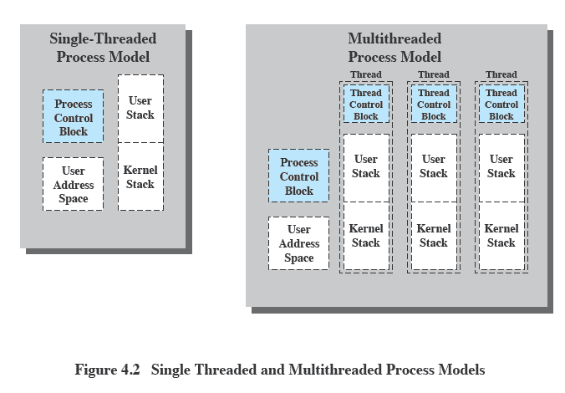
Threads vs. Processes
Notes:
Figure 4.2 illustrates the distinction between threads and processes from the point of view of process management. In a single-threaded process model (i.e., there is no distinct concept of thread), the representation of a process includes its process control block and user address space, as well as user and kernel stacks to manage the call/return behavior of the execution of the process. While the process is running, it controls the processor registers. The contents of these registers are saved when the process is not running. In a multithreaded environment, there is still a single process control block and user address space associated with the process, but now there are separate stacks for each thread, as well as a separate control block for each thread containing register values, priority, and other thread-related state information.

Slide 9
Benefits of Threads
Takes less time to create a new thread than a process
Less time to terminate a thread than a process
Switching between two threads takes less time than switching between processes
Threads enhance efficiency in communication between programs
Notes:
Thus, all of the threads of a process share the state and resources of that process. They reside in the same address space and have access to the same data. When one thread alters an item of data in memory, other threads see the results if and when they access that item. If one thread opens a file with read privileges, other threads in the same process can also read from that file.
The key benefits of threads derive from the performance implications:
1. It takes far less time to create a new thread in an existing process than to
create a brand-new process. Studies done by the Mach developers show that
thread creation is ten times faster than process creation in UNIX [TEVA87].
2. It takes less time to terminate a thread than a process.
3. It takes less time to switch between two threads within the same process than to switch between processes.
4. Threads enhance efficiency in communication between different executing programs. In most operating systems, communication between independent processes requires the intervention of the kernel to provide protection and the mechanisms needed for communication. However, because threads within the same process share memory and files, they can communicate with each other without invoking the kernel.
Thus, if there is an application or function that should be implemented as a set of related units of execution, it is far more efficient to do so as a collection of threads rather than a collection of separate processes.

Slide 10
Thread Use in a Single-User System
Foreground and background work
Asynchronous processing
Speed of execution
Modular program structure
Notes:
[LETW88] gives four examples of the uses of threads in a single-user multiprocessing system:
• Foreground and background work: For example, in a spreadsheet program,
one thread could display menus and read user input, while another thread executes user commands and updates the spreadsheet. This arrangement often increases the perceived speed of the application by allowing the program to prompt for the next command before the previous command is complete.
• Asynchronous processing: Asynchronous elements in the program can be
implemented as threads. For example, as a protection against power failure, one can design a word processor to write its random access memory (RAM) buffer to disk once every minute. A thread can be created whose sole job is periodic backup and that schedules itself directly with the OS; there is no need for fancy code in the main program to provide for time checks or to coordinate input and output.
• Speed of execution: A multithreaded process can compute one batch of data
while reading the next batch from a device. On a multiprocessor system, multiple threads from the same process may be able to execute simultaneously. Thus, even though one thread may be blocked for an I/O operation to read in a batch of data, another thread may be executing.
• Modular program structure: Programs that involve a variety of activities or a
variety of sources and destinations of input and output may be easier to design and implement using threads.

Slide 11
Threads
Most of the state information dealing with execution is maintained in thread-level data structures
In an OS that supports threads, scheduling and dispatching is done on a thread basis
suspending a process involves suspending all threads of the process
termination of a process terminates all threads within the process
Notes:
In an OS that supports threads, scheduling and dispatching is done on a thread basis; hence, most of the state information dealing with execution is maintained in thread-level data structures. There are, however, several actions that affect all of the threads in a process and that the OS must manage at the process level. For example, suspension involves swapping the address space of one process out of main memory to make room for the address space of another process. Because all threads in a process share the same address space, all threads are suspended at the same time. Similarly, termination of a process terminates all threads within that process.

Slide 12
Thread Execution States
Thread operations associated with a change in thread state are:
Spawn (create)
Block
Unblock
Finish
The key states for
a thread are:
Running
Ready
Blocked
Notes:
THREAD STATES
As with processes, the key states for a thread are Running, Ready, and Blocked. Generally, it does not make sense to associate suspend states with threads because such states are process-level concepts. In particular, if a process is swapped out, all of its threads are necessarily swapped out because they all share the address space of the process. There are four basic thread operations associated with a change in thread state [ANDE04]:
• Spawn: Typically, when a new process is spawned, a thread for that process is also spawned. Subsequently, a thread within a process may spawn another thread within the same process, providing an instruction pointer and arguments for the new thread. The new thread is provided with its own register context and stack space and placed on the ready queue.
• Block: When a thread needs to wait for an event, it will block (saving its user registers, program counter, and stack pointers). The processor may now turn to the execution of another ready thread in the same or a different process.
• Unblock: When the event for which a thread is blocked occurs, the thread is moved to the Ready queue.
• Finish: When a thread completes, its register context and stacks are deallocated.

Slide 13
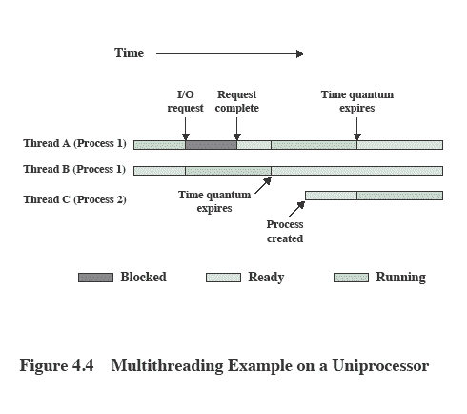
Multithreading on a Uniprocessor
Notes:
On a uniprocessor, multiprogramming enables the interleaving of multiple threads within multiple processes. In the example of Figure 4.4 , three threads in two processes are interleaved on the processor. Execution passes from one thread to another either when the currently running thread is blocked or when its time slice is exhausted.

Slide 14
Thread Synchronization
It is necessary to synchronize the activities of the various threads
all threads of a process share the same address space and other resources
any alteration of a resource by one thread affects the other threads in the same process
Notes:
THREAD SYNCHRONIZATION
All of the threads of a process share the same address space and other resources, such as open files. Any alteration of a resource by one thread affects the environment of the other threads in the same process. It is therefore necessary to synchronize the activities of the various threads so that they do not interfere with each other or corrupt data structures. For example, if two threads each try to add an element to a doubly linked list at the same time, one element may be lost or the list may end up malformed. The issues raised and the techniques used in the synchronization of threads are, in general, the same as for the synchronization of processes. These issues and techniques are the subject of Chapters 5 and 6 .

Slide 15
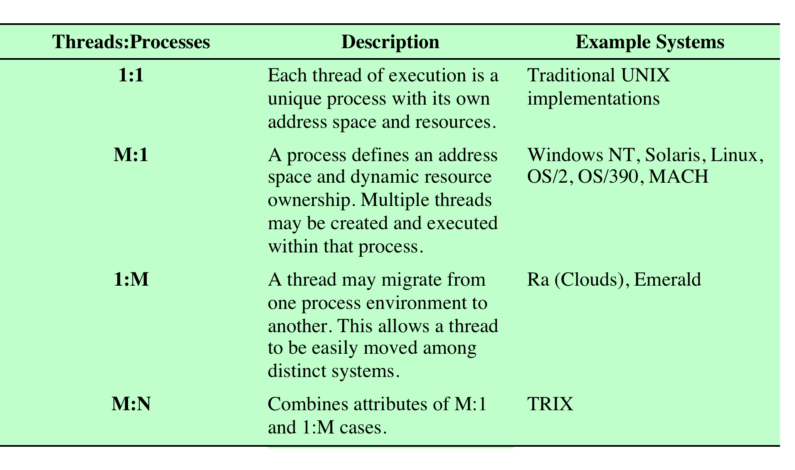
Relationship Between Threads and Processes
Table 4.2 Relationship between Threads and Processes
Notes:
As we have said, the concepts of resource allocation and dispatching unit have traditionally been embodied in the single concept of the process—that is, as a 1 : 1
relationship between threads and processes. Recently, there has been much interest in providing for multiple threads within a single process, which is a many-toone
relationship. However, as Table 4.2 shows, the other two combinations have also been investigated, namely, a many-to-many relationship and a one-to-many relationship.
The idea of having a many-to-many relationship between threads and processes has been explored in the experimental operating system TRIX [PAZZ92, WARD80]. In TRIX, there are the concepts of domain and thread. A domain is a static entity, consisting of an address space and “ports” through which messages may be sent and received. A thread is a single execution path, with an execution stack, processor state, and scheduling information.
As with the multithreading approaches discussed so far, multiple threads may execute in a single domain, providing the efficiency gains discussed earlier. However, it is also possible for a single user activity, or application, to be performed in multiple domains. In this case, a thread exists that can move from one domain to another.

Slide 16
Multiple Cores & Multithreading
Multithreading and multicore chips have the potential to improve performance of applications that have large amounts of parallelism
Gaming, simulations, etc. are examples
Performance doesn’t necessarily scale linearly with the number of cores …
Notes:
The potential performance benefits of a multicore organization depend on the ability to effectively exploit the parallel resources available to the application. Let us focus first on a single application running on a multicore system. Amdahl’s law (see Appendix E ) states that:
Speedup = time to execute program on a single processor time to execute program on N parallel processors
= 1 (1 - f ) + f N
The law assumes a program in which a fraction (1 - f) of the execution time involves code that is inherently serial and a fraction f that involves code that is infinitely
parallelizable with no scheduling overhead. This law appears to make the prospect of a multicore organization attractive. But as Figure 4.7a shows, even a small amount of serial code has a noticeable impact. If only 10% of the code is inherently serial ( f = 0.9) , running the program on a multicore system with eight processors yields a performance gain of only a factor of 4.7. In addition, software typically incurs overhead as a result of communication and distribution of work to multiple processors and cache coherence overhead. This
results in a curve where performance peaks and then begins to degrade because of the increased burden of the overhead of using multiple processors. Figure 4.7b ,
from [MCDO07], is a representative example.
However, software engineers have been addressing this problem and there are numerous applications in which it is possible to effectively exploit a multicore system. [MCDO07] reports on a set of database applications, in which great attention

Slide 17
Amdahl’s Law
Speedup depends on the amount of code that must be executed sequentially
Formula:
Speedup = time to run on single processor
time to execute on N || processors
1
= (1 – f) + f / N
(where f is the amount of parallelizable code)
Notes:
The potential performance benefits of a multicore organization depend on the ability to effectively exploit the parallel resources available to the application. Let us focus first on a single application running on a multicore system. Amdahl’s law (see Appendix E ) states that:
Speedup = time to execute program on a single processor time to execute program on N parallel processors
= 1 (1 - f ) + f N
The law assumes a program in which a fraction (1 - f) of the execution time involves code that is inherently serial and a fraction f that involves code that is infinitely
parallelizable with no scheduling overhead. This law appears to make the prospect of a multicore organization attractive. But as Figure 4.7a shows, even a small amount of serial code has a noticeable impact. If only 10% of the code is inherently serial ( f = 0.9) , running the program on a multicore system with eight processors yields a performance gain of only a factor of 4.7. In addition, software typically incurs overhead as a result of communication and distribution of work to multiple processors and cache coherence overhead. This
results in a curve where performance peaks and then begins to degrade because of the increased burden of the overhead of using multiple processors. Figure 4.7b ,
from [MCDO07], is a representative example.
However, software engineers have been addressing this problem and there are numerous applications in which it is possible to effectively exploit a multicore system. [MCDO07] reports on a set of database applications, in which great attention

Slide 18
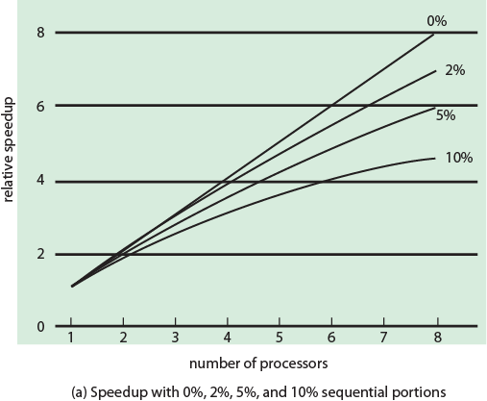
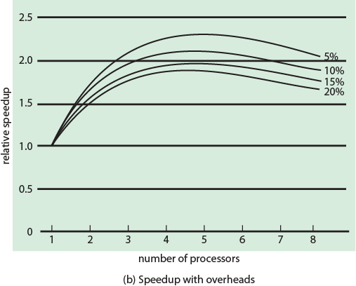
Performance Effect of Multiple Cores
Figure 4.7 (a)
Figure 4.7 (b)
Notes:
The potential performance benefits of a multicore organization depend on the ability to effectively exploit the parallel resources available to the application. Let us focus first on a single application running on a multicore system. Amdahl’s law (see Appendix E ) states that:
Speedup = time to execute program on a single processor time to execute program on N parallel processors
= 1 (1 - f ) + f N
The law assumes a program in which a fraction (1 - f) of the execution time involves code that is inherently serial and a fraction f that involves code that is infinitely
parallelizable with no scheduling overhead. This law appears to make the prospect of a multicore organization attractive. But as Figure 4.7a shows, even a small amount of serial code has a noticeable impact. If only 10% of the code is inherently serial ( f = 0.9) , running the program on a multicore system with eight processors yields a performance gain of only a factor of 4.7. In addition, software typically incurs overhead as a result of communication and distribution of work to multiple processors and cache coherence overhead. This
results in a curve where performance peaks and then begins to degrade because of the increased burden of the overhead of using multiple processors. Figure 4.7b ,
from [MCDO07], is a representative example.
However, software engineers have been addressing this problem and there are numerous applications in which it is possible to effectively exploit a multicore system. [MCDO07] reports on a set of database applications, in which great attention

Slide 19
Windows Processes
Processes and services provided by the Windows Kernel are relatively simple and general purpose
implemented as objects
created as new process or a copy of an existing
an executable process may contain one or more threads
both processes and thread objects have built-in synchronization capabilities
Notes:
Windows process design is driven by the need to provide support for a variety of OS environments. Processes supported by different OS environments differ in a number
of ways, including the following:
• How processes are named
• Whether threads are provided within processes
• How processes are represented
• How process resources are protected
• What mechanisms are used for interprocess communication and synchronization
• How processes are related to each other
Accordingly, the native process structures and services provided by the Windows Kernel are relatively simple and general purpose, allowing each OS subsystem to emulate a particular process structure and functionality. Important characteristics of Windows processes are the following:
• Windows processes are implemented as objects.
• A process can be created as new process, or as a copy of an existing process.
• An executable process may contain one or more threads.
• Both process and thread objects have built-in synchronization capabilities.

Slide 20
Process and Thread Objects
Windows makes use of two types of process-related objects:
Processes
an entity corresponding to a user job or application that owns resources
Threads
a dispatchable unit of work that executes sequentially and is interruptible
Notes:
The object-oriented structure of Windows facilitates the development of a general- purpose process facility. Windows makes use of two types of process-related objects: processes and threads. A process is an entity corresponding to a user job or application that owns resources, such as memory and open files. A thread is a dispatchable unit of work that executes sequentially and is interruptible, so that the processor can turn to another thread.

Slide 21
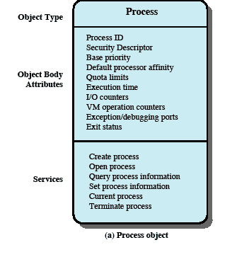
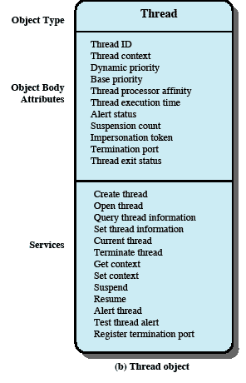
Windows Process and Thread Objects
Notes:
Each Windows process is represented by an object whose general structure is shown in Figure 4.11a . Each process is defined by a number of attributes and encapsulates a number of actions, or services, that it may perform. A process will perform a service when called upon through a set of published interface methods. When Windows creates a new process, it uses the object class, or type, defined for the Windows process as a template to generate a new object instance. At the time of creation, attribute values are assigned.
Figure 4.11b depicts the object structure for a thread object.

Slide 22
Multithreaded Process
Achieves concurrency without the overhead of using multiple processes
Threads within the same process can exchange information through their common address space and have access to the shared resources of the process
Threads in different processes can exchange information through shared memory that has been set up between the two processes
Notes:
Windows supports concurrency among processes because threads in different processes may execute concurrently (appear to run at the same time). Moreover, multiple threads within the same process may be allocated to separate processors and execute simultaneously (actually run at the same time). A multithreaded process achieves concurrency without the overhead of using multiple processes. Threads within the same process can exchange information through their common address space and have access to the shared resources of the process. Threads in different processes can exchange information through shared memory that has been set up between the two processes.
An object-oriented multithreaded process is an efficient means of implementing a server application. For example, one server process can service a number of clients concurrently.

Slide 23
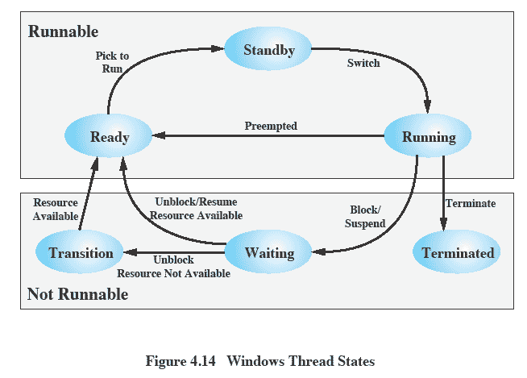
Thread States
Figure 4.12 Windows Thread States
Notes:
An existing Windows thread is in one of six states ( Figure 4.12 ):
• Ready: A ready thread may be scheduled for execution. The Kernel dispatcher
keeps track of all ready threads and schedules them in priority order.
• Standby: A standby thread has been selected to run next on a particular processor.
The thread waits in this state until that processor is made available. If the standby thread’s priority is high enough, the running thread on that processor may be preempted in favor of the standby thread. Otherwise, the standby thread waits until the running thread blocks or exhausts its time slice.
• Running: Once the Kernel dispatcher performs a thread switch, the standby
thread enters the Running state and begins execution and continues execution until it is preempted by a higher-priority thread, exhausts its time slice, blocks, or terminates. In the first two cases, it goes back to the Ready state.
• Waiting: A thread enters the Waiting state when (1) it is blocked on an event
(e.g., I/O), (2) it voluntarily waits for synchronization purposes, or (3) an environment subsystem directs the thread to suspend itself. When the waiting
condition is satisfied, the thread moves to the Ready state if all of its resources are available.
• Transition: A thread enters this state after waiting if it is ready to run but the
resources are not available. For example, the thread’s stack may be paged out of memory. When the resources are available, the thread goes to the Ready state.
• Terminated: A thread can be terminated by itself, by another thread, or when
its parent process terminates. Once housekeeping chores are completed, the thread is removed from the system, or it may be retained by the Executive 6 for future re-initialization.

Slide 24
Linux Tasks
A process, or task, in Linux is represented by a task_struct data structure
This structure contains information in a number of categories
Notes:
A process, or task, in Linux is represented by a task_struct data structure. The task_struct data structure contains information in a number of categories:
• State:
The execution state of the process (executing, ready, suspended, stopped, zombie). This is described subsequently.
• Scheduling information:
Information needed by Linux to schedule processes. A process can be normal or real time and has a priority. Real-time processes are scheduled before normal processes, and within each category, relative priorities can be used. A counter keeps track of the amount of time a process is allowed to execute.
• Identifiers:
Each process has a unique process identifier and also has user and group identifiers. A group identifier is used to assign resource access privileges to a group of processes.
• Interprocess communication:
Linux supports the IPC mechanisms found in UNIX SVR4, described in Chapter 6 .
• Links:
Each process includes a link to its parent process, links to its siblings (processes with the same parent), and links to all of its children.
Times and timers:
Includes process creation time and the amount of processor time so far consumed by the process. A process may also have associated one or more interval timers. A process defines an interval timer by means of a system call; as a result, a signal is sent to the process when the timer expires. A timer may be single use or periodic.
• File system:
Includes pointers to any files opened by this process, as well as pointers to the current and the root directories for this process.
• Address space:
Defines the virtual address space assigned to this process.
• Processor-specific context:
The registers and stack information that constitute the context of this process.

Slide 25
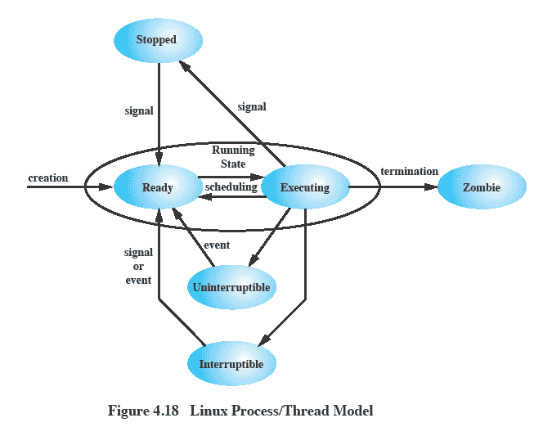
Linux Process/Thread Model
Figure 4.16 Linux Process/Thread Model
Notes:
Running:
Corresponds to two states.
A Running process is either executing or
it is ready to execute.
Interruptible:
A blocked state, in which the process is waiting for an event, such as the end of an I/O operation, the availability of a resource, or a signal from another process.
Uninterruptible:
Another blocked state.
The difference between the Interruptible state is that in this state, a process is waiting directly on hardware conditions and therefore will not handle any signals.
Stopped:
The process has been halted and can only resume by positive action from another process.
E.G., a process that is being debugged can be put into the Stopped state.
Zombie:
The process has been terminated but, for some reason, still must have its task structure in the process table.

Slide 26
Linux Threads
Linux does not recognize a distinction between threads and processes
User-level threads are mapped into kernel-level processes
A new process is created by copying the attributes of the current process
The new process can be cloned so that it shares resources
The clone() call creates separate stack spaces for each process
Notes:
Traditional UNIX systems support a single thread of execution per process, while modern UNIX systems typically provide support for multiple kernel-level threads per process. As with traditional UNIX systems, older versions of the Linux kernel offered no support for multithreading. Instead, applications would need to be written with a set of user-level library functions, the most popular of which is known as pthread (POSIX thread) libraries , with all of the threads mapping into a single kernel-level process. 8 We have seen that modern versions of UNIX offer kernel-level threads. Linux provides a unique solution in that it does not recognize a distinction between threads and processes. Using a mechanism similar to the lightweight processes of Solaris, user-level threads are mapped into kernel-level processes. Multiple user-level threads that constitute a single user-level process are mapped into Linux kernel-level processes that share the same group ID. This enables these processes to share resources such as files and memory and to avoid the need for a context switch when the scheduler switches among processes in the same group.
A new process is created in Linux by copying the attributes of the current process. A new process can be cloned so that it shares resources, such as files, signal handlers, and virtual memory. When the two processes share the same virtual memory, they function as threads within a single process. However, no separate type of data structure is defined for a thread. In place of the usual fork() command, processes are created in Linux using the clone() command. This command includes a set of flags as arguments, defined in Table 4.5 . The traditional fork() system call is implemented by Linux as a clone() system call with all of the clone flags cleared.
When the Linux kernel performs a switch from one process to another, it checks whether the address of the page directory of the current process is the same as that of the to-be-scheduled process. If they are, then they are sharing the same address space, so that a context switch is basically just a jump from one location of code to another location of code.
Although cloned processes that are part of the same process group can share the same memory space, they cannot share the same user stacks. Thus the clone() call creates separate stack spaces for each process.

