Slide 1
Chapter 2
Operating System Overview
Operating Systems:
Internals and Design Principles
Seventh Edition
By William Stallings
Notes:
“Operating Systems: Internal and Design Principles”, 7/e, by William Stallings, Chapter 2 “Operating System Overview”.

Slide 2
Operating System
An interface between applications and computer
A program that controls the execution of application programs and the allocation of system resources
Main objectives of an OS:
Convenience
Efficiency
Ability to evolve
Notes:
An OS is a program that controls the execution of application programs and acts as
an interface between applications and the computer hardware. It can be thought of
as having three objectives:
• Convenience: An OS makes a computer more convenient to use.
• Efficiency: An OS allows the computer system resources to be used in an efficient
manner.
• Ability to evolve: An OS should be constructed in such a way as to permit the
effective development, testing, and introduction of new system functions without
interfering with service.

Slide 3
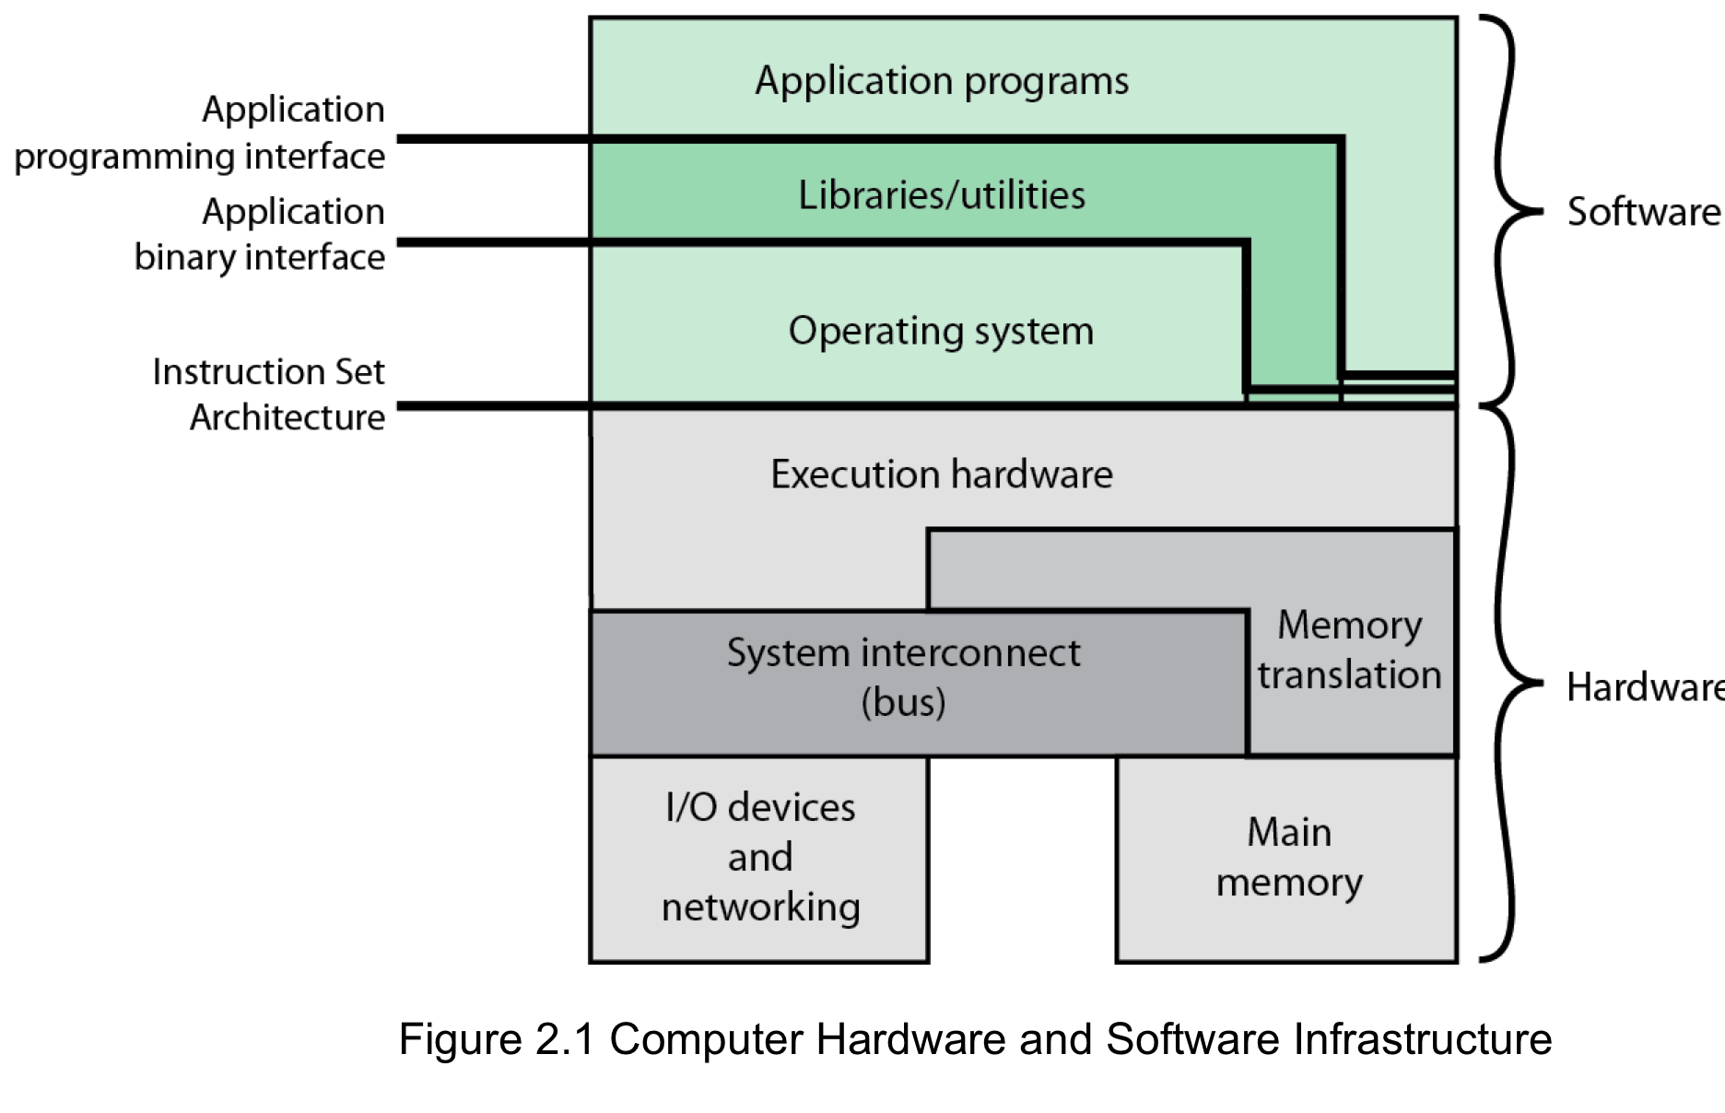
Computer Hardware and Software Infrastructure
Notes:
The Operating System as a User/Computer Interface
The hardware and software used in providing applications to a user can be viewed
in a layered or hierarchical fashion, as depicted in Figure 2.1 . The user of those
applications, the end user, generally is not concerned with the details of computer
hardware. Thus, the end user views a computer system in terms of a set of applications.
An application can be expressed in a programming language and is developed
by an application programmer. If one were to develop an application program as a
set of machine instructions that is completely responsible for controlling the computer
hardware, one would be faced with an overwhelmingly complex undertaking.
To ease this chore, a set of system programs is provided. Some of these programs
are referred to as utilities, or library programs. These implement frequently used
functions that assist in program creation, the management of files, and the control of
I/O devices. A programmer will make use of these facilities in developing an application,
and the application, while it is running, will invoke the utilities to perform
certain functions. The most important collection of system programs comprises the
OS. The OS masks the details of the hardware from the programmer and provides
the programmer with a convenient interface for using the system. It acts as mediator,
making it easier for the programmer and for application programs to access and
use those facilities and services.

Slide 4
Efficiency:The Operating System As a Resource Manager
A computer is a set of resources for moving, storing, & processing data
The OS is responsible for managing these resources
The OS exercises its control
through software
Notes:
A computer is a set of resources for the movement, storage, and processing of data
and for the control of these functions. The OS is responsible for managing these
resources.

Slide 5
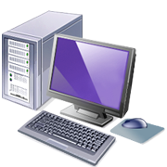
Operating System as Software
Functions in the same way as ordinary computer software
Program, or suite of programs, executed by the processor
Frequently relinquishes control and must be able to regain control to decide on the next thing the processor should do.
Notes:
The OS, as a control mechanism is unusual in two respects:
• The OS functions in the same way as ordinary computer software; that is, it is
a program or suite of programs executed by the processor.
• The OS frequently relinquishes control and must depend on the processor to
allow it to regain control.
Like other computer programs, the OS provides instructions for the processor.
The key difference is in the intent of the program. The OS directs the processor
in the use of the other system resources and in the timing of its execution of other
programs. But in order for the processor to do any of these things, it must cease
executing the OS program and execute other programs. Thus, the OS relinquishes
control for the processor to do some “useful” work and then resumes control long
enough to prepare the processor to do the next piece of work. The mechanisms
involved in all this should become clear as the chapter proceeds.

Slide 6
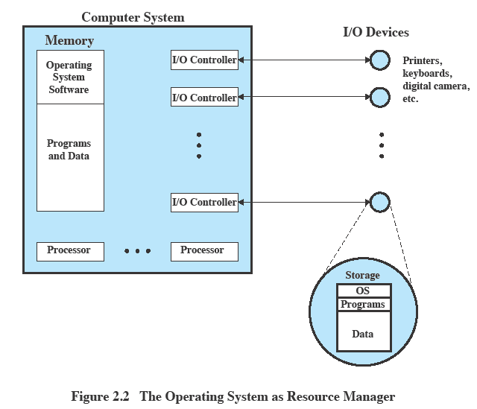
Operating
System as
Resource Manager
Notes:
Figure 2.2 suggests the main resources that are managed by the OS. A portion
of the OS is in main memory. This includes the kernel , or nucleus , which contains
the most frequently used functions in the OS and, at a given time, other portions
of the OS currently in use. The remainder of main memory contains user programs
and data. The memory management hardware in the processor and the OS jointly
control the allocation of main memory, as we shall see. The OS decides when an I/O
device can be used by a program in execution and controls access to and use of files.
The processor itself is a resource, and the OS must determine how much processor
time is to be devoted to the execution of a particular user program. In the case of a
multiple-processor system, this decision must span all of the processors.

Slide 7
Evolution of
Operating Systems
Stages include:
Serial Processing
Simple Batch Systems
Multiprogrammed Batch Systems
Time Sharing Systems
Notes:
In attempting to understand the key requirements for an OS and the significance of the major features of a contemporary OS, it is useful to consider how operating systems have evolved over the years.

Slide 8
Serial Processing
Earliest Computers:
Problems:
Scheduling:
  most installations used a hardcopy sign-up sheet to reserve computer time
      time allocations could run short or long, resulting in wasted computer time
      Setup time
  a considerable amount of time was spent just on setting up the program to run
No operating system
    programmers interacted directly with the computer hardware
Computers ran from a console with display lights, toggle switches, some form of input device, and a printer
Users had access to the computer in “series”
Notes:
With the earliest computers, from the late 1940s to the mid-1950s, the programmer
interacted directly with the computer hardware; there was no OS. These computers
were run from a console consisting of display lights, toggle switches, some form of
input device, and a printer. Programs in machine code were loaded via the input
device (e.g., a card reader). If an error halted the program, the error condition was
indicated by the lights. If the program proceeded to a normal completion, the output
appeared on the printer.
These early systems presented two main problems:
• Scheduling : Most installations used a hardcopy sign-up sheet to reserve computer
time. Typically, a user could sign up for a block of time in multiples of a
half hour or so. A user might sign up for an hour and finish in 45 minutes; this
would result in wasted computer processing time. On the other hand, the user
might run into problems, not finish in the allotted time, and be forced to stop
before resolving the problem.
• Setup time: A single program, called a job , could involve loading the compiler
plus the high-level language program (source program) into memory,
saving the compiled program (object program) and then loading and linking
together the object program and common functions. Each of these steps could
involve mounting or dismounting tapes or setting up card decks. If an error
occurred, the hapless user typically had to go back to the beginning of the
setup sequence. Thus, a considerable amount of time was spent just in setting
up the program to run.
This mode of operation could be termed serial processing , reflecting the fact
that users have access to the computer in series. Over time, various system software
tools were developed to attempt to make serial processing more efficient. These
include libraries of common functions, linkers, loaders, debuggers, and I/O driver
routines that were available as common software for all users.

Slide 9
Simple Batch Systems
Early computers were very expensive
  important to maximize processor utilization
Monitor (primitive operating system)
  user no longer has direct access to processor
  job is submitted to computer operator who batches them together and places them on an input device
Notes:
Early computers were very expensive, and therefore it was important to maximize
processor utilization. The wasted time due to scheduling and setup time was
unacceptable.
To improve utilization, the concept of a batch OS was developed. It appears
that the first batch OS (and the first OS of any kind) was developed in the mid-1950s
by General Motors for use on an IBM 701 [WEIZ81]. The concept was subsequently
refined and implemented on the IBM 704 by a number of IBM customers. By the
early 1960s, a number of vendors had developed batch operating systems for their
computer systems. IBSYS, the IBM OS for the 7090/7094 computers, is particularly
notable because of its widespread influence on other systems.
The central idea behind the simple batch-processing scheme is the use of a
piece of software known as the monitor . With this type of OS, the user no longer has
direct access to the processor. Instead, the user submits the job on cards or tape to a
computer operator, who batches the jobs together sequentially and places the entire
batch on an input device, for use by the monitor. Each program is constructed to
branch back to the monitor when it completes processing, at which point the monitor
automatically begins loading the next program.

Slide 10
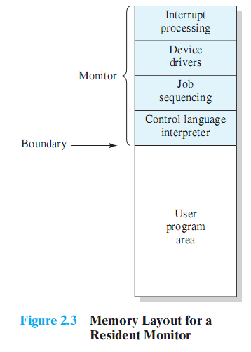
Monitor Point of View
Monitor controls the sequence of events
Resident Monitor is software always in memory
Monitor reads in job and gives control
Job returns control to monitor
Notes:
Monitor point of view: The monitor controls the sequence of events. For this
to be so, much of the monitor must always be in main memory and available
for execution ( Figure 2.3 ). That portion is referred to as the resident monitor .
The rest of the monitor consists of utilities and common functions that are
loaded as subroutines to the user program at the beginning of any job that
requires them. The monitor reads in jobs one at a time from the input device
(typically a card reader or magnetic tape drive). As it is read in, the current job
is placed in the user program area, and control is passed to this job. When the
job is completed, it returns control to the monitor, which immediately reads
in the next job. The results of each job are sent to an output device, such as a
printer, for delivery to the user.

Slide 11

Desirable Hardware
Features
Memory protection for monitor
while the user program is executing, it must not alter the memory area containing the monitor
Timer
prevents a job from monopolizing the system
Privileged instructions
can only be executed by the monitor
Interrupts
gives OS more flexibility in controlling user programs
Notes:
The monitor, or batch OS, is simply a computer program. It relies on the ability
of the processor to fetch instructions from various portions of main memory to
alternately seize and relinquish control. Certain other hardware features are also
desirable:
• Memory protection: While the user program is executing, it must not alter the
memory area containing the monitor. If such an attempt is made, the processor
hardware should detect an error and transfer control to the monitor. The
monitor would then abort the job, print out an error message, and load in the
next job.
• Timer: A timer is used to prevent a single job from monopolizing the system.
The timer is set at the beginning of each job. If the timer expires, the user program
is stopped, and control returns to the monitor.
• Privileged instructions : Certain machine level instructions are designated privileged
and can be executed only by the monitor. If the processor encounters
such an instruction while executing a user program, an error occurs causing
control to be transferred to the monitor. Among the privileged instructions
are I/O instructions, so that the monitor retains control of all I/O devices. This
prevents, for example, a user program from accidentally reading job control
instructions from the next job. If a user program wishes to perform I/O, it must
request that the monitor perform the operation for it.
Interrupts : Early computer models did not have this capability. This feature
gives the OS more flexibility in relinquishing control to and regaining control
from user programs.

Slide 12
Modes of Operation
User Mode
user program executes in user mode
certain areas of memory are protected from user access
certain instructions may not be executed
Kernel Mode
monitor executes in kernel mode
privileged instructions may be executed
protected areas of memory may be accessed
Notes:
Considerations of memory protection and privileged instructions lead to the
concept of modes of operation. A user program executes in a user mode , in which
certain areas of memory are protected from the user’s use and in which certain
instructions may not be executed. The monitor executes in a system mode, or what
has come to be called kernel mode , in which privileged instructions may be executed
and in which protected areas of memory may be accessed.
Of course, an OS can be built without these features. But computer vendors
quickly learned that the results were chaos, and so even relatively primitive batch
operating systems were provided with these hardware features.

Slide 13
Simple Batch System Overhead
Processor time alternates between execution of user programs and execution of the monitor
Sacrifices:
  some main memory is now given over to the monitor
  some processor time is consumed by the monitor
Despite overhead, the simple batch system improves utilization of the computer.
Notes:
With a batch OS, processor time alternates between execution of user programs
and execution of the monitor. There have been two sacrifices: Some main
memory is now given over to the monitor and some processor time is consumed by
the monitor. Both of these are forms of overhead. Despite this overhead, the simple
batch system improves utilization of the computer.

Slide 14
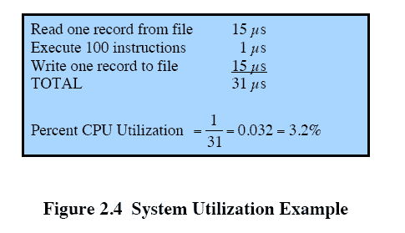
Multiprogrammed
Batch Systems
Processor is often idle
    even with automatic job sequencing
    I/O devices are slow compared to processor
Notes:
Even with the automatic job sequencing provided by a simple batch OS, the processor
is often idle. The problem is that I/O devices are slow compared to the processor.
Figure 2.4 details a representative calculation. The calculation concerns a program
that processes a file of records and performs, on average, 100 machine instructions
per record. In this example, the computer spends over 96% of its time waiting for
I/O devices to finish transferring data to and from the file.

Slide 15

Uniprogramming
The processor spends a certain amount of time executing, until it reaches an I/O instruction; it must then wait until that I/O instruction concludes before proceeding
Notes:
Figure 2.5a illustrates this situation, where we have a single program, referred to as uniprogramming.
The processor spends a certain amount of time executing, until it reaches an I/O instruction.
It must then wait until that I/O instruction concludes before proceeding.

Slide 16
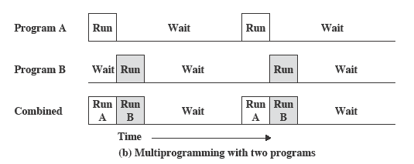
Multiprogramming
What if there’s enough memory to hold the OS (resident monitor) and two user programs.
When one job needs to wait for I/O, the processor can switch to the other job, which may not be waiting.
Notes:
This inefficiency is not necessary. We know that there must be enough
memory to hold the OS (resident monitor) and one user program. Suppose that
there is room for the OS and two user programs. When one job needs to wait for
I/O, the processor can switch to the other job, which is likely not waiting for I/O
( Figure 2.5b ).

Slide 17
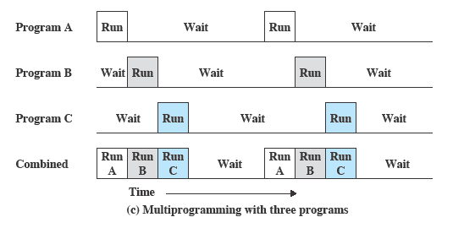
Multiprogramming
Multiprogramming
    also known as multitasking
    memory is expanded to hold three, four, or more programs and switch among all of them
Notes:
Furthermore, we might expand memory to hold three, four, or more
programs and switch among all of them ( Figure 2.5c ). The approach is known as
multiprogramming , or multitasking . It is the central theme of modern operating
systems.

Slide 18
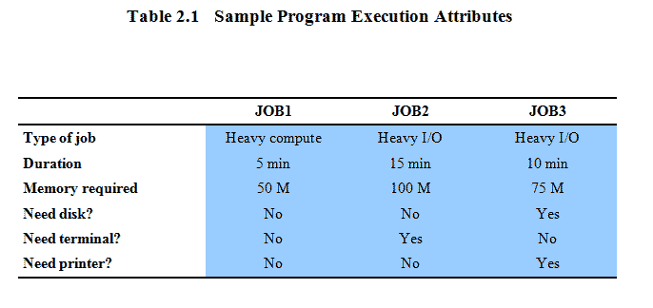
Multiprogramming Example
Notes:
To illustrate the benefit of multiprogramming, we give a simple example.
Consider a computer with 250 Mbytes of available memory (not used by the OS),
a disk, a terminal, and a printer. Three programs, JOB1, JOB2, and JOB3, are
submitted for execution at the same time, with the attributes listed in Table 2.1 .
We assume minimal processor requirements for JOB2 and JOB3 and continuous
disk and printer use by JOB3. For a simple batch environment, these jobs will be
executed in sequence. Thus, JOB1 completes in 5 minutes. JOB2 must wait until
the 5 minutes are over and then completes 15 minutes after that. JOB3 begins after
20 minutes and completes at 30 minutes from the time it was initially submitted.

Slide 19
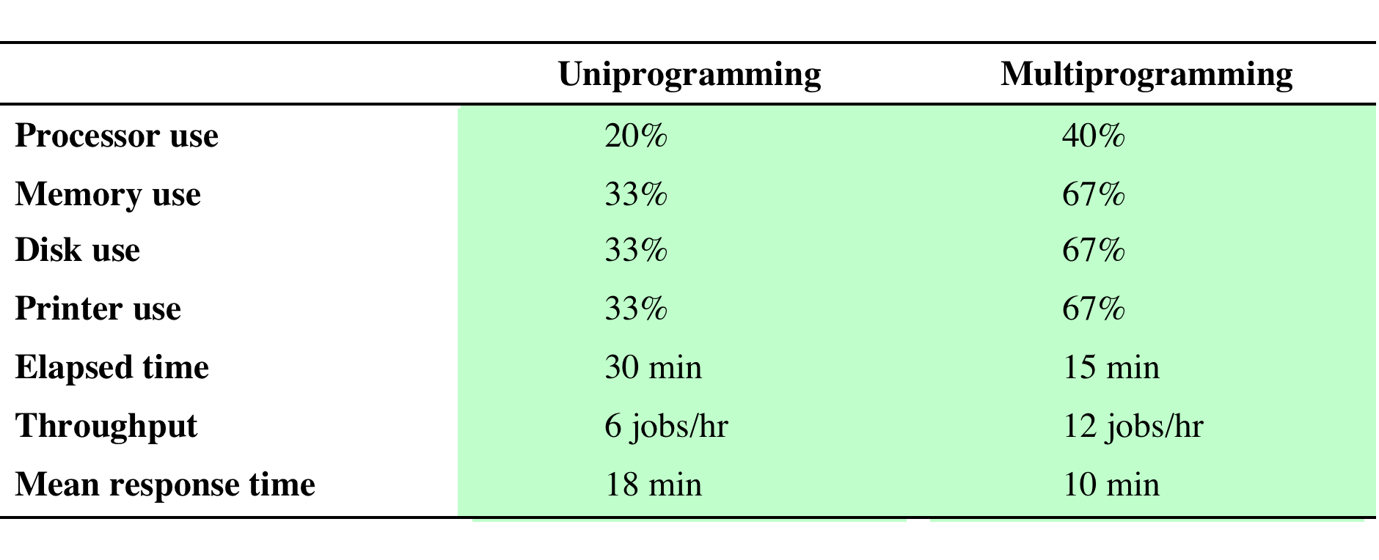
Effects on Resource Utilization
Table 2.2 Effects of Multiprogramming on Resource Utilization
Notes:
The average resource utilization, throughput, and response times are shown in the
uniprogramming column of Table 2.2 .

Slide 20
Time-Sharing Systems
Can be used to handle multiple interactive jobs
Processor time is shared among multiple users
Origin: multiple users simultaneously access the system through terminals, with the OS interleaving the execution of each user program in a short burst or quantum of computation
Notes:
Just as multiprogramming allows the processor to handle multiple batch jobs
at a time, multiprogramming can also be used to handle multiple interactive jobs. In
this latter case, the technique is referred to as time sharing , because processor time is
shared among multiple users. In a time-sharing system, multiple users simultaneously
access the system through terminals, with the OS interleaving the execution of each
user program in a short burst or quantum of computation. Thus, if there are n users
actively requesting service at one time, each user will only see on the average 1/ n
of the effective computer capacity, not counting OS overhead. However, given the
relatively slow human reaction time, the response time on a properly designed system
should be similar to that on a dedicated computer.

Slide 21
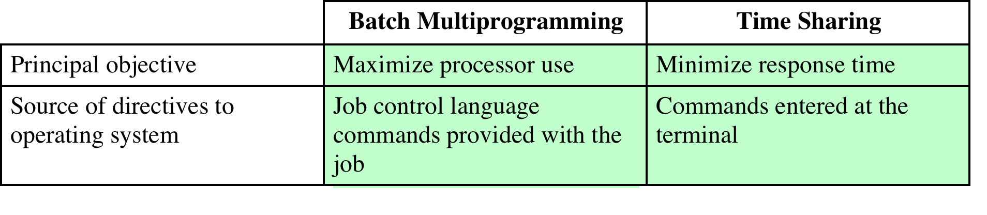
Batch Multiprogramming vs. Time Sharing
Table 2.3 Batch Multiprogramming versus Time Sharing
Notes:
Both batch processing and time sharing use multiprogramming. The key
differences are listed in Table 2.3 .

Slide 22
Compatible Time-Sharing Systems
CTSS
Time Slicing
  System clock generates interrupts at a rate of approximately one every 0.2 seconds
  At each interrupt OS regained control and could assign processor to another user
  At regular time intervals the current user would be preempted and another user loaded in
  Old user programs and data were written out to disk
  Old user program code and data were restored in main memory when that program was next given a turn
One of the first time-sharing operating systems
  Developed at MIT by a group known as Project MAC for IBM 709/7094
  Ran on a computer with 32,000 36-bit words of main memory, with the resident monitor consuming 5000 of that
  To simplify both the monitor and memory management a program was always loaded to start at the location of the 5000th word
Notes:
One of the first time-sharing operating systems to be developed was the
Compatible Time-Sharing System (CTSS) [CORB62], developed at MIT by a
group known as Project MAC (Machine-Aided Cognition, or Multiple-Access
Computers). The system was first developed for the IBM 709 in 1961 and later
transferred to an IBM 7094.
Compared to later systems, CTSS is primitive. The system ran on a computer
with 32,000 36-bit words of main memory, with the resident monitor consuming 5000
of that. When control was to be assigned to an interactive user, the user’s program
and data were loaded into the remaining 27,000 words of main memory. A program
was always loaded to start at the location of the 5000th word; this simplified
both the monitor and memory management. A system clock generated interrupts
at a rate of approximately one every 0.2 seconds. At each clock interrupt, the OS
regained control and could assign the processor to another user. This technique is
known as time slicing . Thus, at regular time intervals, the current user would be
preempted and another user loaded in. To preserve the old user program status for
later resumption, the old user programs and data were written out to disk before the
new user programs and data were read in. Subsequently, the old user program code
and data were restored in main memory when that program was next given a turn.

Slide 23
Major Advances
Operating Systems are among the most complex pieces of software ever developed
Major advances in development include:
Memory management
Information protection and security
Scheduling and resource management
System structure
Processes
Notes:
Operating systems are among the most complex pieces of software ever developed.
This reflects the challenge of trying to meet the difficult and in some cases
competing objectives of convenience, efficiency, and ability to evolve. [DENN80a]
proposes that there have been four major theoretical advances in the development
of operating systems:
• Processes
• Memory management
• Information protection and security
• Scheduling and resource management
Each advance is characterized by principles, or abstractions, developed to
meet difficult practical problems. Taken together, these five areas span many of
the key design and implementation issues of modern operating systems. The brief
review of these five areas in this section serves as an overview of much of the rest
of the text.

Slide 24
Process
Fundamental to the structure of operating systems
A process can be defined as:
a program in execution
an instance of a running program
the entity that can be assigned to, and executed on, a processor
a unit of activity characterized by a single sequential thread of execution, a current state, and an associated set of system resources
Notes:
Central to the design of operating systems is the concept of process. This term was
first used by the designers of Multics in the 1960s [DALE68]. It is a somewhat
more general term than job. Many definitions have been given for the term process ,
including
• A program in execution
• An instance of a program running on a computer
• The entity that can be assigned to and executed on a processor
• A unit of activity characterized by a single sequential thread of execution, a
current state, and an associated set of system resources

Slide 25
Components of a Process
A process contains three components:
  an executable program
  the associated data needed by the program (variables, work space, buffers, etc.)
  the execution context (or “process state”) of the program
  The execution context is essential:
  it is the internal data by which the OS is able to supervise and control the process
  includes the contents of the various process registers
  includes information such as the priority of the process and whether the process is waiting for the completion of a particular I/O event
Notes:
We can think of a process as consisting of three components:
• An executable program
• The associated data needed by the program (variables, work space, buffers, etc.)
• The execution context of the program
This last element is essential.
The execution context, or process state, is the internal data by which the OS is able to supervise and control the process.
This internal information is separated from the process, because the OS has information not permitted to the process.
The context includes all of the information that the OS needs to manage the process and that the processor needs to execute the process properly including:
contents of the various processor registers, such as the program counter and data registers
And information of use to the OS, such as the priority of the process and whether the process is waiting for the completion of a particular I/O event.

Slide 26
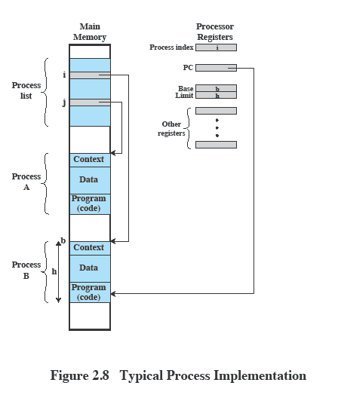
Process Management
The entire state of the process at any instant is contained in its context
New features can be designed and incorporated into the OS by expanding the context to include any new information needed to support the feature
Notes:
Figure 2.8 indicates a way in which processes may be managed. Two processes,
A and B, exist in portions of main memory. That is, a block of memory is
allocated to each process that contains the program, data, and context information.
Each process is recorded in a process list built and maintained by the OS. The
process list contains one entry for each process, which includes a pointer to the
location of the block of memory that contains the process. The entry may also
include part or all of the execution context of the process. The remainder of the
execution context is stored elsewhere, perhaps with the process itself (as indicated
in Figure 2.8 ) or frequently in a separate region of memory. The process index
register contains the index into the process list of the process currently controlling
the processor. The program counter points to the next instruction in that process
to be executed. The base and limit registers define the region in memory occupied
by the process: The base register is the starting address of the region of memory
and the limit is the size of the region (in bytes or words). The program counter and
all data references are interpreted relative to the base register and must not exceed
the value in the limit register. This prevents interprocess interference.
In Figure 2.8 , the process index register indicates that process B is executing.
Process A was previously executing but has been temporarily interrupted. The
contents of all the registers at the moment of A’s interruption were recorded in its
execution context. Later, the OS can perform a process switch and resume execution
of process A. The process switch consists of storing the context of B and restoring
the context of A. When the program counter is loaded with a value pointing into A’s
program area, process A will automatically resume execution.

Slide 27
Multithreading
Technique in which a process, executing an application, is divided into threads that can run concurrently
Thread
dispatchable unit of work
includes a processor context and its own data area to enable subroutine branching
executes sequentially and is interruptible
Process
a collection of one or more threads and associated system resources
programmer has greater control over the modularity of the application and the timing of application related events
Notes:
Multithreading is a technique in which a process, executing an application, is
divided into threads that can run concurrently. We can make the following distinction:
• Thread: A dispatchable unit of work. It includes a processor context (which
includes the program counter and stack pointer) and its own data area for a
stack (to enable subroutine branching). A thread executes sequentially and is
interruptible so that the processor can turn to another thread.
• Process : A collection of one or more threads and associated system resources
(such as memory containing both code and data, open files, and devices). This
corresponds closely to the concept of a program in execution. By breaking
a single application into multiple threads, the programmer has great control
over the modularity of the application and the timing of application-related
events.
Multithreading is useful for applications that perform a number of essentially
independent tasks that do not need to be serialized. An example is a database server
that listens for and processes numerous client requests. With multiple threads running
within the same process, switching back and forth among threads involves
less processor overhead than a major process switch between different processes.
Threads are also useful for structuring processes that are part of the OS kernel as
described in subsequent chapters.

Slide 28
Symmetric
Multiprocessing (SMP)
Term that refers to a computer hardware architecture and also to the OS behavior that exploits that architecture
Several processes can run in parallel
Multiple processors are transparent to the user
    these processors share same main memory and I/O facilities
    all processors can perform the same functions
The OS takes care of scheduling of threads or processes on individual processors and of synchronization among processors
Notes:
Symmetric multiprocessing (SMP) is a term that refers to a computer hardware
architecture (described in Chapter 1 ) and also to the OS behavior that exploits
that architecture. The OS of an SMP schedules processes or threads across all of the
processors.
Multithreading and SMP are often discussed together, but the two are
independent facilities. Even on a uniprocessor system, multithreading is useful for
structuring applications and kernel processes. An SMP system is useful even for
nonthreaded processes, because several processes can run in parallel. However, the
two facilities complement each other and can be used effectively together.
An attractive feature of an SMP is that the existence of multiple processors is
transparent to the user. The OS takes care of scheduling of threads or processes on
individual processors and of synchronization among processors.

Slide 29
SMP Advantages
Performance
more than one process can be running simultaneously, each on a different processor
Availability
failure of a single process does not halt the system
Incremental Growth
performance of a system can be enhanced by adding an additional processor
Scaling
vendors can offer a range of products based on the number of processors configured in the system
Notes:
SMP has a number of potential advantages over uniprocessor architecture,
including the following:
• Performance: If the work to be done by a computer can be organized so that
some portions of the work can be done in parallel, then a system with multiple
processors will yield greater performance than one with a single processor of
the same type. This is illustrated in Figure 2.12 . With multiprogramming, only
one process can execute at a time; meanwhile all other processes are waiting
for the processor. With multiprocessing, more than one process can be running
simultaneously, each on a different processor.
• Availability: In a symmetric multiprocessor, because all processors can perform
the same functions, the failure of a single processor does not halt the
system. Instead, the system can continue to function at reduced performance.
• Incremental growth: A user can enhance the performance of a system by adding
an additional processor.
• Scaling: Vendors can offer a range of products with different price and performance
characteristics based on the number of processors configured in the
system.
It is important to note that these are potential, rather than guaranteed, benefits. The
OS must provide tools and functions to exploit the parallelism in an SMP system.

Slide 30
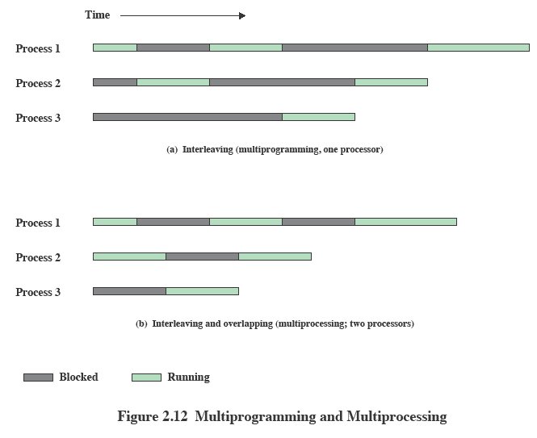
Multiprogramming
Multiprocessing
Notes:
If the work to be done by a computer can be organized so that
some portions of the work can be done in parallel, then a system with multiple
processors will yield greater performance than one with a single processor of
the same type. This is illustrated in Figure 2.12 . With multiprogramming, only
one process can execute at a time; meanwhile all other processes are waiting
for the processor. With multiprocessing, more than one process can be running
simultaneously, each on a different processor.

Slide 31
Virtual Machines and Virtualization
Virtualization
  enables a single PC or server to simultaneously run multiple operating systems or multiple sessions of a single OS
  Each (guest) operating system runs in a virtual machine (VM), and can execute multiple applications
  Guest operating systems execute as if they were interacting directly with the hardware, but in fact they are interacting
  with a Virtual Machine Monitor (VMM) which runs
  directly on the hardware or on a host operating
  system
Notes:
Traditionally, applications have run directly on an OS on a PC or a server. Each PC
or server would run only one OS at a time. Thus, the vendor had to rewrite parts
of its applications for each OS/platform they would run on. An effective strategy
for dealing with this problem is known as virtualization . Virtualization technology
enables a single PC or server to simultaneously run multiple operating systems or
multiple sessions of a single OS. A machine with virtualization can host numerous
applications, including those that run on different operating systems, on a single
platform. In essence, the host operating system can support a number of virtual
machines (VM) , each of which has the characteristics of a particular OS and, in some
versions of virtualization, the characteristics of a particular hardware platform.
The VM approach is becoming a common way for businesses and individuals
to deal with legacy applications and to optimize their hardware usage by maximizing
the number of kinds of applications that a single computer can handle [GEER09].
Commercial VM offerings by companies such as VMware and Microsoft are widely
used, with millions of copies having been sold. In addition to their use in server
environments, these VM technologies also are used in desktop environments to run
multiple operating systems, typically Windows and Linux.

Slide 32
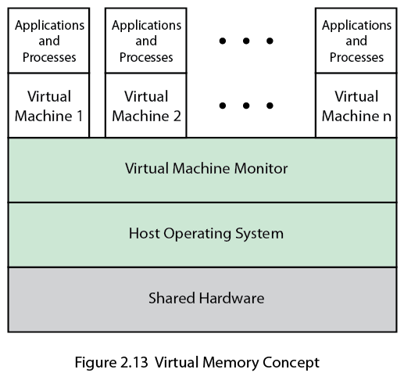
Virtual
Machine Concept
Note: In some cases, servers in particular, the VMM runs directly on the hardware.
This figure represents a
hosted virtual machine
Correction: should be Virtual MACHINE Concept
Notes:
The specific architecture of the VM approach varies among vendors.
Figure 2.13 shows a typical arrangement. The virtual machine monitor (VMM) , or
hypervisor , runs on top of (or is incorporated into) the host OS. The VMM supports
VMs, which are emulated hardware devices. Each VM runs a separate OS.
The VMM handles each operating system’s communications with the processor,
the storage medium, and the network. To execute programs, the VMM hands off
the processor control to a virtual OS on a VM. Most VMs use virtualized network
connections to communicate with one another, when such communication is needed.
Key to the success of this approach is that the VMM provides a layer between software
environments and the underlying hardware and host OS that is programmable,
transparent to the software above it, and makes efficient use of the hardware
below it.

Slide 33
Multicore OS Considerations
The design challenge for a many-core multicore system is to efficiently harness the multicore processing power and intelligently manage the substantial on-chip resources efficiently
Potential for parallelism exists at three levels:
hardware parallelism within each core processor, known as instruction level parallelism
potential for multiprogramming and multithreaded execution within each processor
potential for a single application to execute in concurrent processes or threads across multiple cores
Notes:
far in this section for SMP systems. But additional concerns arise. The issue is one
of the scale of the potential parallelism. Current multicore vendors offer systems
with up to eight cores on a single chip. With each succeeding processor technology
generation, the number of cores and the amount of shared and dedicated cache
memory increases, so that we are now entering the era of “many-core” systems.
The design challenge for a many-core multicore system is to efficiently
harness the multicore processing power and intelligently manage the substantial
on-chip resources efficiently. A central concern is how to match the inherent parallelism
of a many-core system with the performance requirements of applications.
The potential for parallelism in fact exists at three levels in contemporary multicore
system. First, there is hardware parallelism within each core processor, known as
instruction level parallelism, which may or may not be exploited by application programmers
and compilers. Second, there is the potential for multiprogramming and
multithreaded execution within each processor. Finally, there is the potential for
a single application to execute in concurrent processes or threads across multiple
cores. Without strong and effective OS support for the last two types of parallelism
just mentioned, hardware resources will not be efficiently used.
In essence, then, since the advent of multicore technology, OS designers have
been struggling with the problem of how best to extract parallelism from computing
workloads. A variety of approaches are being explored for next-generation operating
systems. We introduce two general strategies in this section and consider some
details in later chapters.

Slide 34
Microsoft Windows Overview
MS-DOS 1.0 released in 1981
  4000 lines of assembly language source code
  ran in 8 Kbytes of memory
  used Intel 8086 microprocessor
  Windows 3.0 shipped in 1990
  16-bit
  GUI interface
  implemented as a layer on top of MS-DOS
Windows 95
  32-bit version
  led to the development of Windows 98 and Windows Me
  Windows NT (3.1) released in 1993
  32-bit OS with the ability to support older DOS and Windows applications as well as provide OS/2 support
  Windows 2000
  included services and functions to support distributed processing
  Active Directory
  plug-and-play and power-management facilities
  Windows XP released in 2001
  goal was to replace the versions of Windows based on MS-DOS with an OS based on NT
  Windows Vista shipped in 2007
  Windows Server released in 2008
  Windows 7 shipped in 2009, as well as Windows Server 2008 R2
  Windows Azure
  targets cloud computing
Notes:
The story of Windows begins with a very different OS, developed by Microsoft for
the first IBM personal computer and referred to as MS-DOS. The initial version,
MS-DOS 1.0, was released in August 1981. It consisted of 4000 lines of assembly
language source code and ran in 8 Kbytes of memory using the Intel 8086
microprocessor.
The IBM PC was an important stage in a continuing revolution in computing
that has expanded computing from the data center of the 1960s, to the departmental
minicomputer of the 1970s, and to the desktop in the 1980s. The revolution has continued
with computing moving into the briefcase in the 1990s, and into our pockets
during the most recent decade.
Microsoft’s initial OS ran a single application at a time, using a command line
interface to control the system. It took a long time for Microsoft to develop a true
GUI interface for the PC; on their third try they succeeded. The 16-bit Windows
3.0 shipped in 1990 and instantly became successful, selling a million copies in six
months. Windows 3.0 was implemented as a layer on top of MS-DOS and suffered
from the limitations of that primitive system. Five years later, Microsoft shipped a
32-bit version, Windows 95, which was also very successful and led to the development
of additional versions: Windows 98 and Windows Me.
Meanwhile, it had become clear to Microsoft that the MS-DOS platform could
not sustain a truly modern OS. In 1989 Microsoft hired Dave Cutler, who had developed
the very successful RSX-11M and VAX/VMS operating systems at Digital
Equipment Corporation. Cutler’s charter was to develop a modern OS, which was
portable to architectures other than the Intel x86 family, and yet compatible with
the OS/2 system that Microsoft was jointly developing with IBM, as well as the portable
UNIX standard, POSIX. This system was christened NT (New Technology).
The first version of Windows NT (3.1) was released in 1993, with the same GUI
as Windows 3.1, the follow-on to Windows 3.0. However, NT 3.1 was a new 32-bit
OS with the ability to support older DOS and Windows applications as well as provide
OS/2 support. Several versions of NT 3.x followed with support for additional
hardware platforms. In 1996, Microsoft released NT 4.0 with the same user interface
as Windows 95. In 2000, Microsoft introduced the next major upgrade of the NT OS:
Windows 2000. The underlying Executive and Kernel architecture is fundamentally
the same as in NT 3.1, but new features have been added. The emphasis in Windows
2000 was the addition of services and functions to support distributed processing.
The central element of Windows 2000’s new features was Active Directory, which
is a distributed directory service able to map names of arbitrary objects to any kind
of information about those objects. Windows 2000 also added the plug-and-play
and power-management facilities that were already in Windows 98, the successor to
Windows 95. These features are particularly important for laptop computers.
In 2001, a new desktop version of NT was released, known as Windows XP.
The goal of Windows XP was to finally replace the versions of Windows based on
MS-DOS with an OS based on NT. In 2007, Microsoft shipped Windows Vista for
the desktop and a short time later, Windows Server 2008. In 2009, they shipped
Windows 7 and Windows Server 2008 R2. Despite the difference in naming, the
client and server versions of these systems use many of the same files, but with additional
features and capabilities enabled for servers.
Over the years, NT has attempted to support multiple processor architectures;
the Intel i860 was the original target for NT as well as the x86. Subsequently, NT
added support for the Digital Alpha architecture, the PowerPC, and the MIPS.
Later came the Intel IA64 (Itanium) and the 64-bit version of the x86, based on
the AMD64 processor architecture. Windows 7 supports only x86 and AMD64.
Windows Server 2008 R2 supports only AMD64 and IA64—but Microsoft has
announced that it will end support for IA64 in future releases. All the other processor
architectures have failed in the market, and today only the x86, AMD64, and
ARM architectures are viable. Microsoft’s support for ARM is limited to their
Windows CE OS, which runs on phones and handheld devices. Windows CE has
little relationship to the NT-based Windows that runs on slates, netbooks/laptops,
desktops, and servers.
Microsoft has announced that it is developing a version of NT that targets
cloud computing: Windows Azure. Azure includes a number of features that are
specific to the requirements of public and private clouds. Though it is closely related
to Windows Server, it does not share files in the same way that the Windows client
and server versions do.

Slide 35
Threads and SMP
Two important characteristics of Windows are its support for threads and for symmetric multiprocessing (SMP)
  OS routines can run on any available processor, and different routines can execute simultaneously on different processors
  Windows supports the use of multiple threads of execution within a single process. Multiple threads within the same process may execute on different processors simultaneously
  Server processes may use multiple threads to process requests from more than one client simultaneously
  Windows provides mechanisms for sharing data and resources between processes and flexible interprocess communication capabilities
Notes:
Two important characteristics of Windows are its support for threads and for
symmetric multiprocessing (SMP), both of which were introduced in Section 2.4 .
[RUSS11] lists the following features of Windows that support threads and SMP:
• OS routines can run on any available processor, and different routines can
execute simultaneously on different processors.
• Windows supports the use of multiple threads of execution within a single
process. Multiple threads within the same process may execute on different
processors simultaneously.
• Server processes may use multiple threads to process requests from more than
one client simultaneously.
• Windows provides mechanisms for sharing data and resources between processes
and flexible interprocess communication capabilities.

Slide 36
Traditional UNIX Systems
Were developed at Bell Labs and became operational on a PDP-7 in 1970
Incorporated many ideas from Multics
PDP-11was a milestone because it first showed that UNIX could be an OS for all computers
Next milestone was rewriting UNIX in the programming language C
    demonstrated the advantages of using a high-level language for system code
    Was described in a technical journal for the first time in 1974
    First widely available version outside Bell Labs was Version 6 in 1976
    Version 7, released in 1978 is the ancestor of most modern UNIX systems
    Most important of the non-AT&T systems was UNIX BSD (Berkeley Software Distribution)
Notes:
PDP-7 in 1970. Some of the people involved at Bell Labs had also participated in
the time-sharing work being done at MIT’s Project MAC. That project led to the
development of first CTSS and then Multics. Although it is common to say that
the original UNIX was a scaled-down version of Multics, the developers of UNIX
actually claimed to be more influenced by CTSS [RITC78]. Nevertheless, UNIX
incorporated many ideas from Multics.
Work on UNIX at Bell Labs, and later elsewhere, produced a series of versions
of UNIX. The first notable milestone was porting the UNIX system from the PDP-7 to
the PDP-11. This was the first hint that UNIX would be an OS for all computers. The
next important milestone was the rewriting of UNIX in the programming language
C. This was an unheard-of strategy at the time. It was generally felt that something as
complex as an OS, which must deal with time-critical events, had to be written exclusively
in assembly language. Reasons for this attitude include the following:
• Memory (both RAM and secondary store) was small and expensive by today’s
standards, so effective use was important. This included various techniques for
overlaying memory with different code and data segments, and self-modifying
code.
• Even though compilers had been available since the 1950s, the computer
industry was generally skeptical of the quality of automatically generated
code. With resource capacity small, efficient code, both in terms of time and
space, was essential.
• Processor and bus speeds were relatively slow, so saving clock cycles could
make a substantial difference in execution time.
The C implementation demonstrated the advantages of using a high-level
language for most if not all of the system code. Today, virtually all UNIX implementations
are written in C.
These early versions of UNIX were popular within Bell Labs. In 1974, the
UNIX system was described in a technical journal for the first time [RITC74]. This
spurred great interest in the system. Licenses for UNIX were provided to commercial
institutions as well as universities. The first widely available version outside Bell
Labs was Version 6, in 1976. The follow-on Version 7, released in 1978, is the ancestor
of most modern UNIX systems. The most important of the non-AT&T systems
to be developed was done at the University of California at Berkeley, called UNIX
BSD (Berkeley Software Distribution), running first on PDP and then VAX computers.
AT&T continued to develop and refine the system. By 1982, Bell Labs had
combined several AT&T variants of UNIX into a single system, marketed commercially
as UNIX System III. A number of features was later added to the OS to
produce UNIX System V.

Slide 37
LINUX Overview
Started out as a UNIX variant for the IBM PC
Linus Torvalds, a Finnish student of computer science, wrote the initial version
Linux was first posted on the Internet in 1991
Today it is a full-featured UNIX system that runs on several platforms
Is free and the source code is available
Key to success has been the availability of free software packages
Highly modular and easily configured
Notes:
Linux started out as a UNIX variant for the IBM PC (Intel 80386) architecture.
Linus Torvalds, a Finnish student of computer science, wrote the initial version.
Torvalds posted an early version of Linux on the Internet in 1991. Since then, a
number of people, collaborating over the Internet, have contributed to the development
of Linux, all under the control of Torvalds. Because Linux is free and the
source code is available, it became an early alternative to other UNIX workstations,
such as those offered by Sun Microsystems and IBM. Today, Linux is a full-featured
UNIX system that runs on all of these platforms and more, including Intel Pentium
and Itanium, and the Motorola/IBM PowerPC.
Key to the success of Linux has been the availability of free software packages
under the auspices of the Free Software Foundation (FSF). FSF’s goal is stable,
platform-independent software that is free, high quality, and embraced by the user
community. FSF’s GNU project 3 provides tools for software developers, and the
GNU Public License (GPL) is the FSF seal of approval. Torvalds used GNU tools
in developing his kernel, which he then released under the GPL. Thus, the Linux
distributions that you see today are the product of FSF’s GNU project, Torvald’s
individual effort, and the efforts of many collaborators all over the world.
In addition to its use by many individual programmers, Linux has now made
significant penetration into the corporate world. This is not only because of the
free software, but also because of the quality of the Linux kernel. Many talented
programmers have contributed to the current version, resulting in a technically
impressive product. Moreover, Linux is highly modular and easily configured. This
makes it easy to squeeze optimal performance from a variety of hardware platforms.
Plus, with the source code available, vendors can tweak applications and utilities to
meet specific requirements. Throughout this book, we will provide details of Linux
kernel internals based on the most recent version, Linux 2.6.

Slide 38
Modular
Monolithic Kernel
Most UNIX systems are monolithic (includes virtually all of the OS functionality in one large block of code that runs as a single process with a single address space)
All the functional components of the kernel have access to all of its internal data structures and routines
Linux improves on this somewhat because it is structured as a collection of modules
Loadable Modules
Relatively independent blocks
A module is an object file whose code can be linked to and unlinked from the kernel at runtime
A module is executed in kernel mode on behalf of the current process
Have two important characteristics:
    Dynamic linking
    Stackable modules
Notes:
Although Linux does not use a microkernel approach, it achieves many of the potential advantages of this approach by means of its particular modular architecture.
Linux is structured as a collection of modules, a number of which can be automatically loaded and unloaded on demand.
These relatively independent blocks are referred to as loadable modules.
In essence, a module is an object file whose code can be linked to and unlinked from the kernel at runtime.
The Linux loadable modules have two important characteristics:
Dynamic linking: A kernel module can be loaded and linked into the kernel while the kernel is already in memory and executing.
A module can also be unlinked and removed from memory at any time.
Saves kernel memory.
Stackable modules: The modules are arranged in a hierarchy.
Individual modules serve as libraries when they are referenced by client modules higher up in the hierarchy, and as clients when they reference modules further down.

