Slide 1
Odnos prema greskama
Šta raditi sa bug-ovima

Slide 2
agenda
Šta je bug?
Životni ciklus Bug-a
Bug priority & Bug Severity
Bug template/šabloni
Software requirements

Slide 3
Šta je bug?

Slide 4
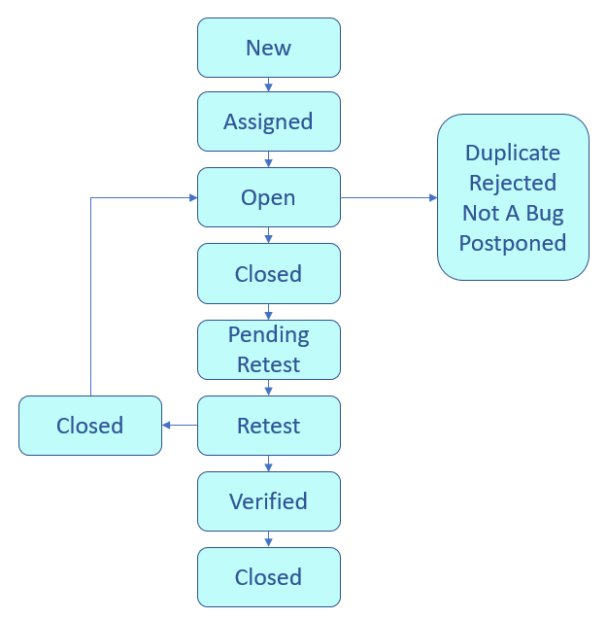
Bug life cycle
New
Assigned
Open
Fixed
Pending retest
Retest
Verified
Reopen
Closed
Duplicate
Rejected
Deferred
Not a bug

Slide 5
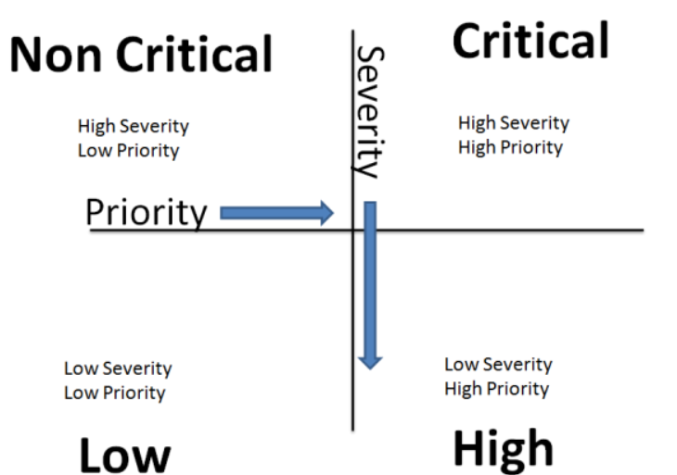
Bug priority & Bug severity

Slide 6
Bug priority & Bug severity

Slide 7
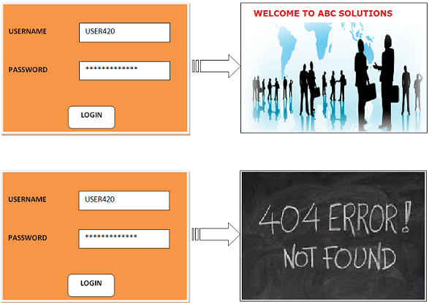
Bug priority & Bug severity

Slide 8
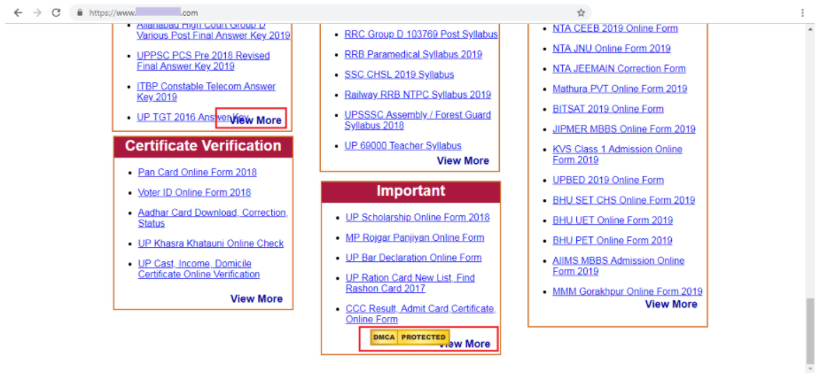
Bug priority & Bug severity

Slide 9
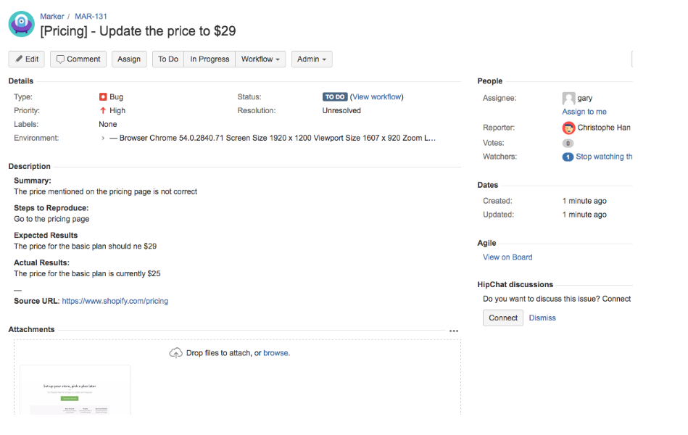
Bug Template

Slide 10
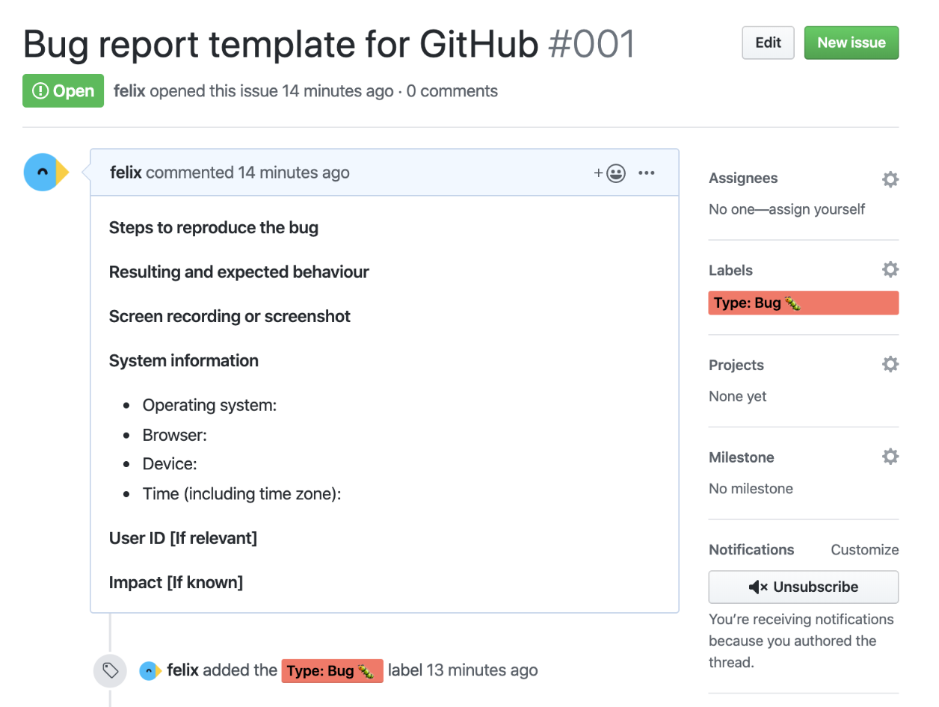
Bug Template

Slide 11
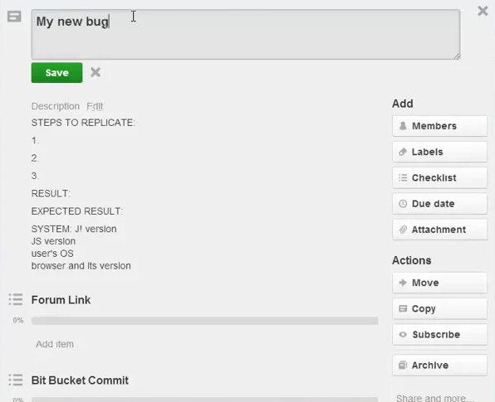
Bug Template

Slide 12
Q&A

Slide 13
THANK YOU!
Igor ZlatkoviĆ

