Slide 1
Test Fundamentals
An Introduction to test cases

Slide 2
agenda
What is Test scenario
What is test case
How to write Test Case
Boundary Value Analysis (BVA)
Equivalence Class Partitioning
Decision Table Based Testing

Slide 3
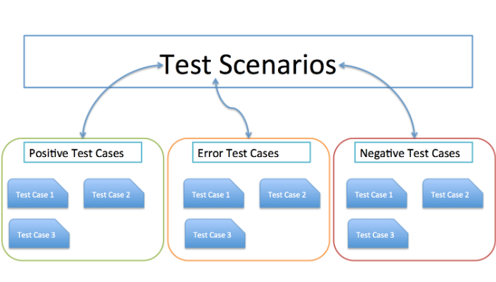
Test scenario
Notes:
Test Case is a set of actions executed to verify particular features or functionality whereas Test Scenario is any functionality that can be tested.
Test Case is mostly derived from test scenarios while Test Scenarios are derived from test artifacts like BRS and SRS.
Test Case helps in exhaustive testing of an application whereas Test Scenario helps in an agile way of testing the end to end functionality.
Test Cases are focused on what to test and how to test while Test Scenario is more focused on what to test.
Test Cases are low-level actions whereas Test Scenarios are high-level actions.
Test Case requires more resources and time for test execution while Test Scenario require fewer resources and time for test execution.
Test Case includes test steps, data, expected results for testing whereas Test Scenario includes an end to end functionality to be tested.

Slide 4
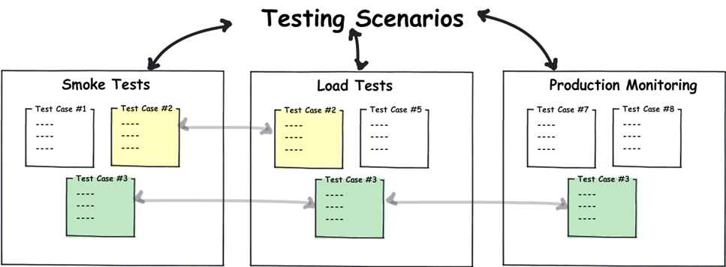
Test scenario

Slide 5
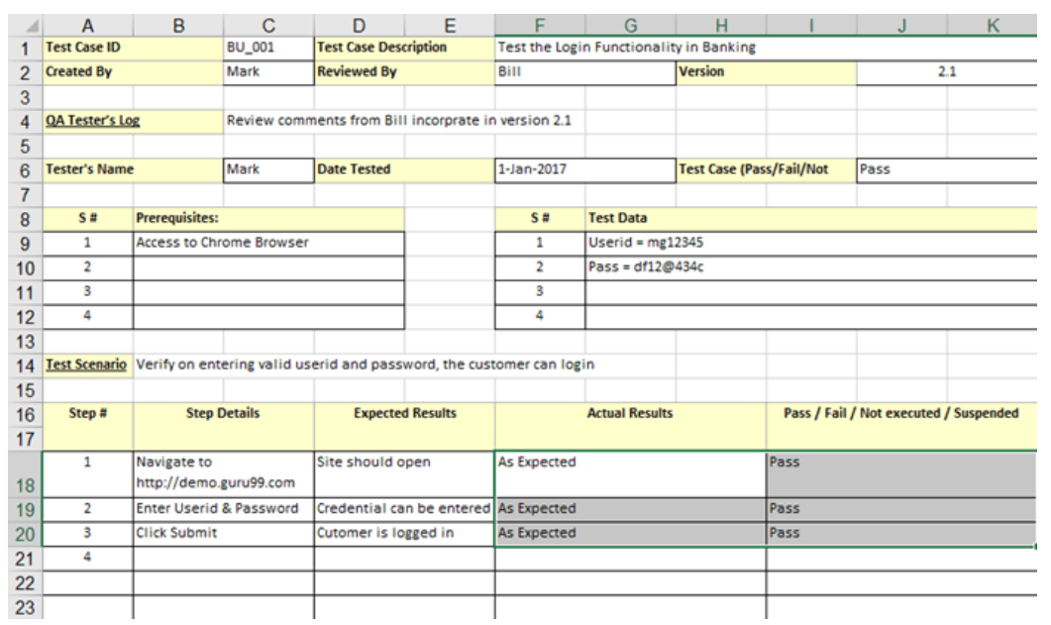
test case
Notes:
Test case ID - Each test case should be represented by a unique ID. To indicate test types follow some convention like "TC_UI_1" indicating "User Interface Test Case#1.”
Pre-condition - Any requirement that needs to be done before execution of this test case. To execute this test case list all pre-conditions

Slide 6
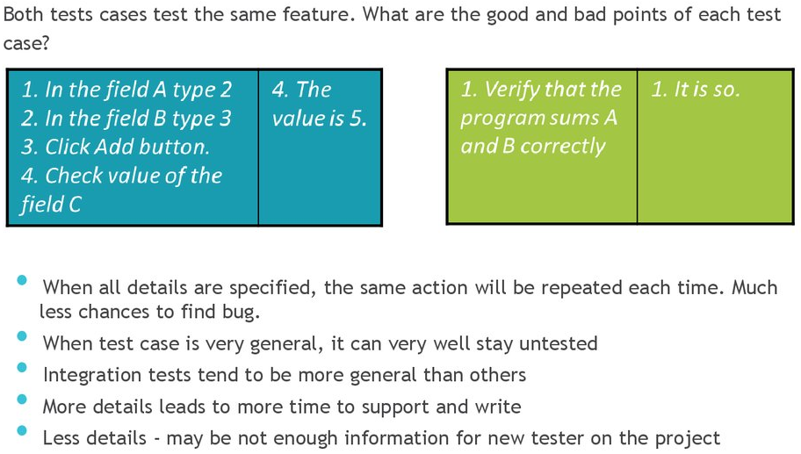
test case ( specific or general )

Slide 7
How to write Test Case
Test Suite Id - The ID of the test suite to which this automated test case belongs
Test Case Id – The ID of Test Case
Title /Subject – Use a Strong Title
Precondition and Assumptions test
Description – Steps to be executed
Test data – The test data, or links to the test data, that are to be used while conducting the test
Expected result – The expected result of the test
Actual result – The actual result of the test or test case execution
Status – Passed / Failed
Related requirement – The ID of the related requirement this test case relates/traces to.
Created by
Date of creation
Executed by
Date of execution
Test Environment – The environment (Hardware/ Software/ Network) in which the test was executed
Comments

Slide 8
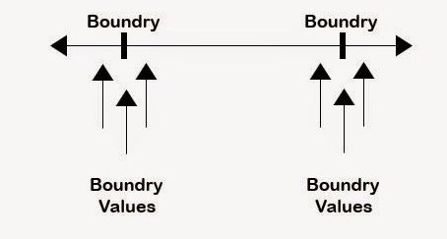
Boundary Value Analysis (BVA)

Slide 9
Equivalence Class Partitioning

Slide 10
Decision Table Based Testing

Slide 11
Q&A

Slide 12
THANK YOU!
Dušica Baralić

