Slide 1
Osnove Testiranje softvera

Slide 2
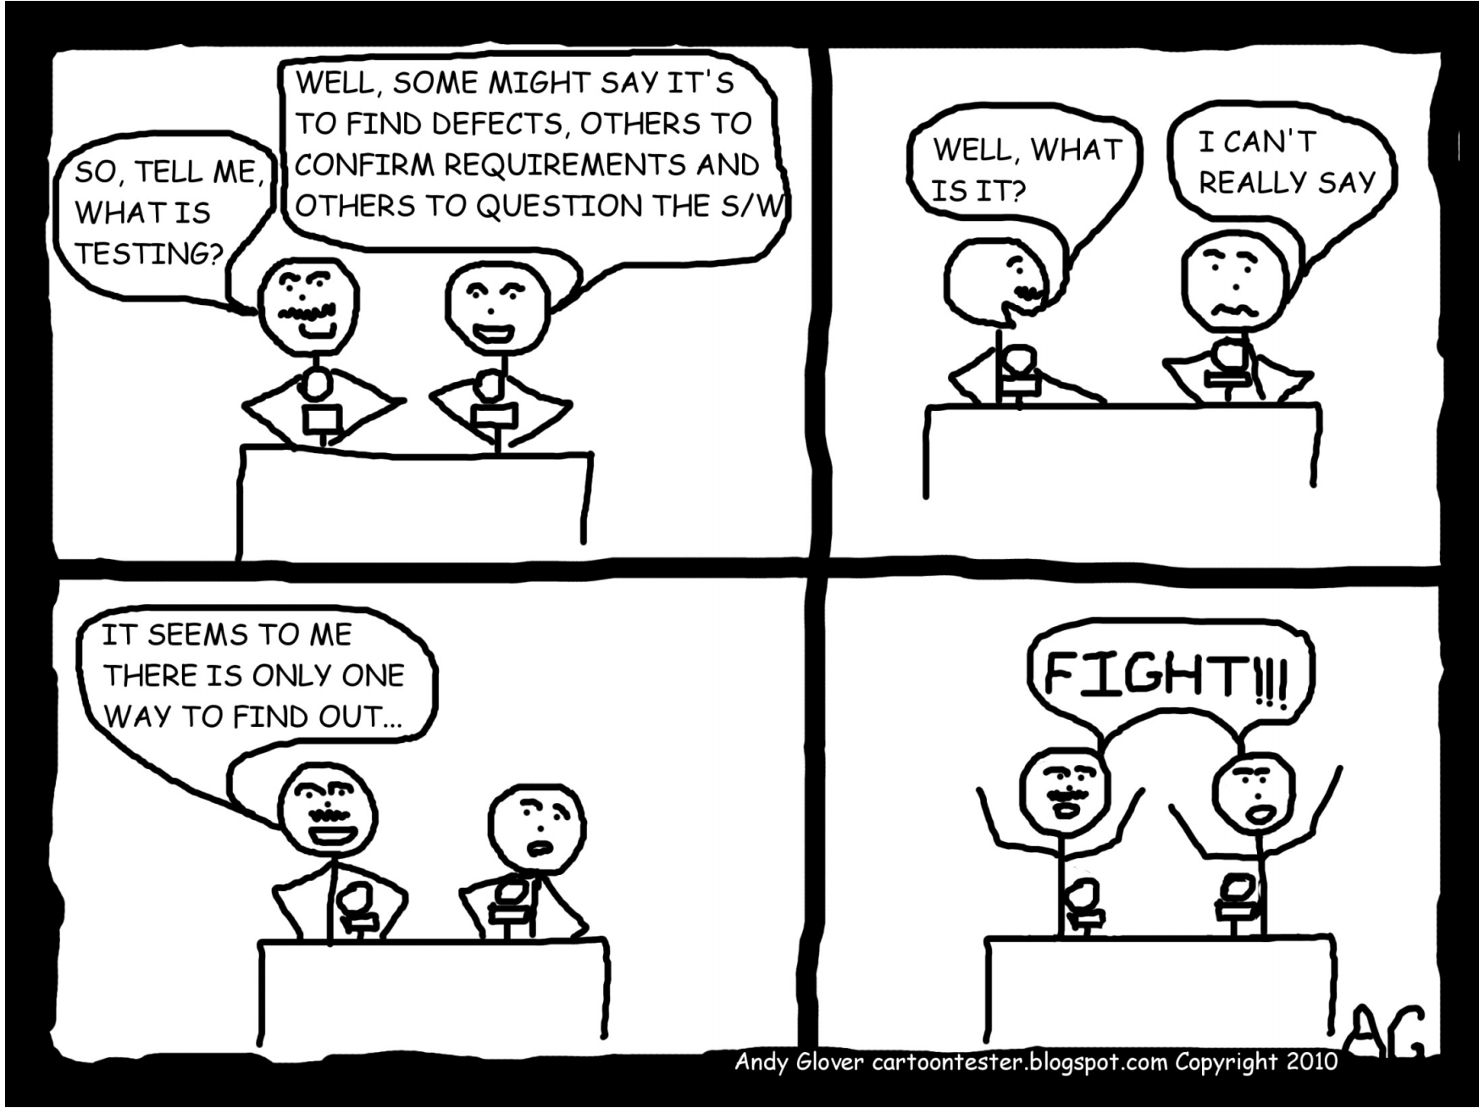
WHAT is Software Testing?
Notes:
Celebrities deathmatch (MTV)
Investigation - We may not always know what the outcome will be but it’s our job to uncover information which help people make decisions. It is much more than comparing against a specification which has an expected result. We need to think critically, ask difficult questions, pick up on risks, notice those things which at first glance seem inconsequential, yet on close examination are much more important and need investigating further.
Exploration - A list of requirements is never really complete, there will always be requirements which are not stated, which are assumed, or omitted. Regardless of how comprehensive your requirements are, they will never be an exhaustive list. You won’t know everything the software will do up front. That’s where exploratory testing comes in.
Exploratory testing is defined as simultaneous learning, test design and execution. The tester explores the application, discovering new information, learning, and finding new things to test as they go.
Mitigation - One of the reasons we test is to discover issues, risks, and other information about a software product, enabling action to be taken so that the end user is not adversely impacted by them. This action might be:
Fixing bugs
Re-assessing and changing the original requirements
Providing user assistance within the product
Creating user documentation
Communicating known issues to stakeholders
Valuable - Software testing is a valuable activity in software development but often misunderstood due to its unpredictable and creative nature.
Developers output code as a result of their day to day work, analysts may output requirements or documentation, yet tester’s output may sometimes be difficult to measure. Often, testers struggle to communicate their plans, progress and outcomes. This can make it tricky for those who do not know testing, to understand what has been done, how it has been done, and why. As a result, some struggle to see the value of testers and testing. There are many companies out there who develop software with no tester involvement whatsoever.
The lack of countable things created by testers is one reason some people like to use test cases as a way of measuring, they are a tangible, countable output. The value of testing extends beyond test cases.
Testing is valuable at all stages of the development lifecycle, not just when code has been written. Other things can be tested too.
Ideas
Requirements
Designs
Assumptions
Documentation
Infrastructure
Processes
It’s the testers job to ask questions, explore, and think critically about all of these things. It could result in something that could have turned into a bug later in the development process being caught much earlier.
Communication - A massive part of a tester’s job is communication. Testers provide information about the quality of a software product, so it’s important we communicate this information accurately to enable the right decisions to be made.
Someone can start as a tester with few technical skills, but a real ability to communicate with others and be clear about what it is you are saying is vital.
As testers, we need to make sure we use the correct words and phrasing so as to not be ambiguous, and to remove the risk of misunderstanding. What you mean to say isn’t always what you end up saying, and often assumptions are made, and incorrect actions are taken as a result of poor or insufficient communication.
Potentially Infinite - All testing is sampling. For every non trivial product, there are an unimaginable number of parameters with a great number of possible values. How do you know you are testing the important ones? We can’t test everything.
It’s part of our job to make the decisions about what to test, understand the consequences of only testing those things, and be able to explain our decisions.

Slide 3
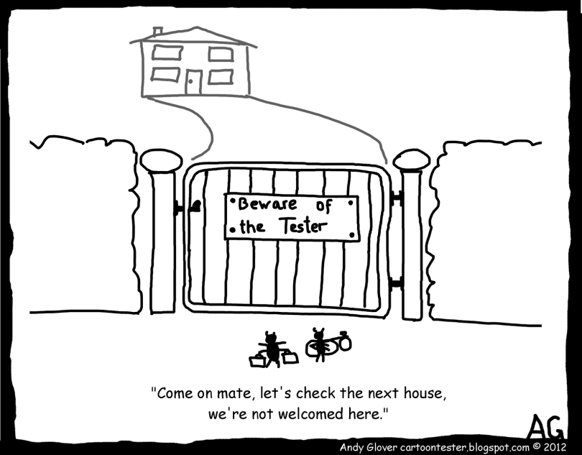
Traditional Testing Mindset
Software testing is a process of executing a program or application with the intent of finding the software bugs.
Notes:
Kad pitas testere sta je njhov posao, vecina odgovora je: “we need to find defects or perhaps go looking at the requirements and making sure they're all met." Or maybe even, my least favorite, "To break the software.”
It's an attitude not appropriate for Agile because instead of collaborating, we get a hostile relationship, so we're asking people to think differently.

Slide 4
Developer vs Tester

Slide 5
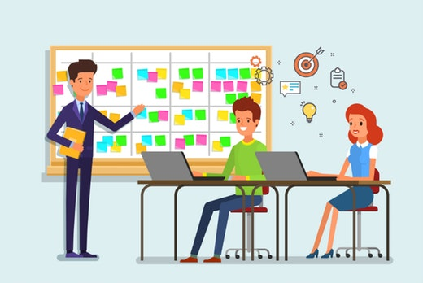
Agile (testing) mindset
Testers - How do we help the team succeed and how do we prevent defects from occurring in the first place
Developers - How can I create testable code and deliver the software successfully
Notes:
Transforming from “Bug Finder” to “Bug Preventer”
It’s not about the process it’s about how we think
Be open, asses progress, make correction
Ask how can we help? – others in team are not opponent
Rest of the team (including developers) - instead of taking my code and giving it to somebody else to test, they need to think a little bit differently. A lot of times, programmers test their own code and they do it really, really well, but sometimes, they have a cognitive bias that might blind them to some risks.

Slide 6
Why is Testing necessary?

Slide 7
Why is Testing necessary?
Testers don’t break the code, they break your illusions about the code.
By Maaret Pyhäjärvi (adopted from James Bach)
https://www. youtube.com/watch?v=IGQmdoK_ZfY
Notes:
Testing is necessary because we all make mistakes, all the time.
Others would see our mistakes better than we do.
Some of those mistakes are less important, but some of them are expensive or dangerous.
Testing was perceived as confirmation that developed system meets its requirements
Today testing is performed with primary aim of finding faults. It’s destructive process and can be viewed as criticism of products and its authors
its useful as it can save time, money and reduce risks.

Slide 8
SEQUENTAL (waterfall) SDLC
Requirements
Plan
Design
Build
Test
Production
Support
Notes:
Developers and QAs worked as separate teams – functional teams (every team works for them self)
The same required (PRD) document was referred to by developers and QAs simultaneously. Developers did their designing and coding and QAs did their test case writing referring to the same required document. The planning and execution were done in silos
- The test case reviews were solely done by the QA leaders. Sharing the QA test cases with the developers was not considered a good practice. (Reason – The developers would code based on the test cases and the QAs would lose on the defects )
- Testing was considered the LAST activity of an implementation cycle. Most of the time, QAs would get the feature in the last stage and were expected to complete the entire testing in a very limited time. (And the QAs did it)
- The only goal of the QAs was to identify bugs & defects. The overall performance of the QAs was judged based on the number of valid bugs/defects they submit
- Email communication was preferred
- Automation was considered an end activity and mostly focused on the UI. Regression suit was considered the best candidate for Automation

Slide 9
Sequential (waterfall) SDLC in reality
Requirements
Plan
Design
Build
Test
Production
Support

Slide 10
Waterfall TEAM(s)
AR
TST
BA
BA
DEV
AR
TST
DEV
PM
PM
At the begging of the project
At the end of the project

Slide 11
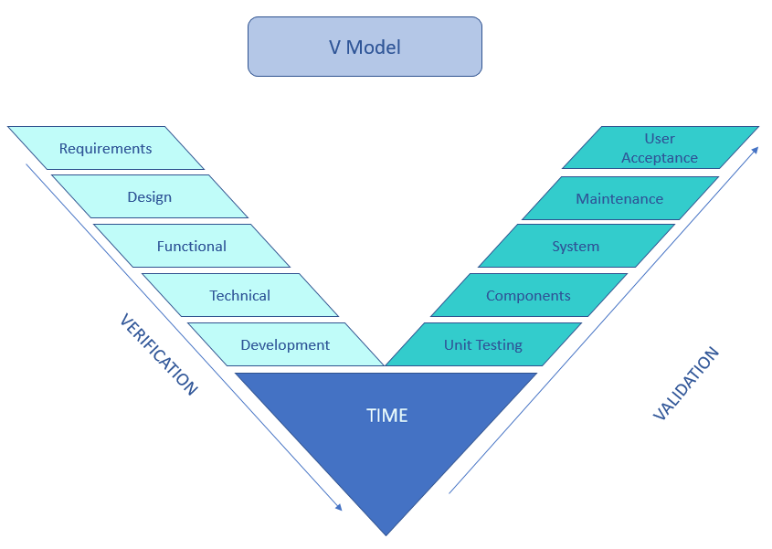
V Model
AR
TST
BA
BA
DEV
AR
TST
DEV
PM
PM

Slide 12
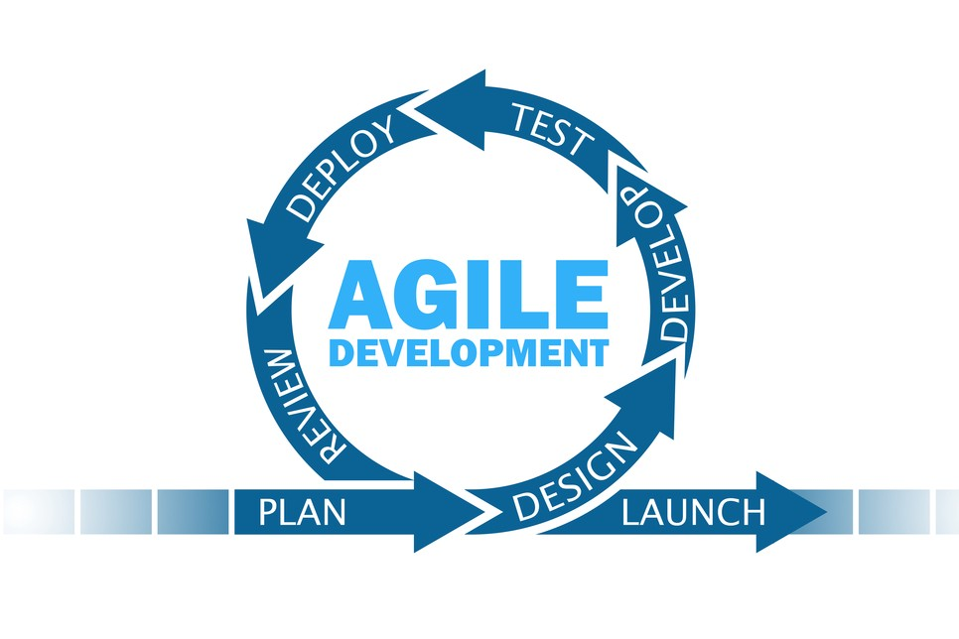
Agile
Notes:
Osnovne karakteristike:
Iterativan proces (nije linearan kao waterfall)
Fokus na razvoju funkcionalnosti koji donose vrednost klijentu u kratkim ciklusima
Integrisano testiranje i razvoj softvera sto bi (u teoriji) trebalo da dovede do kvalitetnijeg softvera
Feedback je pozeljan i zato ga stalno trazimo
Prihvatamo promene u kasnijim fazama razvoja aplikacije

Slide 13
Agile in simple words

Slide 14
Agile (SCRUM) team
CLIENT
BA/PO
DEV
TST
SM
Through out the project

Slide 15
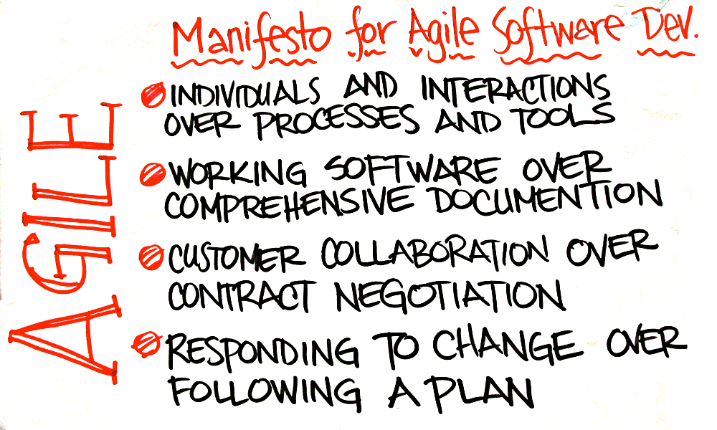
Agile Manifesto (values)

Slide 16
Agile test manifesto

Slide 17
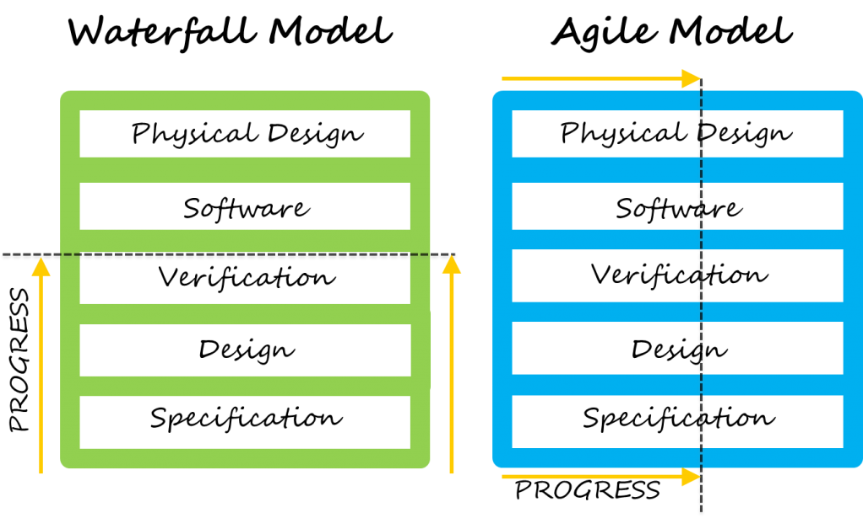
Sequential VS Agile

Slide 18
10 principles of Agile testing
Provide continuous feedback
Deliver value to the customer
Enable face-to-face communication
Have courage
Keep it simple
Practice continuous improvement
Respond to change
Self-organize
Focus on people
Enjoy
Notes:
1. Provide continuous feedback. Agile testers do not simply test constantly. They are also responsible for distributing the results of those tests and facilitating the provision of feedback from customers to developers in order to create a more robust product.
2. Deliver value to the customer. While this is the second principle, it is the paramount principle. The end goal of every action taken by an Agile tester is to create the best product possible for the customer.
3. Enable face-to-face communication. The Agile tester's role is to reduce confusion and errors by communicating directly with developers as well as enabling customers to communicate directly with developers.
4. Have courage. Developers can be defensive about their work. To meet their goal of providing value to the customer, Agile testers must fight for the changes and fixes that need to be made.
5. Keep it simple. Agile testers act on the aphorism that simplicity is the ultimate sophistication. For testing, that means performing only those tests that are necessary, and all tests that are necessary. For the product, that means delivering the simplest possible product that delivers the most possible value.
6. Practice continuous improvement. Agile testers are keen learners; they are never done learning how to do their job better.
7. Respond to change. Agile testers are adaptable and flexible, keeping up with changes in the product and the marketplace.
8. Self-organise. Instead of waiting at an assigned seat on the assembly line, Agile testers spring into action at every point in the process. They actively seek out problems and bring people together to solve them.
9. Focus on people. Agile testers are collaborative, preferring human interaction to technology. Their focus on people enables them to deliver a product that both has utility and is usable.
10. Enjoy. No one is as successful at meeting their goal as when they enjoy what they are doing. Agile testers who enjoy the work are able to deliver the greatest possible value to the customer.

Slide 19
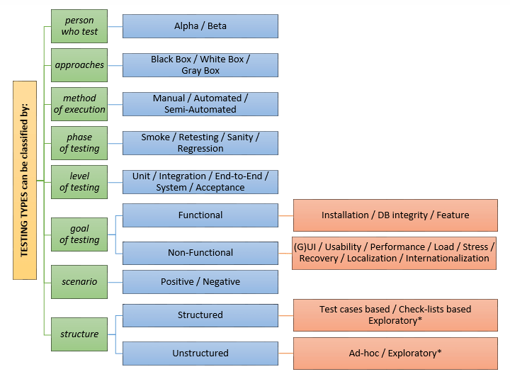
Types of testing

Slide 20
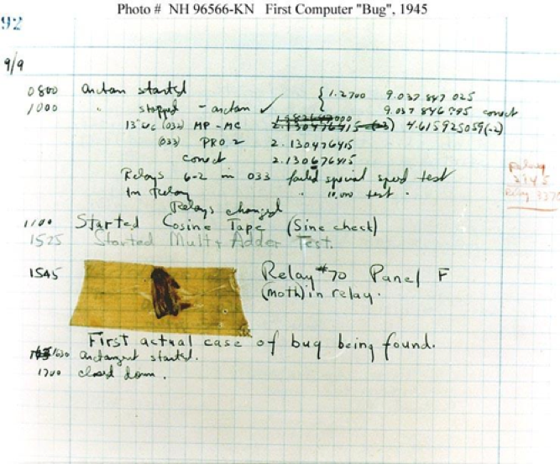
Piece of History: Defect AKA Bug
Why is defect often called ‘bug’?
Notes:
Grace Hopper – Mark II kompjuter – moljac se zalepio na relej – Harvard (kompjuterska labpratorija) – Grace je opisala u dnevniku aktivnosti sta se desilo i tako je skovan termin ’bug’

Slide 21
What is a Bug?
Error: A human action which produces an incorrect result
Fault/Defect: A manifestation of an Error in software – a Fault may cause a Failure
Failure: When actual result deviates from expected result during testing – consequence of a bug
Failure is an event;
Fault is a state of the software, caused by an Error
Fault is a BUG
Notes:
Error – greska
Fault/defect – nedostatak
Failure - kvar

Slide 22
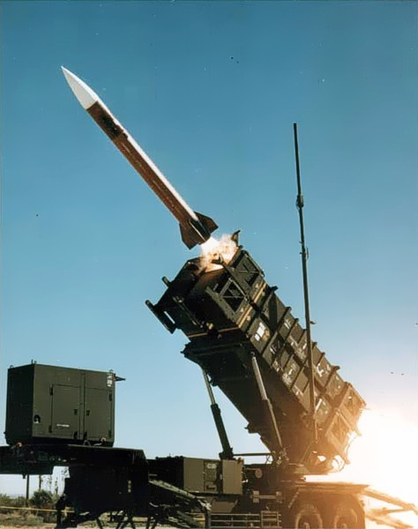
Most famous bugs
Ariene 5 Explosion
https://www.youtube.com/watch?v=5tJPXYA0Nec
Therac-25 medical radiation therapy device (1985-1987):
https://www.youtube.com/watch?v=izGSOsAGIVQ
Mars Climate Orbiter (1998):
https://www.youtube.com/watch?v=urcQAKKAAl0
US prisoners released early due to software glitch (2002-2015):
https://www.youtube.com/watch?v=Kk-J54hbFAg
HSBC Bank - Tax Cheat Scandal 2006:
https://www.youtube.com/watch?v=rlg64vr0DXs
Heartbleed:
https://www.youtube.com/watch?v=WgrBrPW_Zn4
Samsung Galaxy Note 7 battery explosion (2016):
https://www.youtube.com/watch?v=_Cd2WIxKRDk

Slide 23
Principles in software Testing
1. Testing shows presence of defects
2. Exhaustive testing is impossible
3. Early testing
4. Defects clustering
5. Pesticide paradox
6. Testing is context dependent
7. Absence of errors fallacy

Slide 24
P1 Testing shows presence of Defects
Notes:
Testing talks about the presence of defects and don’t talk about the absence of defects. i.e. Software Testing reduces the probability of undiscovered defects remaining in the software but even if no defects are found, it is not a proof of correctness.

Slide 25
P2 Exhaustive testing is impossible
Notes:
System has 10 screens Average of 4 menus per screen Average of 3 options per menu Average of 5 fields per screen 2 types of input per field
Around 50 possible values

Slide 26
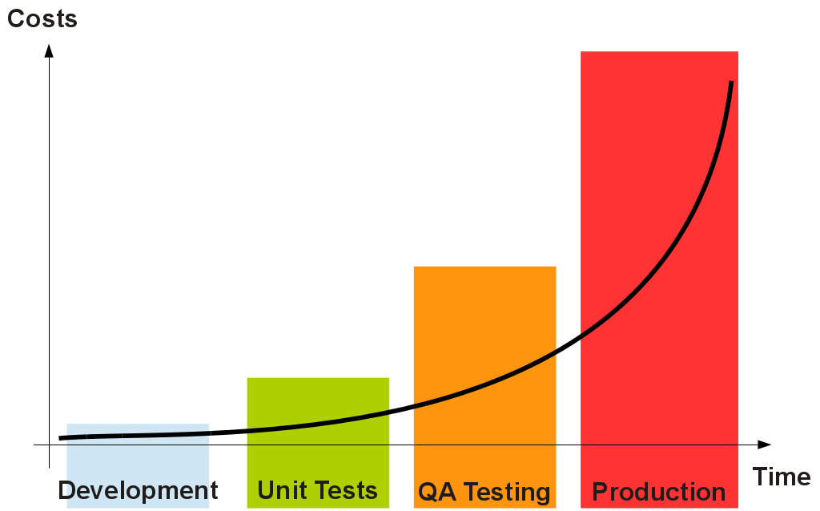
P3 Early Testing
Notes:
Testing activities should start as early as possible in the development life cycle
Test activities should be focused on defined objectives
Cost of finding and fixing defects increases over time (fix earlier – reduce cost!)

Slide 27
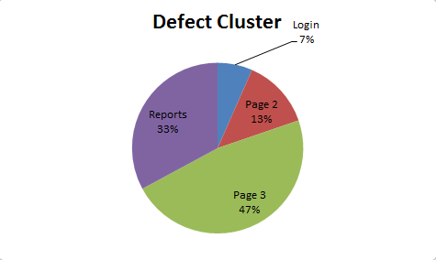
P4 Defect clustering
Notes:
Experience says defects tend to cluster i.e. most defects found during testing are usually confined to a small number of modules “Pareto law” (approximately 80% of the problems are found in 20% of the modules)
This needs to be taken into account in test prioritization

Slide 28
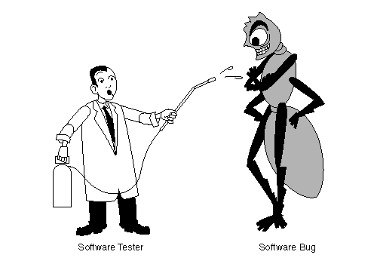
P5 The pesticide paradox
Notes:
Over time effectiveness of previous tests fades i.e. old tests do not find new issue.
Therefore tests need to be reviewed and revised and new tests need to be developed in order to potentially find new bugs

Slide 29
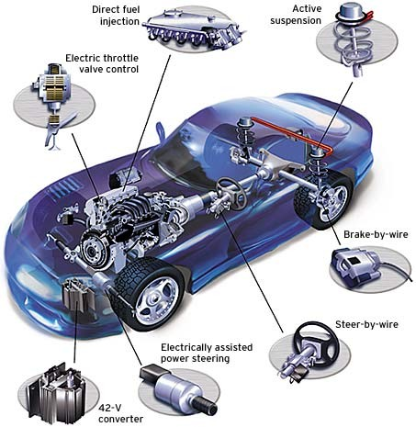
P6 Testing is Context Dependent
Notes:
Testing is done differently in different contexts e.g. safety critical software is tested differently than a website
Therefore, testing can be ~50% of development costs where it was ~80% in NASA’s Apollo program
According to Steve McConnell’s book, Code Complete “Industry Average: about 15 – 50 errors per 1000 lines of delivered code.” He goes on to say that “Microsoft Applications: about 10 – 20 defects per 1000 lines of code during in-house testing, and 0.5 defect per KLOC in production.” It is possible to achieve zero defects but it is also costly. NASA was able to achieve zero defects for the Space Shuttle Software, but at a cost of thousands of dollars per line of code
Different industries impose different testing standards
*KLOC = thousands of lines of code

Slide 30
P7 Absence of Errors Fallacy
Notes:
Even after defects have been resolved, product may still be unusable and/or does not fulfil the users’ needs and expectations

Slide 31
Q&A

Slide 32
THANK YOU!
Igor ZlatkoviĆ

