Slide 1
Chapter 5
Concurrency: Mutual Exclusion and Synchronization
Operating Systems:
Internals and Design Principles
Seventh Edition
By William Stallings
Notes:
“Operating Systems: Internal and Design Principles”, 7/e, by William Stallings, Chapter 5 “Concurrency: Mutual Exclusion and Synchronization”.

Slide 2
Multiple Processes
Operating System design is concerned with the management of processes and threads:
    Multiprogramming
    Multiprocessing
    Distributed Processing
Notes:
The central themes of operating system design are all concerned with the management of processes and threads:
• Multiprogramming: The management of multiple processes within a uniprocessor system
• Multiprocessing : The management of multiple processes within a multiprocessor
• Distributed processing: The management of multiple processes executing on multiple, distributed computer systems. The recent proliferation of clusters is a prime example of this type of system.

Slide 3
Concurrency & Shared Data
Concurrent processes may share data to support communication, info exchange,...
Threads in the same process can share global address space
Concurrent sharing may cause problems
For example: lost updates

Slide 4

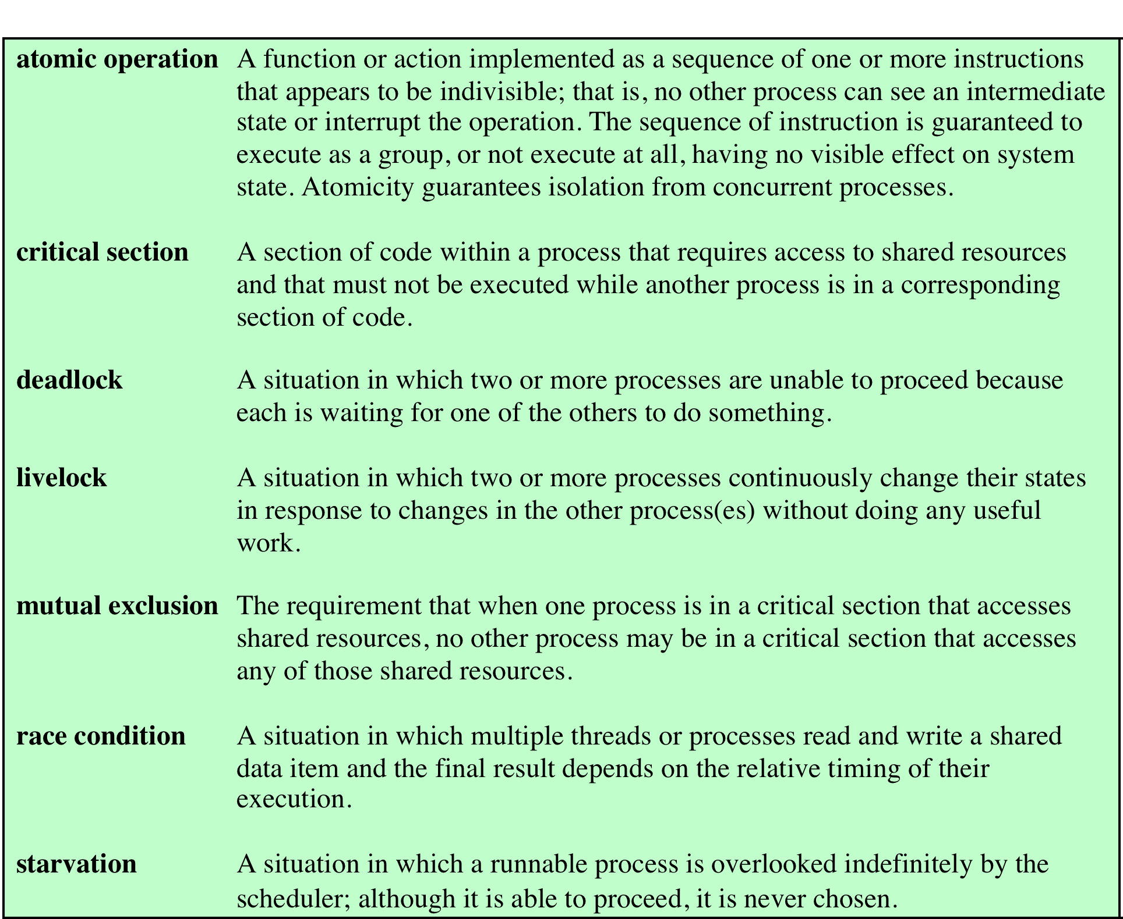
Key
Terms
Concurrency
Table 5.1 Some Key Terms Related to Concurrency
Notes:
Key terms related to concurrency.

Slide 5
Difficulties of Concurrency
Sharing of global resources
Difficult for the OS to manage the allocation of resources optimally
Difficult to locate programming errors as results are not deterministic and reproducible
Notes:
The following difficulties arise:
1. The sharing of global resources is fraught with peril. For example, if two processes both make use of the same global variable and both perform reads and writes on that variable, then the order in which the various reads and writes are executed is critical. An example of this problem is shown in the following subsection.
2. It is difficult for the OS to manage the allocation of resources optimally. For example, process A may request use of, and be granted control of, a particular I/O channel and then be suspended before using that channel. It may be undesirable for the OS simply to lock the channel and prevent its use by other processes; indeed this may lead to a deadlock condition, as described in Chapter 6 .
3. It becomes very difficult to locate a programming error because results are typically not deterministic and reproducible (e.g., see [LEBL87, CARR89, SHEN02] for a discussion of this point).
All of the foregoing difficulties present themselves in a multiprocessor system as well, because here too the relative speed of execution of processes is unpredictable. A multiprocessor system must also deal with problems arising from the simultaneous execution of multiple processes. Fundamentally, however, the problems are the same as those for uniprocessor systems. This should become clear as the discussion proceeds.

Slide 6

Race Condition
Occurs when multiple processes or threads read and write shared data items
The final result depends on the order of execution
      the “loser” of the race is the process that updates last and will determine the final value of the variable
Notes:
A race condition occurs when multiple processes or threads read and write data items so that the final result depends on the order of execution of instructions in the multiple processes. Let us consider two simple examples.
As a first example, suppose that two processes, P1 and P2, share the global variable a . At some point in its execution, P1 updates a to the value 1, and at some point in its execution, P2 updates a to the value 2. Thus, the two tasks are in a race to write variable a . In this example, the “loser” of the race (the process that updates last) determines the final value of a .
For our second example, consider two process, P3 and P4, that share global variables b and c , with initial values b = 1 and c = 2 . At some point in its execution, P3 executes the assignment b = b + c , and at some point in its execution, P4 executes the assignment c = b + c . Note that the two processes update different variables. However, the final values of the two variables depend on the order in which the two processes execute these two assignments. If P3 executes its assignment statement first, then the final values are b = 3 and c = 5 . If P4 executes its assignment statement first, then the final values are b = 4 and c = 3 .
Appendix A includes a discussion of race conditions using semaphores as an example.

Slide 7
Operating System Concerns
Design and management issues raised by the existence of concurrency:
  The OS must:
      be able to keep track of various processes
      allocate and de-allocate resources for each active process
      protect the data and physical resources of each process against interference by other processes
      ensure that the processes and outputs are independent of the processing speed
Notes:
What design and management issues are raised by the existence of concurrency?
We can list the following concerns:
1. The OS must be able to keep track of the various processes. This is done with the use of process control blocks and was described in Chapter 4 .
2. The OS must allocate and de-allocate various resources for each active process.
At times, multiple processes want access to the same resource. These resources include
• Processor time: This is the scheduling function, discussed in Part Four.
• Memory: Most operating systems use a virtual memory scheme. The topic is addressed in Part Three.
• Files: Discussed in Chapter 12 .
• I/O devices: Discussed in Chapter 11 .
3. The OS must protect the data and physical resources of each process against
unintended interference by other processes. This involves techniques that relate to memory, files, and I/O devices. A general treatment of protection is found in Chapter 14 .
4. The functioning of a process, and the output it produces, must be independent
of the speed at which its execution is carried out relative to the speed of other
concurrent processes. This is the subject of this chapter.

Slide 8
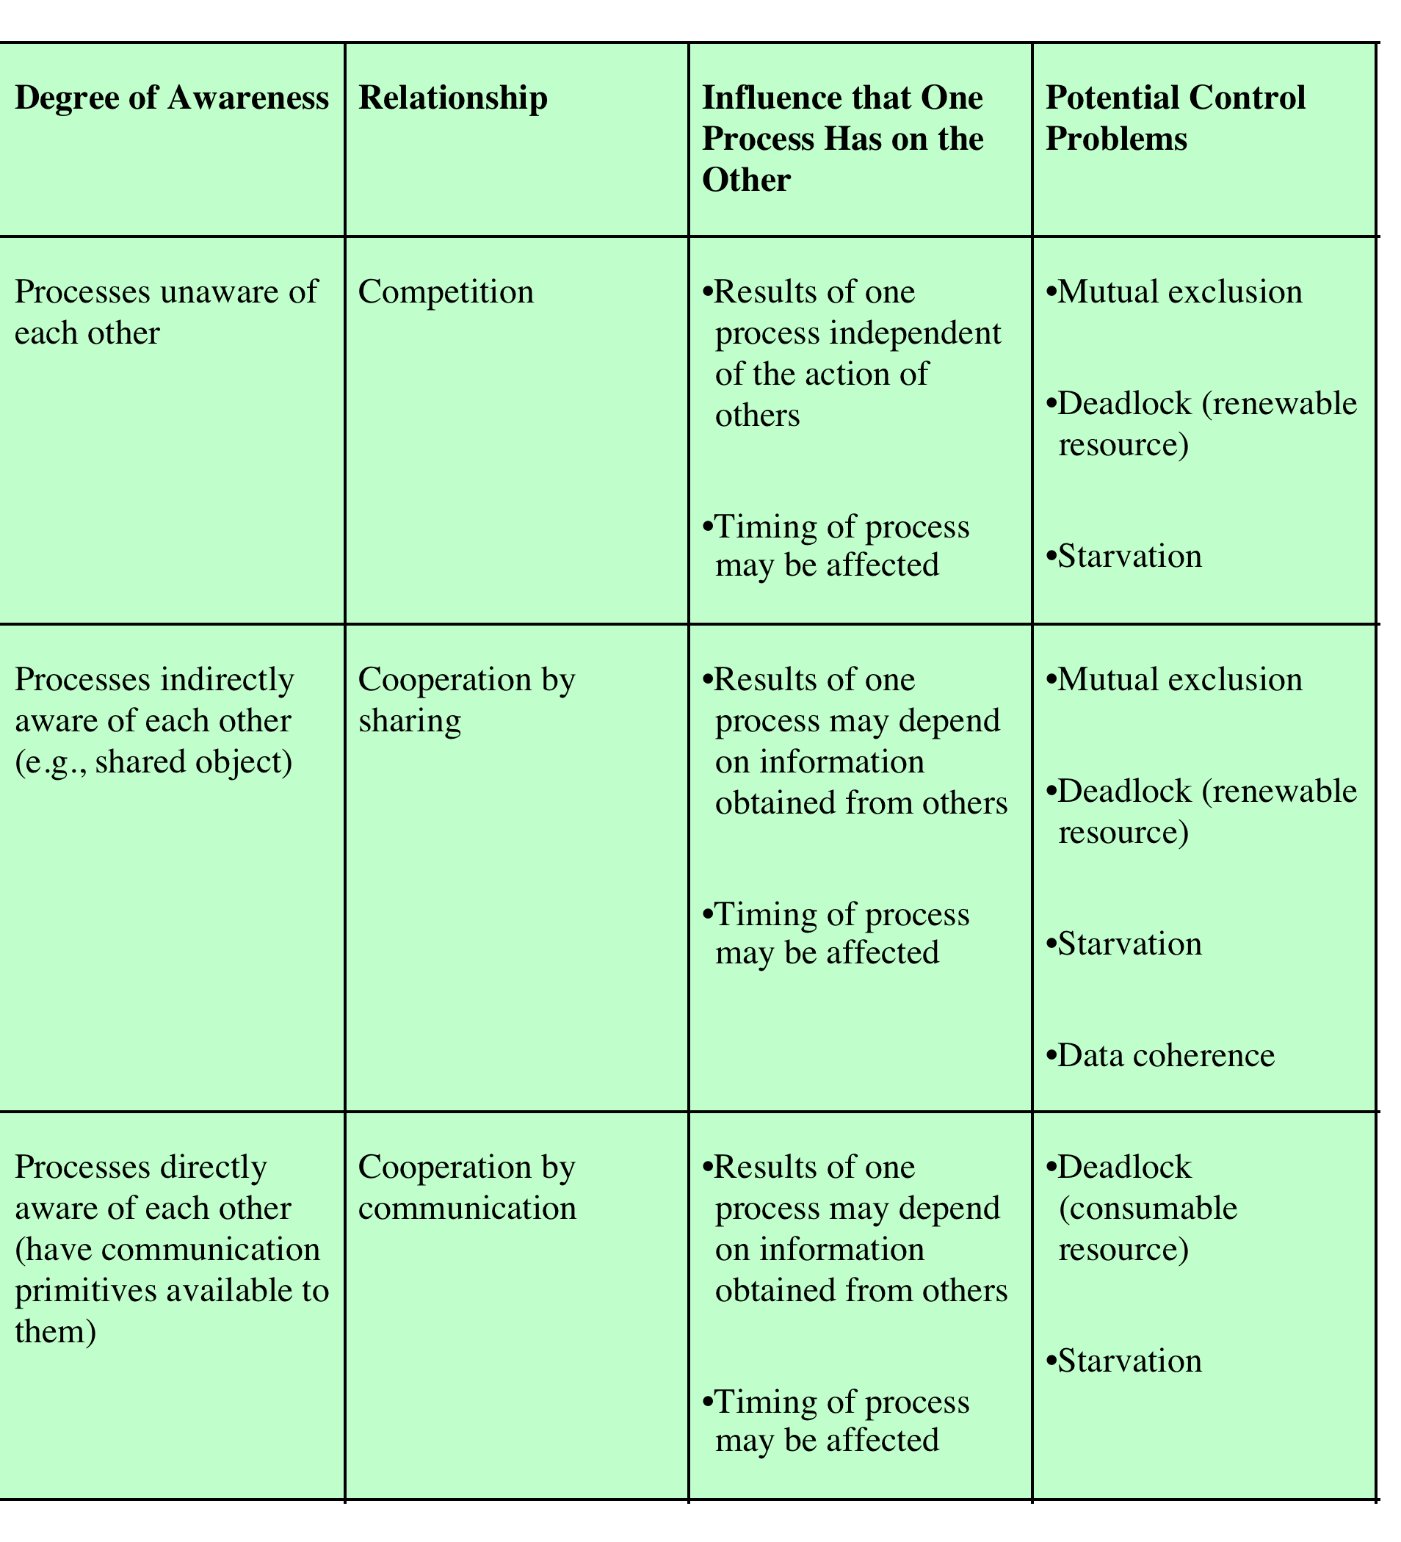
P I
R N
O T
C E
E R
S A
S C
T
I
O
N
Notes:
We can classify the ways in which processes interact on the basis of the degree to which they are aware of each other’s existence. Table 5.2 lists three possible degrees of awareness plus the consequences of each:
• Processes unaware of each other: These are independent processes that are not
intended to work together. The best example of this situation is the multiprogramming of multiple independent processes. These can either be batch jobs or interactive sessions or a mixture. Although the processes are not working together, the OS needs to be concerned about competition for resources. For example, two independent applications may both want to access the same disk or file or printer. The OS must regulate these accesses.
• Processes indirectly aware of each other: These are processes that are not necessarily
aware of each other by their respective process IDs but that share access to some object, such as an I/O buffer. Such processes exhibit cooperation in sharing the common object.
• Processes directly aware of each other: These are processes that are able to
communicate with each other by process ID and that are designed to work jointly on some activity. Again, such processes exhibit cooperation . Conditions will not always be as clear-cut as suggested in Table 5.2 . Rather, several processes may exhibit aspects of both competition and cooperation. Nevertheless, it is productive to examine each of the three items in the preceding list separately and determine their implications for the OS.
8

Slide 9
Resource Competition
Concurrent processes come into conflict when they use the same resource (competitively or shared)
  for example: I/O devices, memory, processor time, clock
Three control problems must be faced
  Need for mutual exclusion
  Deadlock
  Starvation
Sharing processes also need to address coherence
Notes:
Concurrent processes come into conflict with each other when they are competing for the use of the same resource. In its pure form, we can describe the situation as follows. Two or more processes need to access a resource during the course of their execution. Each process is unaware of the existence of other processes, and each is to be unaffected by the execution of the other processes. It follows from this that each process should leave the state of any resource that it uses unaffected. Examples of resources include I/O devices, memory, processor time, and the clock.
There is no exchange of information between the competing processes. However, the execution of one process may affect the behavior of competing processes. In particular, if two processes both wish access to a single resource, then one process will be allocated that resource by the OS, and the other will have to wait. Therefore, the process that is denied access will be slowed down. In an extreme case, the blocked process may never get access to the resource and hence will never terminate successfully.
In the case of competing processes three control problems must be faced. First is the need for mutual exclusion . Suppose two or more processes require access to a single non-sharable resource, such as a printer. During the course of execution, each process will be sending commands to the I/O device, receiving
status information, sending data, and/or receiving data. We will refer to such a resource as a critical resource , and the portion of the program that uses it as a critical section of the program. It is important that only one program at a time be allowed in its critical section. We cannot simply rely on the OS to understand and enforce this restriction because the detailed requirements may not be obvious. In the case of the printer, for example, we want any individual process to have control of the printer while it prints an entire file. Otherwise, lines from competing processes will be interleaved.
The enforcement of mutual exclusion creates two additional control problems. One is that of deadlock . For example, consider two processes, P1 and P2, and two resources, R1 and R2. Suppose that each process needs access to both resources to perform part of its function. Then it is possible to have the following situation: the OS assigns R1 to P2, and R2 to P1. Each process is waiting for one of the two resources. Neither will release the resource that it already owns until it has acquired the other resource and performed the function requiring both resources. The two processes are deadlocked.
A final control problem is starvation . Suppose that three processes (P1, P2, P3) each require periodic access to resource R. Consider the situation in which P1 is in possession of the resource, and both P2 and P3 are delayed, waiting for that resource. When P1 exits its critical section, either P2 or P3 should be allowed access to R. Assume that the OS grants access to P3 and that P1 again requires access before P3 completes its critical section. If the OS grants access to P1 after P3 has finished, and subsequently alternately grants access to P1 and P3, then P2 may indefinitely be denied access to the resource, even though there is no deadlock situation.

Slide 10
Need for Mutual Exclusion
If there is no controlled access to shared data, processes or threads may get an inconsistent view of this data
The result of concurrent execution will depend on the order in which instructions are interleaved.
Errors are timing dependent and usually not reproducible.

Slide 11
A Simple Example
Assume P1 and P2 are executing this code and share the variable a
Processes can be preempted at any time.
Assume P1 is preempted after the input statement, and P2 then executes entirely
The character echoed by P1 will be the one read by P2 !!
static char a;
void echo()
{
cin >> a;
cout << a;
}

Slide 12
What’s the Problem?
This is an example of a race condition
Individual processes (threads) execute sequentially in isolation, but concurrency causes them to interact.
We need to prevent concurrent execution by processes when they are changing the same data. We need to enforce mutual exclusion.

Slide 13
The Critical Section Problem
When a process executes code that manipulates shared data (or resources), we say that the process is in its critical section (CS) for that shared data
We must enforce mutual exclusion on the execution of critical sections.
Only one process at a time can be in its CS (for that shared data or resource).

Slide 14
The Critical Section Problem
Enforcing mutual exclusion guarantees that related CS’s will be executed serially instead of concurrently.
The critical section problem is how to provide mechanisms to enforce mutual exclusion so the actions of concurrent processes won’t depend on the order in which their instructions are interleaved

Slide 15
The Critical Section Problem
Processes/threads must request permission to enter a CS, & signal when they leave CS.
Program structure:
  entry section: requests entry to CS
  exit section: notifies that CS is completed
  remainder section (RS): code that does not involve shared data and resources.
The CS problem exists on multiprocessors as well as on uniprocessors.

Slide 16
Mutual Exclusion and Data Coherence
Mutual Exclusion ensures data coherence if properly used.
Critical Resource (CR) - a shared resource such as a variable, file, or device
Data Coherence:
  The final value or state of a CR shared by concurrently executing processes is the same as the final value or state would be if each process executed serially, in some order.

Slide 17
Deadlock and Starvation
Deadlock: two or more processes are blocked permanently because each is waiting for a resource held in a mutually exclusive manner by one of the others.
Starvation: a process is repeatedly denied access to some resource which is protected by mutual exclusion, even though the resource periodically becomes available.

Slide 18
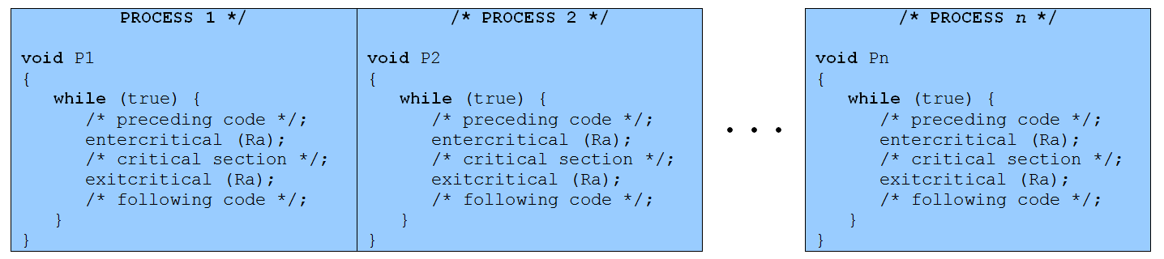
Mutual Exclusion
Figure 5.1 Illustration of Mutual Exclusion
Notes:
Control of competition inevitably involves the OS because it is the OS that allocates resources. In addition, the processes themselves will need to be able to express the requirement for mutual exclusion in some fashion, such as locking a resource prior to its use. Any solution will involve some support from the OS, such as the provision of the locking facility.
Figure 5.1 illustrates the mutual exclusion mechanism in abstract terms. There are n processes to be executed concurrently. Each process includes (1) a critical section that operates on some resource Ra, and (2) additional code preceding and following the critical section that does not involve access to Ra. Because all processes access the same resource Ra, it is desired that only one process at a time be in its critical section. To enforce mutual exclusion, two functions are provided: entercritical and exitcritical . Each function takes as an argument the name of the resource that is the subject of competition. Any process that attempts to enter its critical section while another process is in its critical section, for the same resource, is made to wait.
It remains to examine specific mechanisms for providing the functions entercritical and exitcritical . For the moment, we defer this issue while we consider the other cases of process interaction.

Slide 19
Requirements for Mutual Exclusion
Mutual Exclusion: must be enforced
Non interference: A process that halts must not
interfere with other processes
No deadlock or starvation
Progress:A process must not be denied access to a critical section when there is no other process using it
No assumptions are made about relative process speeds or number of processes
A process remains inside its critical section for a finite time only
Notes:
Any facility or capability that is to provide support for mutual exclusion should
meet the following requirements:
1. Mutual exclusion must be enforced: Only one process at a time is allowed into
its critical section, among all processes that have critical sections for the same resource or shared object.
2. A process that halts in its noncritical section must do so without interfering
with other processes.
3. It must not be possible for a process requiring access to a critical section to be
delayed indefinitely: no deadlock or starvation.
4. When no process is in a critical section, any process that requests entry to its
critical section must be permitted to enter without delay.
5. No assumptions are made about relative process speeds or number of processors.
6. A process remains inside its critical section for a finite time only.
There are a number of ways in which the requirements for mutual exclusion can be satisfied. One approach is to leave the responsibility with the processes that wish to execute concurrently. Processes, whether they are system programs or application programs, would be required to coordinate with one another to enforce mutual exclusion, with no support from the programming language or the OS. We can refer to these as software approaches. Although this approach is prone to high processing overhead and bugs, it is nevertheless useful to examine such approaches to gain a better understanding of the complexity of concurrent processing. This topic is covered in Appendix A . A second approach involves the use of special purpose machine instructions. These have the advantage of reducing overhead but nevertheless will be shown to be unattractive as a general-purpose solution; they are covered in Section 5.2 . A third approach is to provide some level of support within the OS or a programming language. Three of the most important such approaches are examined in Sections 5.3 through 5.5 .

Slide 20

Mutual Exclusion:
Hardware Support
  Interrupt Disabling
  uniprocessor system
  disabling interrupts guarantees mutual exclusion
  Disadvantages:
  the efficiency of execution could be noticeably degraded
  this approach will not work in a multiprocessor architecture

Slide 21

Mutual Exclusion:
Hardware Support
  Special Machine Instructions
    Compare&Swap Instruction
        also called a “compare and exchange instruction”
        a compare is made between a memory value and a test value
        if the old memory value = test value, swap in a new value to the memory location
        always return the old memory value
        carried out atomically in the hardware.
Notes:
COMPARE&SWAP INSTRUCTION
This version of the instruction checks a memory location ( *word ) against a test value ( testval ). If the memory location’s current value is testval, it is replaced with newval ; otherwise it is left unchanged. The old memory value is always returned; thus, the memory location has been updated if the returned value is the same as the test value. This atomic instruction therefore has two parts: A compare is made between a memory value and a test value; if the values are the same, a swap occurs. The entire compare&swap function is carried out atomically—that is, it is not subject to interruption.
Another version of this instruction returns a Boolean value: true if the swap occurred; false otherwise. Some version of this instruction is available on nearly all processor families (x86, IA64, sparc, /390, etc.), and most operating systems use this instruction for support of concurrency.

Slide 22
Mutual Exclusion:
Hardware Support
  Compare&Swap Instruction
    Pseudo-code definition of the
    hardware instruction:
      compare_and_swap (word, test_val, new_val)
      if (word ==test_val)
      word = new_val;
      return new_val
Notes:
COMPARE&SWAP INSTRUCTION
This version of the instruction checks a memory location ( *word ) against a test value ( testval ). If the memory location’s current value is testval, it is replaced with newval ; otherwise it is left unchanged. The old memory value is always returned; thus, the memory location has been updated if the returned value is the same as the test value. This atomic instruction therefore has two parts: A compare is made between a memory value and a test value; if the values are the same, a swap occurs. The entire compare&swap function is carried out atomically—that is, it is not subject to interruption.
Another version of this instruction returns a Boolean value: true if the swap occurred; false otherwise. Some version of this instruction is available on nearly all processor families (x86, IA64, sparc, /390, etc.), and most operating systems use this instruction for support of concurrency.

Slide 23
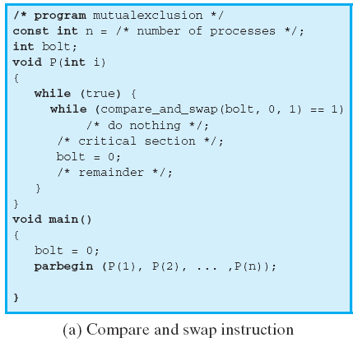
Compare and Swap
Instruction
word = bolt
test_val = 0
new_val = 1
If bolt is 0 when the C&S is executed, the condition is false and P enters its critical section. (leaves bolt = 1)
If bolt = 1 when C&S executes, P continues to execute the while loop. It’s busy waiting ( or spinning)
Figure 5.2 Hardware Support for Mutual Exclusion
Notes:
Figure 5.2a shows a mutual exclusion protocol based on the use of this instruction. A shared variable bolt is initialized to 0. The only process that may enter its critical section is one that finds bolt equal to 0. All other processes attempting to enter their critical section go into a busy waiting mode. The term busy waiting , or spin waiting , refers to a technique in which a process can do nothing until it gets permission to enter its critical section but continues to execute an instruction or set of instructions that tests the appropriate variable to gain entrance. When a process leaves its critical section, it resets bolt to 0; at this point one and only one of the waiting processes is granted access to its critical section. The choice of process depends on which process happens to execute the compare & swap instruction next.

Slide 24
Special Machine Instruction:
Advantages
Applicable to any number of processes on either a single processor or multiple processors sharing main memory
Simple and easy to verify
It can be used to support multiple critical sections; each critical section can be defined by its own variable
Notes:
The use of a special machine instruction to enforce mutual exclusion has a number of advantages:
• It is applicable to any number of processes on either a single processor or multiple processors sharing main memory.
• It is simple and therefore easy to verify.
• It can be used to support multiple critical sections; each critical section can be defined by its own variable.

Slide 25
Special Machine Instruction:
Disadvantages
Busy-waiting is employed, thus while a process is waiting for access to a critical section it continues to consume processor time
Starvation is possible when a process leaves a critical section and more than one process is waiting
Deadlock is possible if priority-
based scheduling is used
Notes:
There are some serious disadvantages:
• Busy waiting is employed: Thus, while a process is waiting for access to a critical section, it continues to consume processor time.
Starvation is possible: When a process leaves a critical section and more than one process is waiting, the selection of a waiting process is arbitrary. Thus, some process could indefinitely be denied access.
• Deadlock is possible: Consider the following scenario on a single-processor system. Process P1 executes the special instruction (e.g., compare & swap, exchange ) and enters its critical section. P1 is then interrupted to give the processor to P2, which has higher priority. If P2 now attempts to use the same resource as P1, it will be denied access because of the mutual exclusion mechanism. Thus, it will go into a busy waiting loop. However, P1 will never be dispatched
because it is of lower priority than another ready process, P2.
Because of the drawbacks of both the software and hardware solutions just outlined, we need to look for other mechanisms.

Slide 26
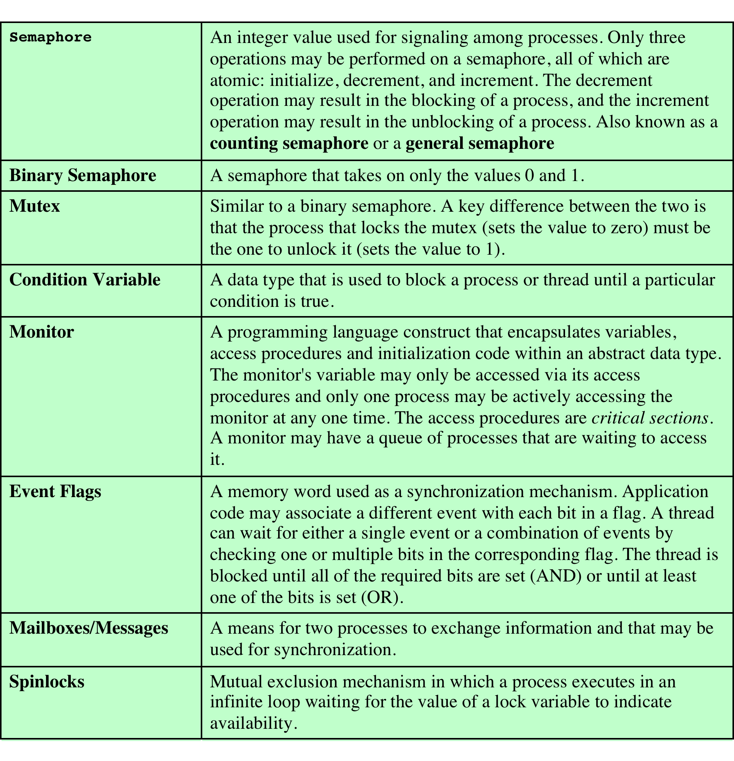
Common Concurrency Mechanisms
Notes:
We now turn to OS and programming language mechanisms that are used to provide concurrency. Table 5.3 summarizes mechanisms in common use. We begin, in this section, with semaphores. The next two sections discuss monitors and message passing. The other mechanisms in Table 5.3 are discussed when treating specific operating system examples, in Chapters 6 and 13 .

Slide 27
Semaphore
There is no way to inspect or manipulate semaphores other than these three operations
A variable that has an integer value upon which only three operations are defined:
May be initialized to a nonnegative integer value
The semWait operation decrements the value
The semSignal operation increments the value
Notes:
The fundamental principle is this: Two or more processes can cooperate by means of simple signals, such that a process can be forced to stop at a specified place until it has received a specific signal. Any complex coordination requirement can be satisfied by the appropriate structure of signals. For signaling, special variables called semaphores are used. To transmit a signal via semaphore s , a process executes the primitive semSignal(s) . To receive a signal via semaphore s , a process executes the primitive semWait(s) ; if the corresponding signal has not yet been transmitted, the process is suspended until the transmission takes place.
To achieve the desired effect, we can view the semaphore as a variable that has an integer value upon which only three operations are defined:
1. A semaphore may be initialized to a nonnegative integer value.
2. The semWait operation decrements the semaphore value. If the value becomes negative, then the process executing the semWait is blocked.
Otherwise, the process continues execution.
3. The semSignal operation increments the semaphore value. If the resulting value is less than or equal to zero, then a process blocked by a semWait operation,
if any, is unblocked. Other than these three operations, there is no way to inspect or manipulate semaphores.
We explain these operations as follows. To begin, the semaphore has a zero or positive value. If the value is positive, that value equals the number of processes that can issue a wait and immediately continue to execute. If the value is zero, either by initialization or because a number of processes equal to the initial semaphore value have issued a wait, the next process to issue a wait is blocked, and the semaphore value goes negative. Each subsequent wait drives the semaphore value further into minus territory. The negative value equals the number of processes waiting to be unblocked. Each signal unblocks one of the waiting processes when the semaphore value is negative.

Slide 28
Consequences
There is no way to know before a process decrements a semaphore whether it will block or not
There is no way to know which process will continue immediately on a uniprocessor system when two processes are running concurrently
You don’t know whether another process is waiting so the number of unblocked processes may be zero or one
Notes:
[DOWN08] points out three interesting consequences of the semaphore definition:
• In general, there is no way to know before a process decrements a semaphore whether it will block or not.
After a process increments a semaphore and another process gets woken up, both processes continue running concurrently. There is no way to know which process, if either, will continue immediately on a uniprocessor system.
• When you signal a semaphore, you don’t necessarily know whether another process is waiting, so the number of unblocked processes may be zero or one.

Slide 29
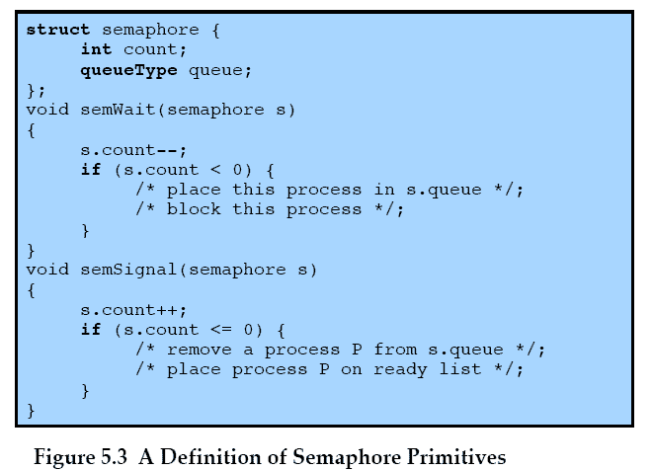
Semaphore Primitives
Notes:
Figure 5.3 suggests a more formal definition of the primitives for semaphores. The semWait and semSignal primitives are assumed to be atomic.

Slide 30
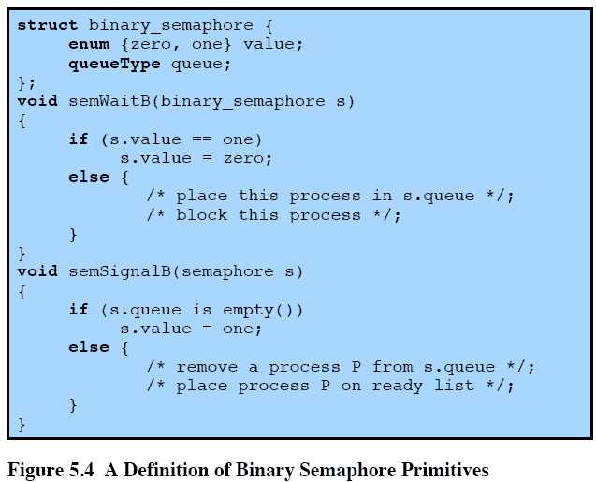
Binary Semaphore Primitives
Notes:
A more restricted version, known as the binary semaphore , is defined in Figure 5.4 . A binary semaphore may only take on the values 0 and 1 and can be defined by the
following three operations:
1. A binary semaphore may be initialized to 0 or 1.
2. The semWaitB operation checks the semaphore value. If the value is zero, then the process executing the semWaitB is blocked. If the value is one, then the value is changed to zero and the process continues execution.
3. The semSignalB operation checks to see if any processes are blocked on this semaphore (semaphore value equals 0). If so, then a process blocked by a semWaitB operation is unblocked. If no processes are blocked, then the value of the semaphore is set to one.
In principle, it should be easier to implement the binary semaphore, and it can be shown that it has the same expressive power as the general semaphore (see Problem 5.17). To contrast the two types of semaphores, the nonbinary semaphore is often referred to as either a counting semaphore or a general semaphore .
A concept related to the binary semaphore is the mutex . A key difference between the two is that the process that locks the mutex (sets the value to zero) must be the one to unlock it (sets the value to 1). In contrast, it is possible for one process to lock a binary semaphore and for another to unlock it.

Slide 31
Strong/Weak Semaphores
A queue is used to hold processes waiting on the semaphore
Strong Semaphores
the process that has been blocked the longest is released from the queue first (FIFO)
Weak Semaphores
the order in which processes are removed from the queue is not specified
Notes:
For both counting semaphores and binary semaphores, a queue is used to hold processes waiting on the semaphore. The question arises of the order in which processes are removed from such a queue. The fairest removal policy is first-in-first-out (FIFO): The process that has been blocked the longest is released from the queue first; a semaphore whose definition includes this policy is called a strong semaphore . A semaphore that does not specify the order in which processes are removed from the queue is a weak semaphore .

Slide 32
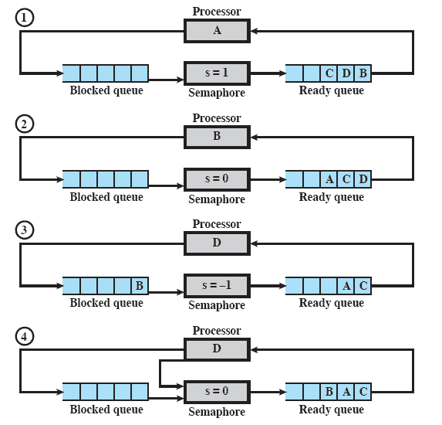
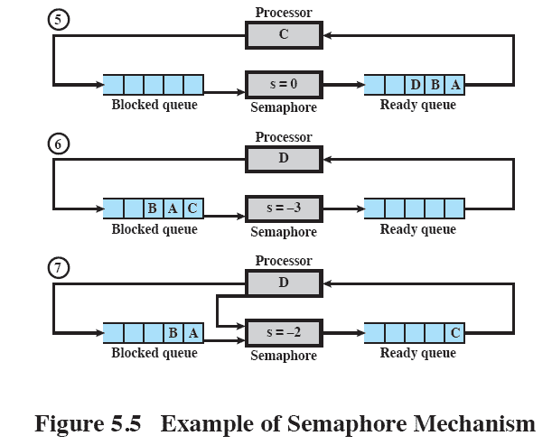
Example of Semaphore Mechanism
Notes:
Figure 5.5 , based on one in [DENN84], is an example of the operation of a strong semaphore. Here processes A, B, and C depend on a result from process D. Initially (1), A is running;
B, C, and D are ready; and the semaphore count is 1, indicating that one of D’s results is available. When A issues a semWait instruction on semaphore s , the semaphore decrements to 0, and A can continue to execute; subsequently it rejoins the ready queue. Then B runs (2), eventually issues a semWait instruction, and is blocked, allowing D to run (3). When D completes a new result, it issues a semSignal instruction, which allows B to move to the ready queue (4). D rejoins the ready queue and C begins to run (5) but is blocked when it issues a semWait instruction. Similarly, A and B run and are blocked on the semaphore, allowing D to resume execution (6). When D has a result, it issues a semSignal , which transfers C to the ready queue. Later cycles of D will release A and B from the Blocked state.

Slide 33
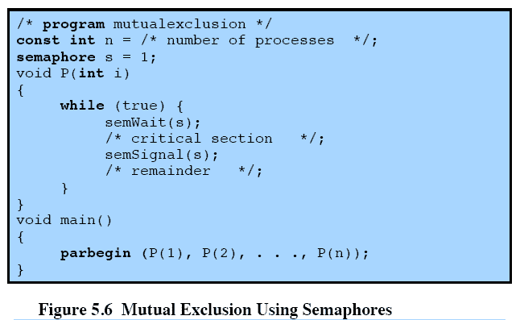
Mutual Exclusion
Notes:
For the mutual exclusion algorithm discussed in the next subsection and illustrated in Figure 5.6 , strong semaphores guarantee freedom from starvation, while weak semaphores do not. We will assume strong semaphores because they are more convenient and because this is the form of semaphore typically provided by operating systems.
Figure 5.6 shows a straightforward solution to the mutual exclusion problem using a semaphore s (compare Figure 5.1 ). Consider n processes, identified in the array P ( i ), all of which need access to the same resource. Each process has a critical section used to access the resource. In each process, a semWait(s) is executed just before its critical section. If the value of s becomes negative, the process is blocked. If the value is 1, then it is decremented to 0 and the process immediately enters its critical section; because s is no longer positive, no other process will be able to enter its critical section.
The semaphore is initialized to 1. Thus, the first process that executes a semWait will be able to enter the critical section immediately, setting the value of s to 0. Any other process attempting to enter the critical section will find it busy and will be blocked, setting the value of s to –1. Any number of processes may attempt entry; each such unsuccessful attempt results in a further decrement of the value of s . When the process that initially entered its critical section departs, s is incremented and one of the blocked processes (if any) is removed from the queue of blocked processes associated with the semaphore and put in a Ready state. When it is next scheduled by the OS, it may enter the critical section.

Slide 34
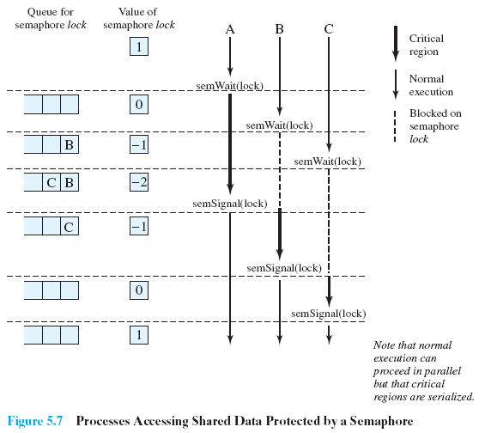

Shared Data Protected by a Semaphore
Notes:
Figure 5.7 , based on one in [BACO03], shows a possible sequence for three processes using the mutual exclusion discipline of Figure 5.6 . In this example three processes (A, B, C) access a shared resource protected by the semaphore lock . Process A executes semWait( lock ) ; because the semaphore has a value of 1 at the time of the semWait operation, A can immediately enter its critical section and the semaphore takes on the value 0. While A is in its critical section, both B and CFigure 5.7 , based on one in [BACO03], shows a possible sequence for three processes using the mutual exclusion discipline of Figure 5.6 . In this example three processes (A, B, C) access a shared resource protected by the semaphore lock .
Process A executes semWait( lock ) ; because the semaphore has a value of 1 at the time of the semWait operation, A can immediately enter its critical section and the semaphore takes on the value 0. While A is in its critical section, both B and C perform a semWait operation and are blocked pending the availability of the semaphore. When A exits its critical section and performs semSignal( lock ) , B, which was the first process in the queue, can now enter its critical section.

Slide 35
Producer/Consumer Problem
General Situation:
one or more producers are generating data and placing these in a buffer
a single consumer is taking items out of the buffer one at time
only one producer or consumer may access the buffer at any one time
The Problem:
ensure that the producer can’t add data into full buffer and consumer can’t remove data from an empty buffer
Notes:
To begin, let us assume that the buffer is infinite and consists of a linear array of elements.
We now examine one of the most common problems faced in concurrent processing: the producer/consumer problem. The general statement is this: There are one or more producers generating some type of data (records, characters) and placing these in a buffer. There is a single consumer that is taking items out of the buffer one at a time. The system is to be constrained to prevent the overlap of buffer operations. That is, only one agent (producer or consumer) may access the buffer at any one time. The problem is to make sure that the producer won’t try to add data into the buffer if it’s full and that the consumer won’t try to remove data from an empty buffer. We will look at a number of solutions to this problem to illustrate both the power and the pitfalls of semaphores.

Slide 36
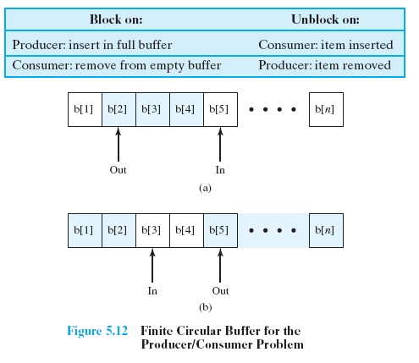
Finite Circular Buffer
Notes:
Finally, let us add a new and realistic restriction to the producer/consumer problem: namely, that the buffer is finite. The buffer is treated as a circular storage ( Figure 5.12 ), and pointer values must be expressed modulo the size of the buffer.

Slide 37
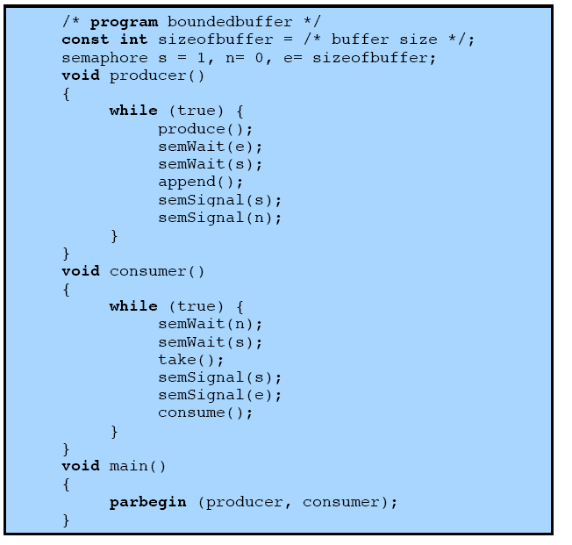
Solution Using
Semaphores
Figure 5.13 A Solution to the Bounded-Buffer Producer/Consumer Problem Using Semaphores
Notes:
Figure 5.13 shows a solution using general semaphores. The semaphore e has been added to keep track of the number of empty spaces.

Slide 38
Implementation of Semaphores
Imperative that the semWait and semSignal operations be implemented as atomic primitives
Can be implemented in hardware or firmware
Software schemes such as Dekker’s or Peterson’s algorithms can be used
Use one of the hardware-supported schemes for mutual exclusion
Notes:
As was mentioned earlier, it is imperative that the semWait and semSignal operations be implemented as atomic primitives. One obvious way is to implement them in hardware or firmware. Failing this, a variety of schemes have been suggested. The essence of the problem is one of mutual exclusion: Only one process at a time may manipulate a semaphore with either a semWait or semSignal operation. Thus, any of the software schemes, such as Dekker’s algorithm or Peterson’s algorithm ( Appendix A ), could be used; this would entail a substantial processing overhead.
Another alternative is to use one of the hardware-supported schemes for mutual exclusion.

Slide 39
Review
Concurrent processes, threads
Access to shared data/resources
Need to enforce mutual exclusion
Hardware mechanisms have limited usefulness
Semaphores: OS mechanism for mutual exclusion & other synchronization issues
Standard semaphore/counting
Binary semaphore
Producer/consumer problem

Slide 40

Monitors
Programming language construct that provides equivalent functionality to that of semaphores and is easier to control
Implemented in a number of programming languages
    including Concurrent Pascal, Pascal-Plus, Modula-2, Modula-3, and Java
    Has also been implemented as a program library
    Software module consisting of one or more procedures, an initialization sequence, and local data
Notes:
The monitor is a programming-language construct that provides equivalent functionality to that of semaphores and that is easier to control. The concept was first formally defined in [HOAR74]. The monitor construct has been implemented in a number of programming languages, including Concurrent Pascal, Pascal-Plus, Modula-2, Modula-3, and Java. It has also been implemented as a program library. This allows programmers to put a monitor lock on any object. In particular, for something like a linked list, you may want to lock all linked lists with one lock, or have one lock for each list, or have one lock for each element of each list.
A monitor is a software module consisting of one or more procedures, an initialization sequence, and local data.

Slide 41
Monitor Characteristics
Local data variables are accessible only by the monitor’s procedures and not by any external procedure
Process enters monitor by invoking one of its procedures
Only one process may be executing in the monitor at a time
Notes:
The chief characteristics of a monitor are the following:
1. The local data variables are accessible only by the monitor’s procedures and
not by any external procedure.
2. A process enters the monitor by invoking one of its procedures.
3. Only one process may be executing in the monitor at a time; any other processes
that have invoked the monitor are blocked, waiting for the monitor to become available.
The first two characteristics are reminiscent of those for objects in object-oriented software. Indeed, an object-oriented OS or programming language can readily implement a monitor as an object with special characteristics.
By enforcing the discipline of one process at a time, the monitor is able to provide a mutual exclusion facility. The data variables in the monitor can be accessed by only one process at a time. Thus, a shared data structure can be protected by placing it in a monitor. If the data in a monitor represent some resource, then the monitor provides a mutual exclusion facility for accessing the resource.
To be useful for concurrent processing, the monitor must include synchronization tools. For example, suppose a process invokes the monitor and, while in the
monitor, must be blocked until some condition is satisfied. A facility is needed by which the process is not only blocked but releases the monitor so that some other process may enter it. Later, when the condition is satisfied and the monitor is again available, the process needs to be resumed and allowed to reenter the monitor at the point of its suspension.

Slide 42
Synchronization
Achieved by the use of condition variables that are contained within the monitor and accessible only within the monitor
    Condition variables are operated on by two functions:
        cwait(c): suspend execution of the calling process on condition c
        csignal(c): resume execution of some process blocked after a cwait on the same condition
Notes:
A monitor supports synchronization by the use of condition variables that are contained within the monitor and accessible only within the monitor. Condition variables are a special data type in monitors, which are operated on by two functions:
• cwait(c) : Suspend execution of the calling process on condition c . The monitor is now available for use by another process.
• csignal(c) : Resume execution of some process blocked after a cwait on the same condition. If there are several such processes, choose one of them; if there is no such process, do nothing.
Note that monitor wait and signal operations are different from those for the semaphore. If a process in a monitor signals and no task is waiting on the condition variable, the signal is lost.

Slide 43
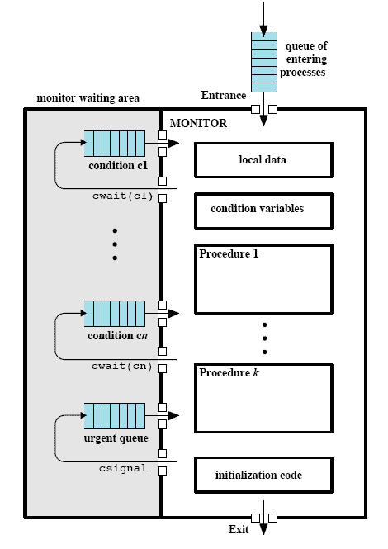
Structure of a Monitor
Figure 5.15 Structure of a Monitor
Notes:
Figure 5.15 illustrates the structure of a monitor. Although a process can enter the monitor by invoking any of its procedures, we can think of the monitor as having a single entry point that is guarded so that only one process may be in the monitor at a time. Other processes that attempt to enter the monitor join a queue of processes blocked waiting for monitor availability. Once a process is in the monitor, it may temporarily block itself on condition x by issuing cwait(x) ; it is then placed in a queue of processes waiting to reenter the monitor when the condition changes, and resume execution at the point in its program following the cwait(x) call. If a process that is executing in the monitor detects a change in the condition variable x , it issues csignal(x) , which alerts the corresponding condition queue that the condition has changed.

Slide 44
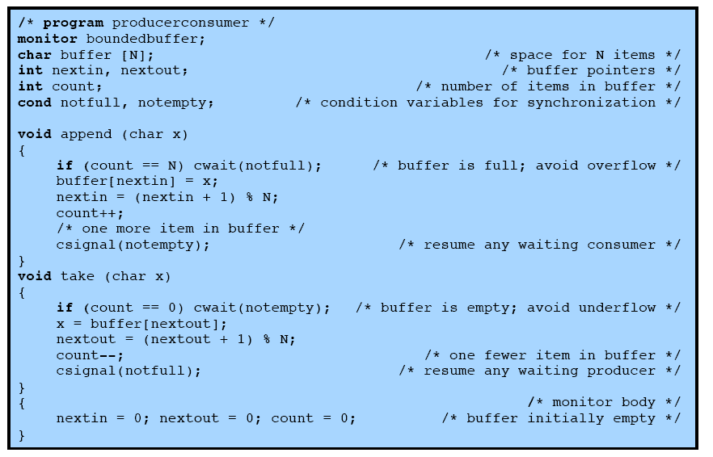
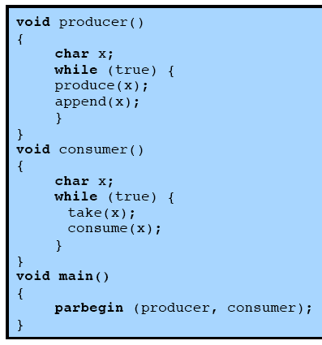
Problem Solution
Using a Monitor
Figure 5.16 A Solution to the Bounded-Buffer Producer/Consumer Problem Using a Monitor
Notes:
As an example of the use of a monitor, let us return to the bounded-buffer producer/consumer problem. Figure 5.16 shows a solution using a monitor. The monitor module, boundedbuffer , controls the buffer used to store and retrieve characters. The monitor includes two condition variables (declared with the construct cond ): notfull is true when there is room to add at least one character to the buffer, and notempty is true when there is at least one character in the buffer.
A producer can add characters to the buffer only by means of the procedure append inside the monitor; the producer does not have direct access to buffer . The procedure first checks the condition notfull to determine if there is space available in the buffer. If not, the process executing the monitor is blocked on that condition. Some other process (producer or consumer) may now enter the monitor. Later, when the buffer is no longer full, the blocked process may be removed from the queue, reactivated, and resume processing. After placing a character in the buffer, the process signals the notempty condition. A similar description can be made of the consumer function.
This example points out the division of responsibility with monitors compared to semaphores. In the case of monitors, the monitor construct itself enforces mutual exclusion: It is not possible for both a producer and a consumer simultaneously to access the buffer. However, the programmer must place the appropriate cwait and csignal primitives inside the monitor to prevent processes from depositing items in a full buffer or removing them from an empty one. In the case of semaphores, both mutual exclusion and synchronization are the responsibility of the programmer.
Note that in Figure 5.16 , a process exits the monitor immediately after executing the csignal function. If the csignal does not occur at the end of the procedure, then, in Hoare’s proposal, the process issuing the signal is blocked to make the monitor available and placed in a queue until the monitor is free. One possibility at this point would be to place the blocked process in the entrance queue, so that it would have to compete for access with other processes that had not yet entered the monitor. However, because a process blocked on a csignal function has already partially performed its task in the monitor, it makes sense to give this process precedence over newly entering processes by setting up a separate urgent queue ( Figure 5.15 ). One language that uses monitors, Concurrent Pascal, requires that csignal only appear as the last operation executed by a monitor procedure.
If there are no processes waiting on condition x , then the execution of csignal( x ) has no effect.

Slide 45
Message Passing
When processes interact with one another two fundamental requirements must be satisfied:
Message Passing is one approach to providing both of these functions
    works with distributed systems and shared memory multiprocessor and uniprocessor systems
synchronization
to enforce mutual exclusion
communication
to exchange information
Notes:
When processes interact with one another, two fundamental requirements must be satisfied: synchronization and communication. Processes need to be synchronized to enforce mutual exclusion; cooperating processes may need to exchange information. One approach to providing both of these functions is message passing. Message passing has the further advantage that it lends itself to implementation in distributed systems as well as in shared-memory multiprocessor and uniprocessor systems.

Slide 46

Message Passing
The actual function is normally provided in the form of a pair of primitives:
        send (destination, message)
        receive (source, message)
        A process sends information in the form of a message to another process designated by a destination
        A process receives information by executing the receive primitive, indicating the source and the message
Notes:
Message-passing systems come in many forms. In this section, we provide a general introduction that discusses features typically found in such systems. The actual function of message passing is normally provided in the form of a pair of primitives:
send (destination, message)
receive (source, message)
This is the minimum set of operations needed for processes to engage in message passing. A process sends information in the form of a message to another process designated by a destination . A process receives information by executing the receive primitive, indicating the source and the message .

Slide 47
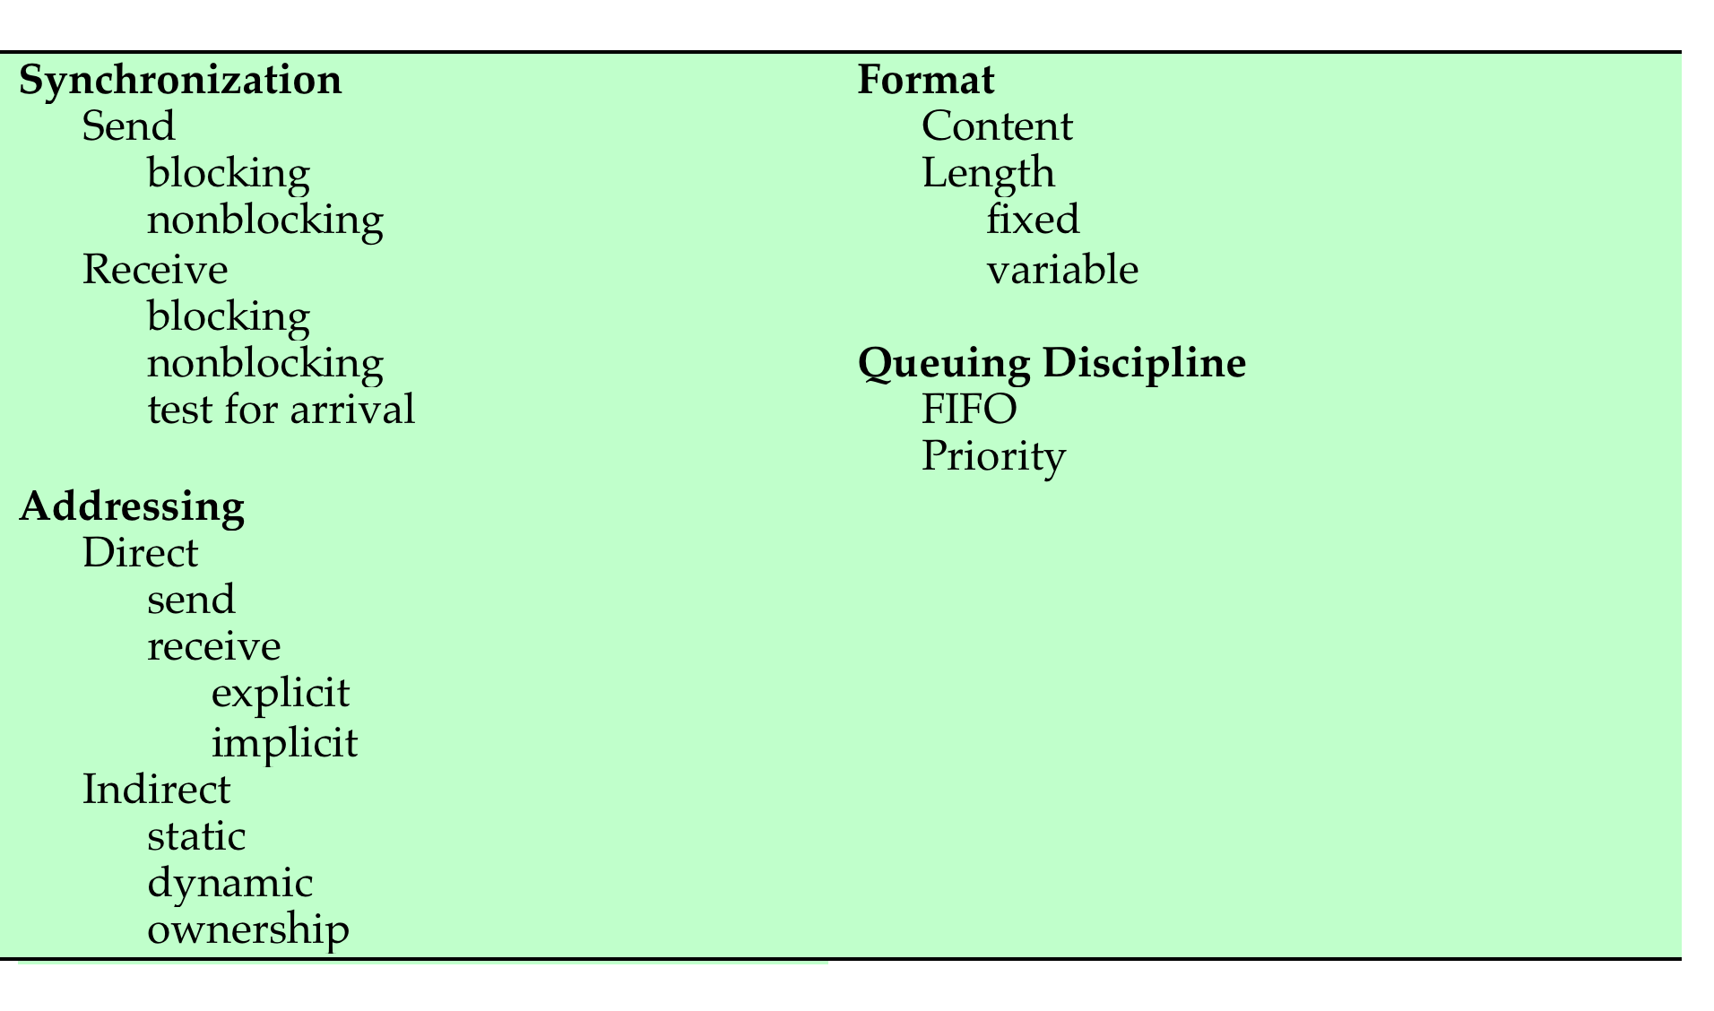
Message Passing
Table 5.5 Design Characteristics of Message Systems for Interprocess Communication and Synchronization
Notes:
A number of design issues relating to message-passing systems are listed in Table 5.5 , and examined in the remainder of this section.

Slide 48
Synchronization
Communication of a message between two processes implies synchronization between the two
the receiver cannot receive a message until it has been sent by another process
When a receive primitive is executed in a process there are two possibilities:
if a message has previously been sent the message is received and execution continues
if there is no waiting message the process is blocked until a message arrives or the process continues to execute, abandoning the attempt to receive
Notes:
The communication of a message between two processes implies some level of synchronization between the two: The receiver cannot receive a message until it has been sent by another process. In addition, we need to specify what happens to a process after it issues a send or receive primitive. Consider the send primitive first. When a send primitive is executed in a process, there are two possibilities: Either the sending process is blocked until the message is received, or it is not. Similarly, when a process issues a receive primitive, there are two possibilities:
1. If a message has previously been sent, the message is received and execution continues.
2. If there is no waiting message, then either (a) the process is blocked until a message arrives, or (b) the process continues to execute, abandoning the attempt to receive.

Slide 49
Blocking Send,
Blocking Receive
Both sender and receiver are blocked until the message is delivered
Sometimes referred to as a rendezvous
Allows for tight synchronization between processes
Notes:
Thus, both the sender and receiver can be blocking or nonblocking. Three combinations are common, although any particular system will usually have only one or two combinations implemented:
• Blocking send, blocking receive: Both the sender and receiver are blocked until the message is delivered; this is sometimes referred to as a rendezvous . This combination allows for tight synchronization between processes.

Slide 50

Nonblocking Send
Nonblocking send, blocking receive
sender continues on but receiver is blocked until the requested message arrives
most useful combination
sends one or more messages to a variety of destinations as quickly as possible
example -- a service process that exists to provide a service or resource to other processes
Nonblocking send, nonblocking receive
neither party is required to wait
Notes:
Nonblocking send, blocking receive: Although the sender may continue on, the receiver is blocked until the requested message arrives. This is probably the most useful combination. It allows a process to send one or more messages to a variety of destinations as quickly as possible. A process that must receive a message before it can do useful work needs to be blocked until such a message arrives. An example is a server process that exists to provide a service or resource to other processes.
• Nonblocking send, nonblocking receive: Neither party is required to wait.
The nonblocking send is more natural for many concurrent programming tasks. For example, if it is used to request an output operation, such as printing, it allows the requesting process to issue the request in the form of a message and then carry on. One potential danger of the nonblocking send is that an error could lead to a situation in which a process repeatedly generates messages. Because there is no blocking to discipline the process, these messages could consume system resources, including processor time and buffer space, to the detriment of other processes and the OS. Also, the nonblocking send places the burden on the programmer to determine that a message has been received: Processes must employ reply messages to acknowledge receipt of a message.
For the receive primitive, the blocking version appears to be more natural for many concurrent programming tasks. Generally, a process that requests a message will need the expected information before proceeding. However, if a message is lost, which can happen in a distributed system, or if a process fails before it sends an anticipated message, a receiving process could be blocked indefinitely. This problem can be solved by the use of the nonblocking receive . However, the danger of this approach is that if a message is sent after a process has already executed a matching receive , the message will be lost. Other possible approaches are to allow a process to test whether a message is waiting before issuing a receive and
allow a process to specify more than one source in a receive primitive. The latter approach is useful if a process is waiting for messages from more than one source
and can proceed if any of these messages arrive.

Slide 51
Addressing
  Schemes for specifying processes in send and receive primitives fall into two categories:
Direct addressing
Indirect addressing
Notes:
Clearly, it is necessary to have a way of specifying in the send primitive which process is to receive the message. Similarly, most implementations allow a receiving process to indicate the source of a message to be received.
The various schemes for specifying processes in send and receive primitives fall into two categories: direct addressing and indirect addressing.

Slide 52
Direct Addressing
    Send primitive includes a specific identifier of the destination process
    Receive primitive can be handled in one of two ways:
      require that the process explicitly designate a sending process
      effective for cooperating concurrent processes
      implicit addressing
      source parameter of the receive primitive possesses a value returned when the receive operation has been performed
Notes:
With direct addressing , the send primitive includes a specific identifier of the destination process. The receive primitive can be handled in one of two ways. One possibility is to require that the process explicitly designate a sending process. Thus, the process must know ahead of time from which process a message is expected. This will often be effective for cooperating concurrent processes. In other cases, however, it is impossible to specify the anticipated source process. An example is a printer server process, which will accept a print request message from any other process. For such applications, a more effective approach is the use of implicit addressing. In this case, the source parameter of the receive primitive possesses a value returned when the receive operation has been performed.

Slide 53
Indirect Addressing
Messages are sent to a shared data structure consisting of queues that can temporarily hold messages
Queues are referred to as mailboxes
One process sends a message to the mailbox and the other process picks up the message from the mailbox
Allows for greater flexibility in the use of messages
Notes:
The other general approach is indirect addressing . In this case, messages are not sent directly from sender to receiver but rather are sent to a shared data structure consisting of queues that can temporarily hold messages. Such queues are generally referred to as mailboxes . Thus, for two processes to communicate, one process sends a message to the appropriate mailbox and the other process picks up the message from the mailbox.
A strength of the use of indirect addressing is that, by decoupling the sender and receiver, it allows for greater flexibility in the use of messages.

Slide 54
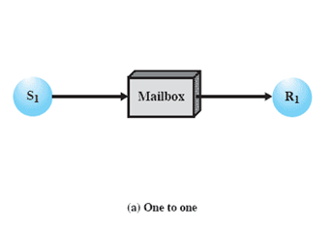
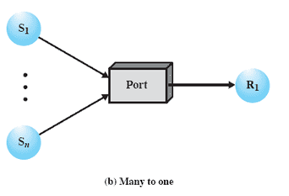
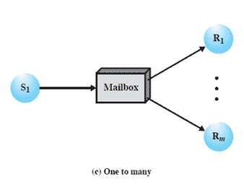
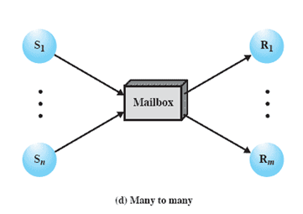
Indirect Process Communication
Notes:
The relationship between senders and receivers can be one to one, many to one, one to many, or many to many ( Figure 5.18 ). A one-to-one relationship allows a private communications link to be set up between two processes. This insulates their interaction from erroneous interference from other processes. A many-to-one relationship is useful
for client/server interaction; one process provides service to a number of other processes. In this case, the mailbox is often referred to as a port . A one-to-many relationship allows for one sender and multiple receivers; it is useful for applications where a message or some information is to be broadcast to a set of processes. A many-to-many relationship allows multiple server processes to provide concurrent service to multiple clients.
1) A one-to-one relationship
allows a private communications link to be set up between two processes.
This insulates their interaction from erroneous interference from other processes.
2) A many-to-one relationship is useful for client/server interaction;
one process provides service to a number of other processes.
In this case, the mailbox is often referred to as a port.
3) A one-to-many relationship allows for one sender and multiple receivers;
it is useful for applications where a message or some information is to be broadcast to a set of processes.
4) A many-to-many relationship
allows multiple server processes to provide concurrent service to multiple clients.
The association of processes to mailboxes can be either static or dynamic. Ports are often statically associated with a particular process; that is, the port is created and assigned to the process permanently. Similarly, a one-to-one relationship is typically defined statically and permanently. When there are many senders, the association of a sender to a mailbox may occur dynamically. Primitives such as connect and disconnect may be used for this purpose.
A related issue has to do with the ownership of a mailbox. In the case of a port, it is typically owned by and created by the receiving process. Thus, when the process is destroyed, the port is also destroyed. For the general mailbox case, the OS may offer a create-mailbox service. Such mailboxes can be viewed either as being owned by the creating process, in which case they terminate with the process, or as being owned by the OS, in which case an explicit command will be required to destroy the mailbox.

Slide 55
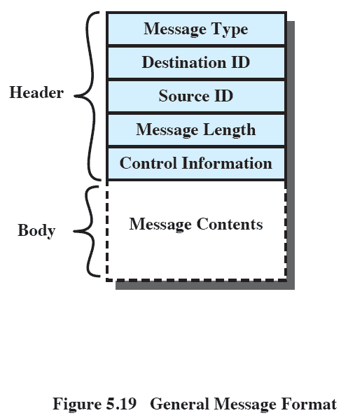

General Message Format
Notes:
The format of the message depends on the objectives of the messaging facility and whether the facility runs on a single computer or on a distributed system. For some
operating systems, designers have preferred short, fixed-length messages to minimize processing and storage overhead. If a large amount of data is to be passed, the data can be placed in a file and the message then simply references that file. A more flexible approach is to allow variable-length messages.
Figure 5.19 shows a typical message format for operating systems that support variable-length messages.
The message is divided into two parts:
a header, which contains information about the message.
The header may contain an identification of the source and intended destination of the message, a length field, and a type field to discriminate among various types of messages.
additional control information, e.g. pointer field so a linked list of messages can be created; a sequence number, to keep track of the number and order of messages passed between source and destination; and a priority field.
a body, which contains the actual contents of the message.

Slide 56
Summary
Messages
Operating system themes are:
Mutual Exclusion
Useful for the enforcement of mutual exclusion discipline
Multiprogramming, multiprocessing, distributed processing
Fundamental to these themes is concurrency
issues of conflict resolution and cooperation arise
Condition in which there is a set of concurrent processes, only one of which is able to access a given resource or perform a given function at any time
One approach involves the use of special purpose machine instructions
Semaphores
Used for signaling among processes and can be readily used to enforce a mutual exclusion discipline
Notes:
Chapter 5 Summary.

